Slide 1

Short Term Follow Up Webinar
May 21, 2018
Recap of the Short Term Follow Up In-Person Meeting
May 17-18, 2018 in Bethesda, MD
Continuity of Operations Planning/Emergency Preparedness - Christen Crews
Molecular and Genetic Education - Amy Gaviglio
Succession Planning - Cindy Ingham
New Staff Orientation and Standard Operating Procedures - Robin Thomas
Long Term Follow Up - Melody Hobert-Mellecker

Slide 2
Short Term Follow Up Meeting
Emergency Planning:
Continuity of Operations Plan (COOP)
Christen F. Crews, MSN, RN
Public Health Nurse Supervisor
Dried Blood Spot and Critical Congenital Heart Disease (CCHD)
Virginia Newborn Screening Program
Ph: (804) 864-7700
Email: christen.crews@vdh.virginia.gov

Slide 3
Short Term Follow Up Meeting
Highlights of Breakout Session: Emergency Planning- Continuity of Operations (COOP)
Most NBS Labs have a coop- but only 6 out of 21 states had a COOP that included follow-up
Lack of testing
States that outsource screening- Backup for testing? Follow-up Services?
Lengthy power outages will affect remote working capabilities
Follow-Up compromised- is lab trained to report out critical results?
Puerto Rico shared experience of recent hurricanes
Advocate for program- newborn screening public health nurses should stay with newborn screening in emergency

Slide 4
Short Term Follow Up Meeting
Solutions/Recommendations: Emergency Planning- Continuity of Operations (COOP)
Expand ability of staff for alternative modes of communication (secure messages, fax remotely, text messaging)
Define ahead of time what follow-up operations continue in emergency- define length (i.e. 1, 3, 7 days)
Ensure that the state COOP incorporates NBS and NBS follow-up, and is aware of the requirements of STFU programs
Use tools such as law enforcement, local hospital, even social media to track down parents requiring notficiation
Include Courier considerations in COOP
Learn from Puerto Rico’s experience
Ensure contractors (clinical specialists) also have COOPs specific to NBS follow-up
Establish MOU with states that may serve as a backup
Review APHL check-list and federal CONPLAN (being finalized) as a template
If COOP is enacted, document each interaction and revisit COOP for future modifications post-crisis

Slide 5
Short Term Follow Up Webinar
May 21, 2018
Recap of the Short Term Follow Up In-Person Meeting:
Molecular and Genetic Education
Amy Gaviglio

Slide 6
Short Term Follow Up Webinar
May 21, 2018
Recap of the Short Term Follow Up In-Person Meeting:
Succession Planning
Cindy Ingham

Slide 7
New Staff orientation and standard operation procedures

Slide 8
Training Resources
APHL NBS Tandem Mass Spectrometry Follow-Up Workshop for Lab and F/U Staff
June 11, 2018 to June 15, 2018, Silver Spring, MD
CDC - Newborn Screening for Inherited Disorders of Metabolism
1 hour course - https://www.train.org/cdctrain/course/1058933/
Virginia has 3 online courses for NBS and CCHD – 2 are free
https://www.newbornscreeningeducation.org/
Genetics Genomics Competency Center G2C2
http://genomicseducation.net/search/advanced
Genetics Home Reference – Online Guide to Understanding Genetic Conditions
https://ghr.nlm.nih.gov/

Slide 9
Short Term Follow Up Meeting
Long Term Follow Up
Melody Hobert-Mellecker, RN BSN
STFU Case Manager
Iowa Newborn Screening Program
Ph: (319) 936-3287
Email: m-hobert-mellecker@uiowa.edu

Slide 10
Short Term Follow Up Meeting
Breakout session: “Size Matters –Program Challenges and Successes”
Long term follow up emerged as a hot topic in the course of our overall discussion in the “medium size” state group

Slide 11
Short Term Follow Up Meeting
Variability between states re: if they currently have LTFU embedded in their NBSP
  Some do
  Most don’t
Increasing need for LTFU especially given addition of late onset disorders

Slide 12
Short Term Follow Up Meeting
Issues:
  How to define LTFU, i.e. where does short term end and long term begin? Is there an intermediate follow up?
  Is it within the scope of public health mission of NBS
    Economics / funding
    Ethics

Slide 13
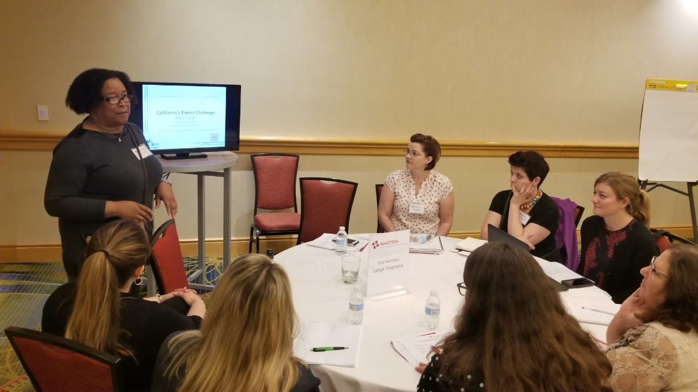
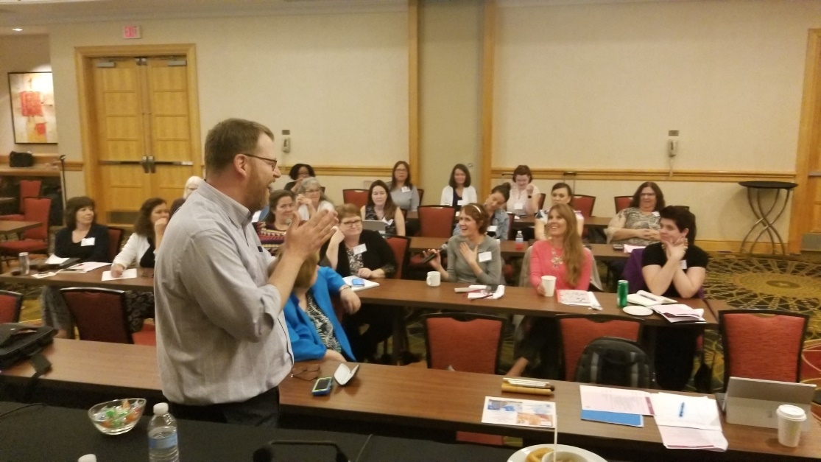
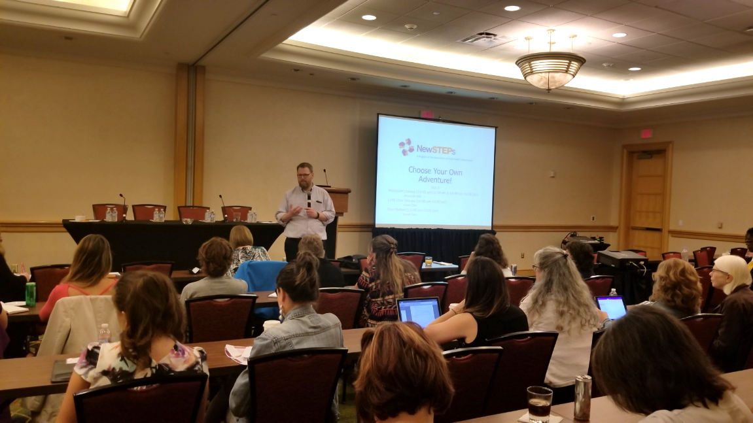
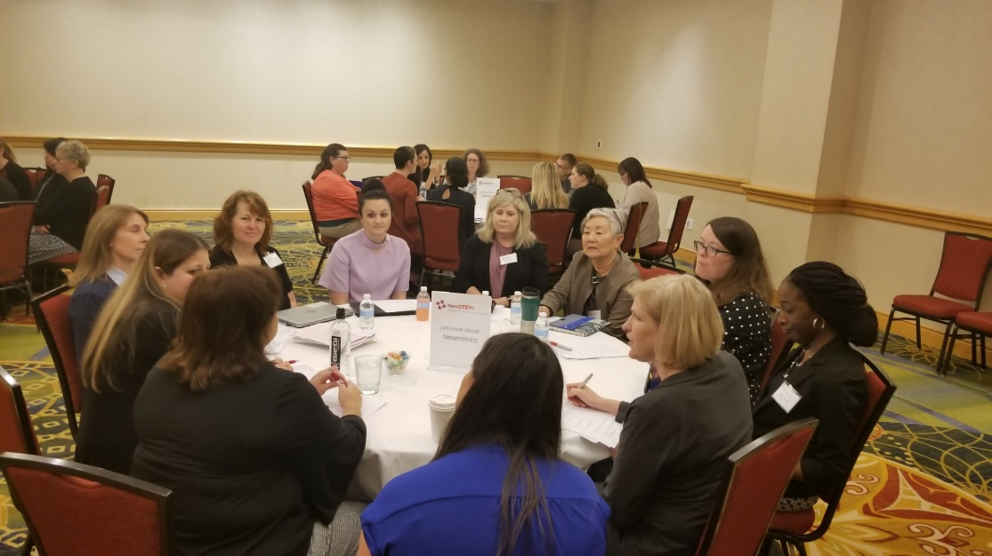
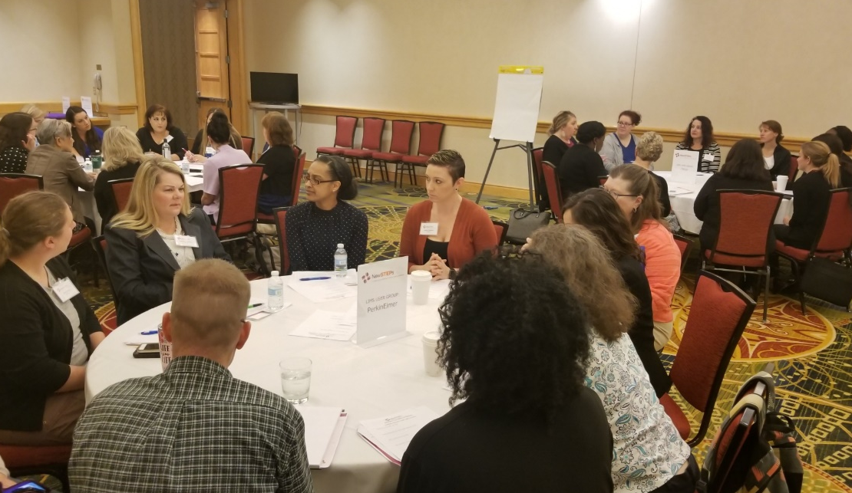
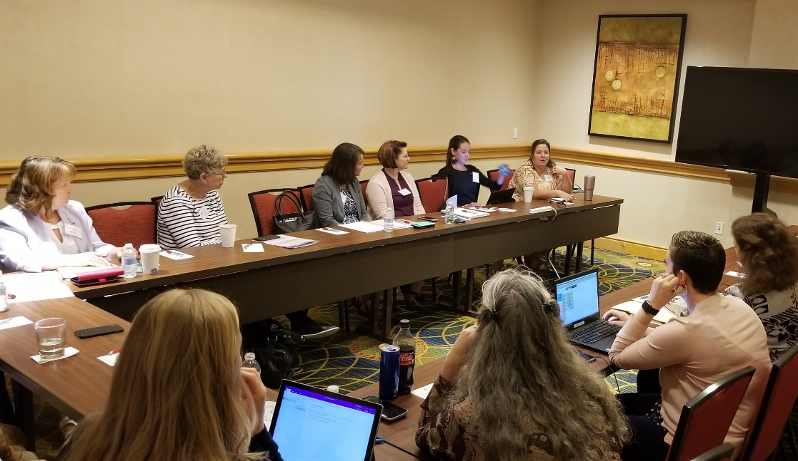

Slide 14
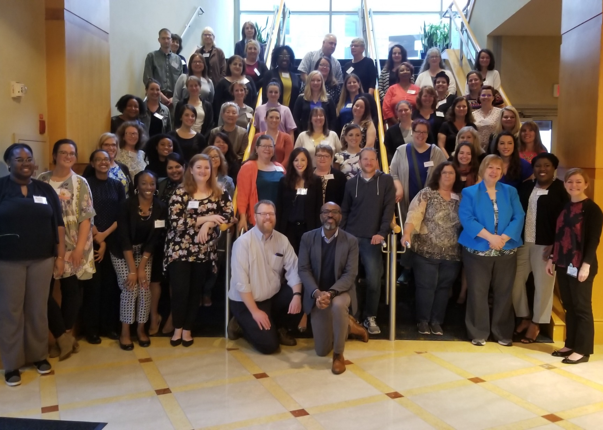
NewSTEPs Short Term Follow Up Meeting
May 17-18, 2018

Slide 15

Short Term Follow-Up Planning Committee Members
Sondi Aponte
Christen Crews
Erin Darby
Sara Denniston
Carol Johnson
Yvonne Kellar-Guenther
Jelili Ojodu
Sikha Singh
John Thompson

Slide 16
Short Term Follow Up Webinar
Q&A
Press *7 to unmute or type your questions in the chat box.
Please direct questions, comments, or suggestions
for future webinar topics to Erin Darby:
erin.darby@aphl.org

