Slide 1
Severe Combined Immunodeficiency National Quarterly Webinar
April 23, 2018
U.S. & Canada: 866.740.1260
Access Code: 7244438

Slide 2
Agenda
Welcome
SCID Newborn Screening Status Map
Clinical Vignette | Evan Shereck, MD, M.Ed, Oregon Health & Science University
Overview of NewSTEPs SCID Public Health Surveillance Case Definitions | Marci Sontag, PhD
Overview of Newborn Screening Translation Research Network (NBSTRN) | Amy Brower, PhD
Overview of U.S. Immunodeficiency Network (USIDNet) and Following Infants with Low Lymphocytes (FILL) Program | Tara Caulder
Open Discussion About Synergizing Registries | Led by Amy Brower, PhD and Marci Sontag, PhD

Slide 3
SCID Newborn Screening Status
www.newsteps.org/scid

Slide 4
SCID Screening in Oregon: A Physician’s Perspective
Evan Shereck, MD, M.Ed
Oregon Health & Science University

Slide 5
December 3, 2014 (Wednesday)
Receive e-mail: 4 day old with 0 TRECs on day 1 of Life

Slide 8
Call the PCP’s Office
Full-term female baby
White/Hispanic
Birth weight 2960 grams
No remarkable history
Will see baby tomorrow

Slide 9
At the PCPs office (the next day)
CBC- white blood cell count of 5.5
Absolute lymphocyte count- 1%
Brought to Doernbecher Children’s Hospital

Slide 10
Upon Admission
Born at 37 weeks to 22 yo mom
Normal, spontaneous delivery- no complications
Went home at 36 hrs of age
Has 2 healthy half-siblings
No remarkable family history
Exclusively breastfed

Slide 11
Work-up
Lymphocytes | Normal Value | Cell Count
CD3⁺ | 600-7000 | 23
CD3⁺CD4⁺ | 400-5300 | 12
CD3⁺CD8⁺ | 200-1900 | 1
CD56⁺ | 100-1900 | 81
CD19⁺ | 40-1900 | 20
Mitogen studies- no response to PHA, ConA, pokeweed

Slide 12
Adenosine Deaminase Levels
Her level- 0
Normal level- 63
-Diagnosed with ADA deficiency SCID
-Historically 15% of SCID cases

Slide 13
Adenosine Deaminase Testing
Test | Normal Value | Patient’s Results
Adenosine Deaminase | 63 | 0
dAXP | < 0.002 | 1.227

Slide 14
Adenosine Deaminase Testing
Test | Normal Value | Patient’s Results
Adenosine Deaminase | 63 | 0
dAXP | < 0.002 | 1.227
-Genetic testing revealed a mutation in the ADA gene
-15% of SCID historically due to ADA deficiency
Notes:
Diagnosis is made based on < !% ADA

Slide 15
Whitmore KV, Front Immunol, 2016

Slide 16
Whitmore KV, Front Immunol, 2016

Slide 17
Whitmore KV. Front Immunol, 2016

Slide 18
AH
No matched sibling donors
Started enzyme replacement
Had gene therapy at UCLA in May 2015

Slide 19
AH
Now 3 years old and thriving
Normal immune system

Slide 20
Any Questions?

Slide 21
Consensus case definitions for conditions identified by newborn screening public health Surveillance
Severe Combined Immune Deficiency Syndrome

Slide 22
Surveillance vs. clinical case definition
Surveillance case definitions are intended to establish uniform criteria for disease reporting
NOT intended for use as
criteria for establishing clinical diagnoses
determining the standard of care necessary for a particular patient
setting guidelines for quality assurance
providing standards for reimbursement
initiating public health actions

Slide 23
Targets
Primary targets of NBS
Typical SCID
Leaky SCID
Omenn Syndrome
Secondary targets of NBS
Syndromes with variable immune defects, with some cases having significantly low T-cell numbers
Secondary T-cell lymphopenia
Idiopathic T-cell lymphopenia

Slide 24
Classification tables

Slide 25
Leaky SCID

Slide 26
Omenn Syndrome

Slide 27
Worksheet for SCID Case Definition

Slide 28
National Data Repository for Newborn Screening
Purpose: Provide tools to state newborn screening systems to adequately evaluate, analyze, and benchmark the performance of their tests and the quality of their newborn screening programs

Slide 30
SCID Specific Case Information

Slide 31
Contact information
Careema Yusuf: careema.yusuf@aphl.org, (240) 485-2761
Marci Sontag, PhD: marci.sontag@ucdenver.edu, (303) 724-4430

Slide 32

Translating Research into Practice: NBSTRN SCID Newborn Screening Initiative
Presentation to the SCID National Quarterly Webinar
April 23, 2018
Amy Brower, PhD

Slide 33

Translating Research into Practice: NBSTRN’s SCID Newborn Screening Initiative
NICHD’s Hunter Kelly Newborn Screening Research Program
NBSTRN Focus on Pilots
NBSTRN Focus on Long-Term Follow-Up
Discussion

Slide 34
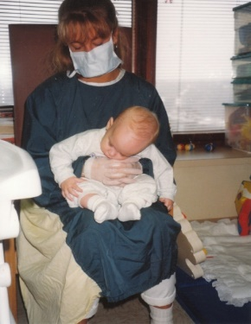
Translating Research into Practice: NBSTRN’s SCID Newborn Screening Initiative
NICHD’s Hunter Kelly Newborn Screening Research Program
NBSTRN Focus on Pilots
NBSTRN Focus on Long-Term Follow-Up
Discussion

Slide 35
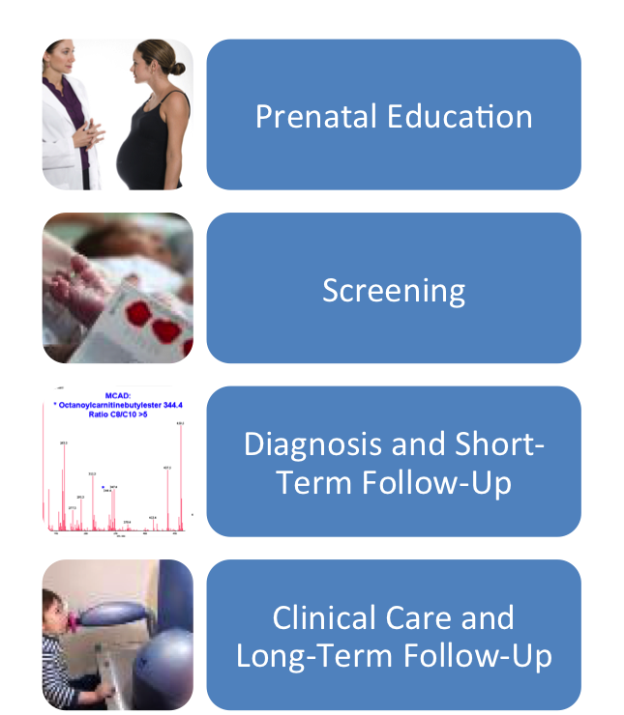
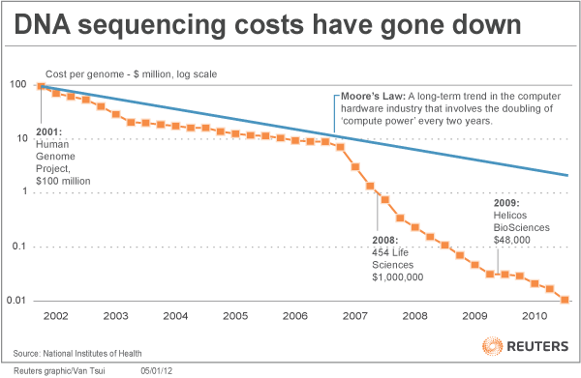

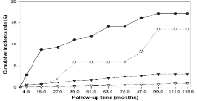
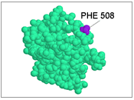




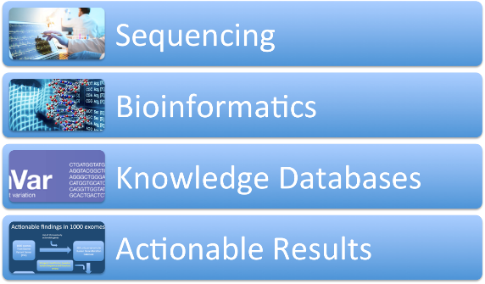
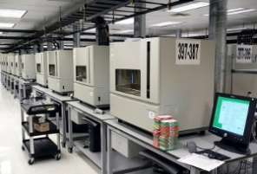
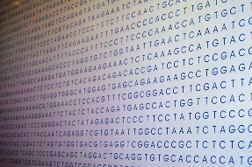

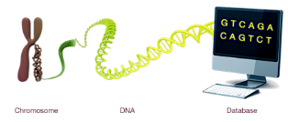



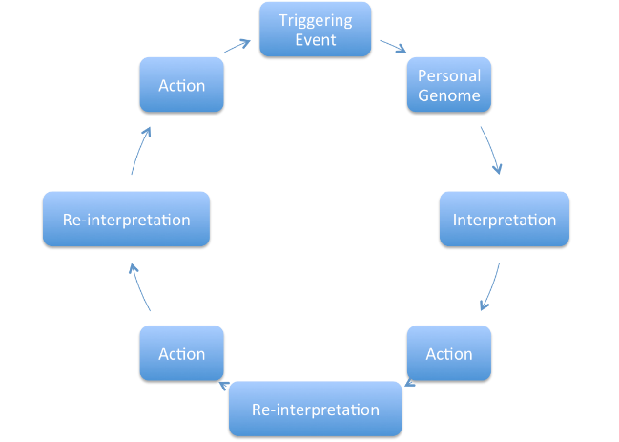





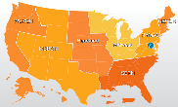

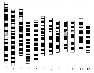



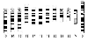



Setting the Stage
Newborn Screening
Technology
Knowledge
Federal Initiatives
Focus on Translation
PGI id: 5910322 – 61215923014
Issued: 01 MAR 07 Recommended next check: 28 FEB 10
Personal Sequence
(owned by individual)

Slide 36


Newborn Screening Saves Lives Act of 2008 & 2014
Funding
Timeliness
Advisory Committees
Reports to Secretary of HHS
Interagency + FDA
Research
Basic, Translational
Health Outcomes
Pilots
Informed Consent
Quality Assurance

Slide 37
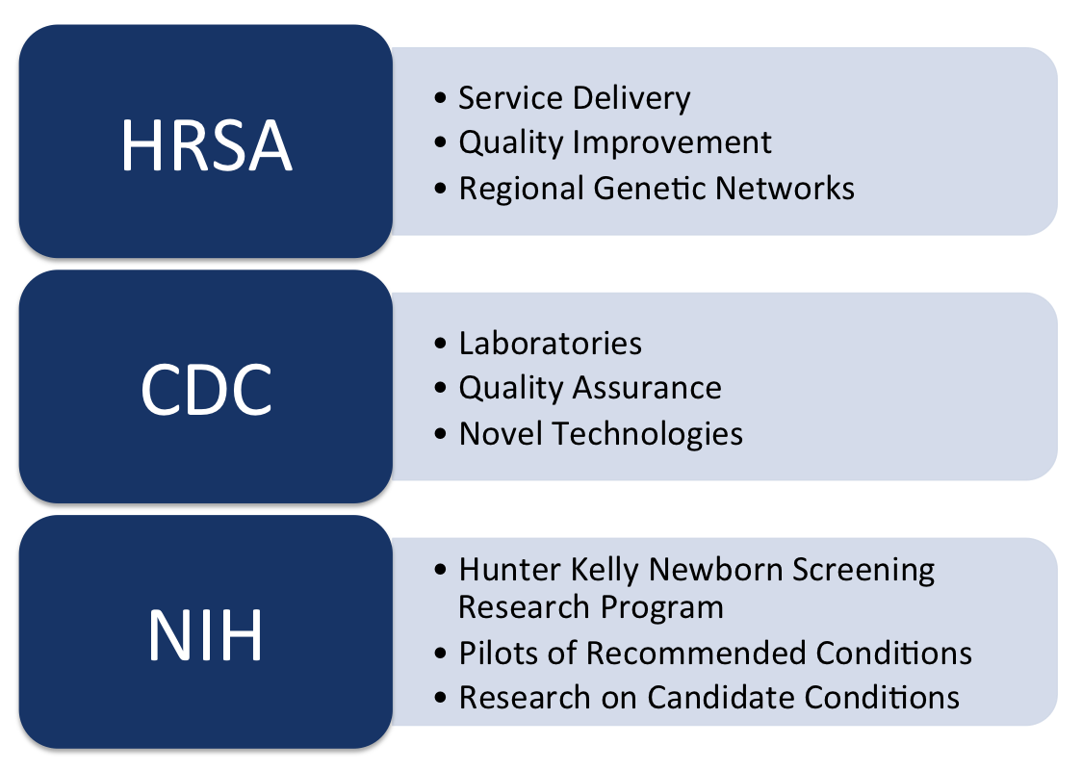
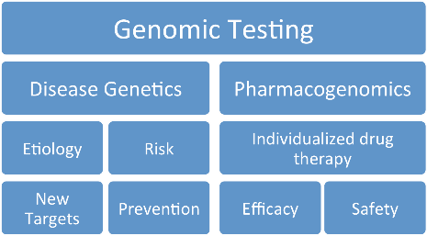
H.R. 1281 (113th): Newborn Screening Saves Lives Reauthorization of 2014

Slide 38
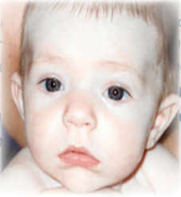
The Hunter Kelly Newborn Screening Research Program
“Authorizes the Secretary to expand the Hunter Kelly Newborn Screening Research Program to: (1) provide research and data for newborn conditions under review by the Advisory Committee to be added to the Recommended Uniform Screening Panel, and (2) conduct pilot studies on conditions recommended by the Advisory Committee to ensure that screenings are ready for nationwide implementation.”
Discover New Technologies to Screen for Disease
Develop New Treatments
Provide Research and Data for Conditions Under Review
Conduct Pilots of Conditions Recommended to RUSP
Notes:
This statute amends the Public Health Service Act to facilitate the creation of Federal guidelines on newborn screening
To assist State newborn screening programs in meeting federal guidelines
To establish grant programs to provide for education and outreach on newborn screening and follow-up care once newborn screening has been conducted
To reauthorize programs under Part A of Title XI of the Act

Slide 39




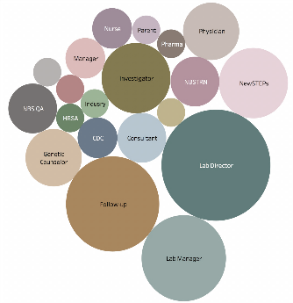
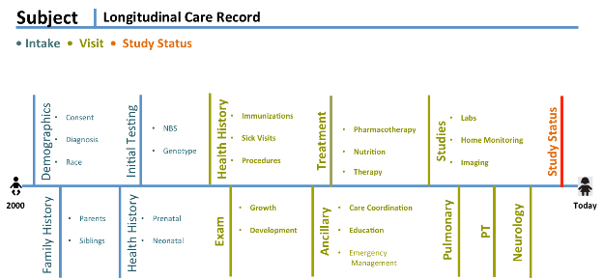
Newborn Screening Translational Research Network
Studies
Coordination and Tools
Pilots
PI Initiated
Krabbe
NIH PAR
Natural Hx
Investigator
Investigator
NIH RFA
NSIGHT
Investigator
NIH Initiated
Pompe
NIH Initiated
MPS1
NIH Initiated
X-ALD
Investigator
Investigator
Investigator
Births Screened and Stakeholders
Long-Term Follow-Up
State Based Implementation
100,000
150,000
100,000
Screening
Pilots/Screening in 2016
No Screening
Notes:
Build in other NIH datasets??

Slide 40
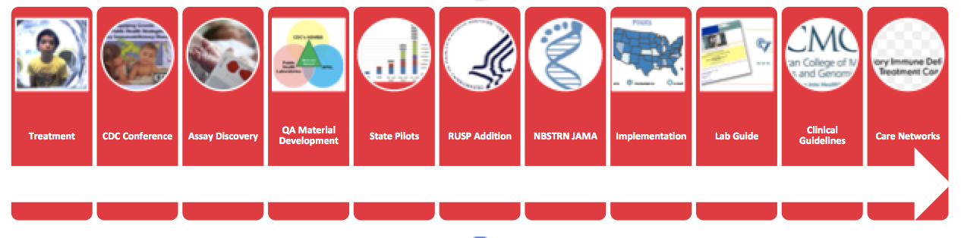
SCID Case Study
Years in the Making….
1970s
2001
2005
2007
2008
2010
2010
2011
2013
2018
2018
Diverse Group of Stakeholders Each Play a Role
Research
Immunologists
Molecular Devices
Pharma
FDA
CDC
NIH
PIDTC
Families
Legislator
State Public Health
Patients
HRSA
Notes:
SCID and related T-cell lymphocyte deficiencies are a group of disorders
Characterized by lack of functioning immune system
Known as the “Bubble Boy Disease”
Babies born with SCID appear healthy
Classic SCID is universally fatal in the first two years without immune reconstitution*

Slide 41
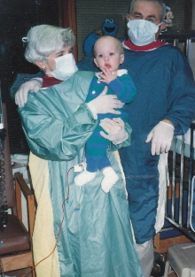
Translating Research into Practice: NBSTRN’s SCID Newborn Screening Initiative
NICHD’s Hunter Kelly Newborn Screening Research Program
NBSTRN Focus on Pilots
NBSTRN Focus on Long-Term Follow-Up
Discussion

Slide 42
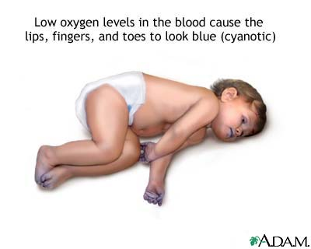
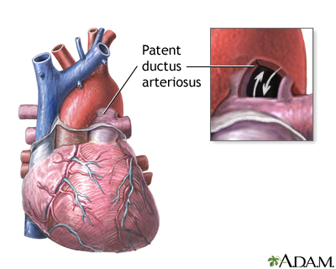
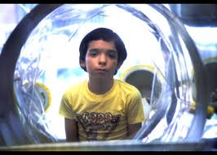
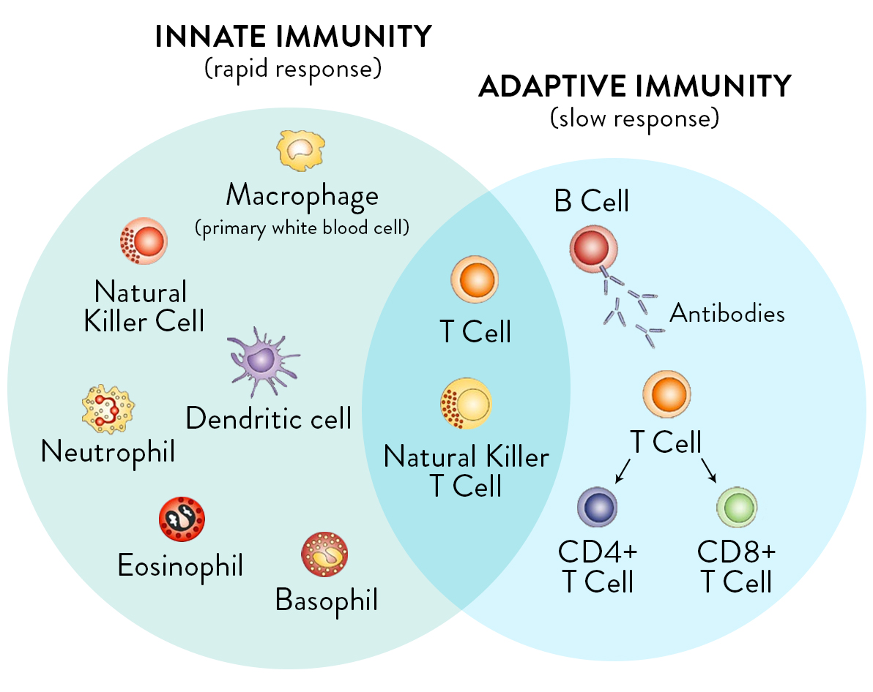
Research Studies and Pilots Create the Evidence Base
Critical Congenital Heart Disease
Severe Combined Immune Deficiency

Slide 43
NBSTRN SCID NBS Initiative
PILOTS
Analytical Validation
Clinical Validation
Laboratory Protocols
Screening Algorithms
Diagnosis
Clinical Guidelines
Treatment Choice
Implementation Pilots
Discovery Pilots

Slide 44
NBSTRN Pilot Coordination
Coordinate and Convene Stakeholder Meetings
Coordinate Monthly Steering Committee Calls
R4S/CLIR Tool for Analytical and Clinical Validation
Longitudinal Pediatric Data Resource - Disease Specific Module Development and Deployment
Provide clinical data collection, analysis and dissemination tools that comply with federal guidelines
Provide expertise on statistical analysis, clinical trial design for researchers and regulatory requirements associated with various ethical and legal issues
Facilitate collection of cases from state NBS programs
Provide technical assistance on the establishment of data sharing agreements between pilot sites and industry partners
Develop and implement Clinical Decision Support Tools including ACTion Sheets
Draft peer reviewed publication describing pilot results

Slide 45

Utilization of NBSTRN for Pilot of SCID Newborn Screening
Core
Coordinate meetings of SCID experts in NBS, diagnosis, and management
Translate findings to state programs, clinicians and other stakeholders
VRDBS
Mechanism to make screen positive samples available to researchers
Samples = 173
Clinical diagnoses = 6
LPDR
Clinical case report forms and system to collect information
Diagnosis categories for screen positive
Screened = 3,030,083 Cases = 52 JAMA Publication
R4S
Analytical and clinical validation of screening technology
Data elements captured = 28
Submitters = 83 Cases = 177
Host monthly stakeholder calls and webinars for the past six years
Current effort genomic analysis and LTFU
Communicate pilot results to ACHDNC and other Federal partners

Slide 46
Utilization of NBSTRN for Pilot of SCID Newborn Screening
Core
Coordinate meetings of SCID experts in NBS, diagnosis, and management
Translate findings to state programs, clinicians and other stakeholders
VRDBS
Mechanism to make screen positive samples available to researchers
Samples = 173
Clinical diagnoses = 6
LPDR
Clinical case report forms and system to collect information
Diagnosis categories for screen positive
Screened = 3,030,083 Cases = 52 JAMA Publication
R4S
Analytical and clinical validation of screening technology
Data elements captured = 28
Submitters = 83 Cases = 177
Host monthly stakeholder calls and webinars for the past six years
Current effort genomic analysis and LTFU
Communicate pilot results to SACHDNC and other Federal partners
Recruit Expertise &
Report to Federal Agencies
Biospecimens
Clinical Utility & Health Outcomes
Analytical & Clinical Validation

Slide 47
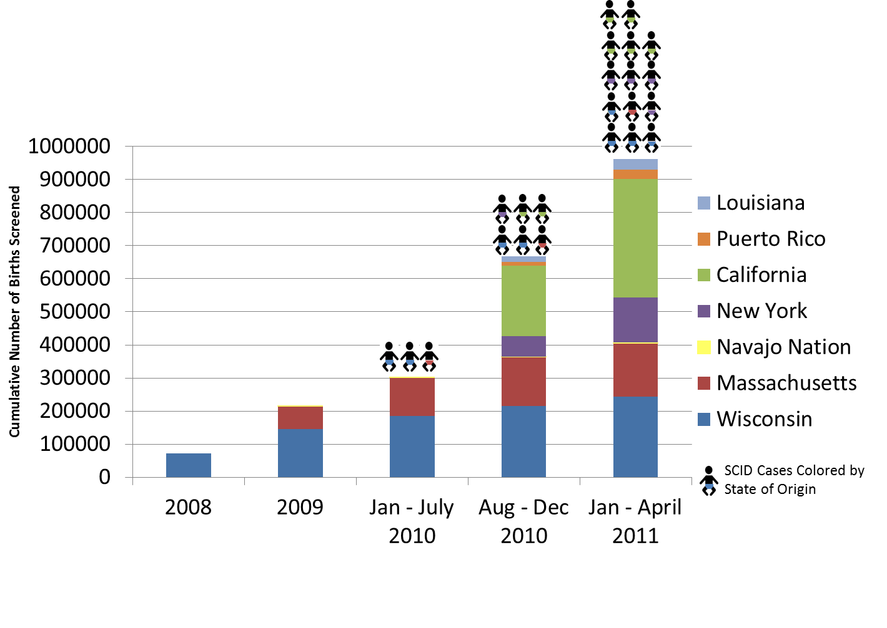
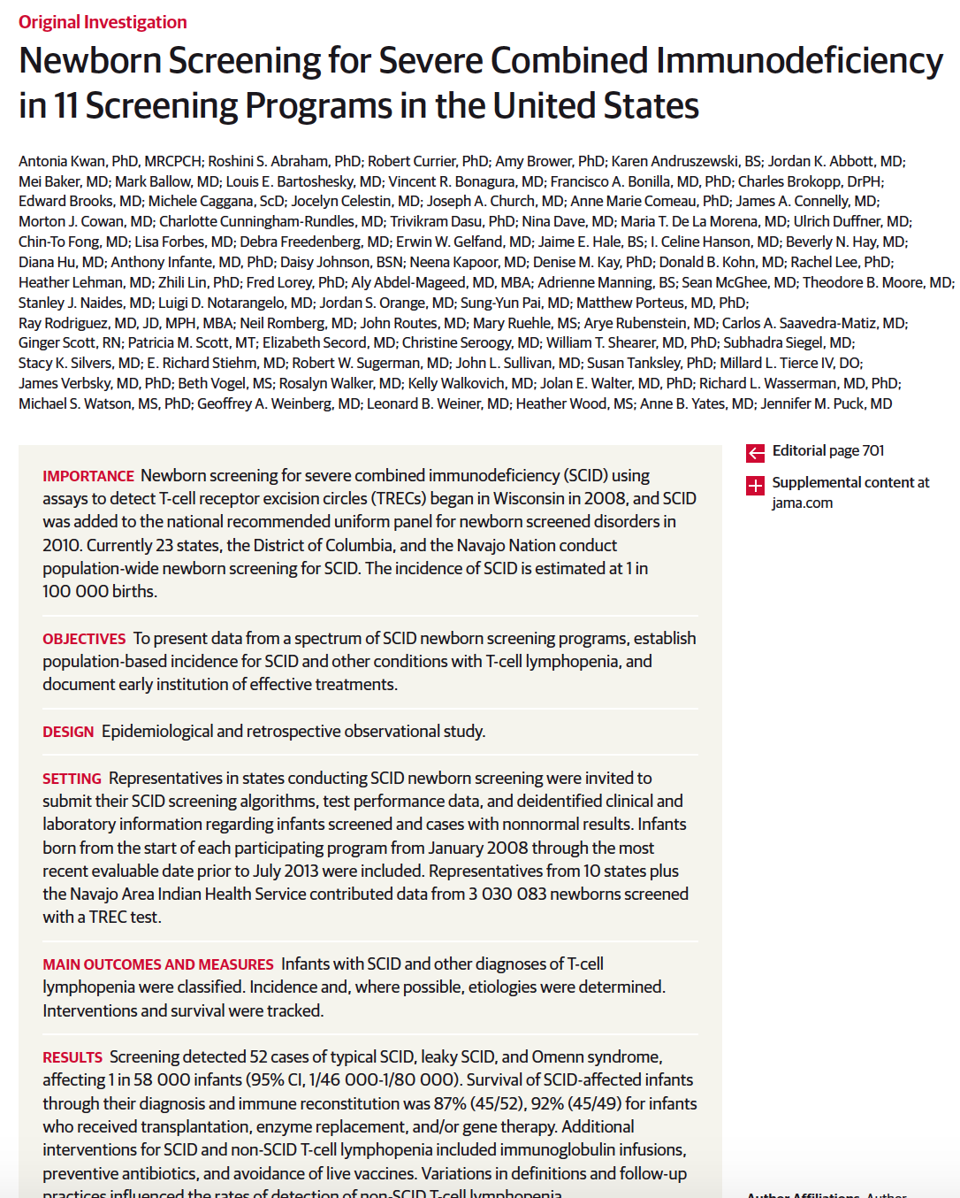


NBSTRN Coordinated Pilot and Cumulative Report of >3M Births
LPDR
R4S

Slide 48
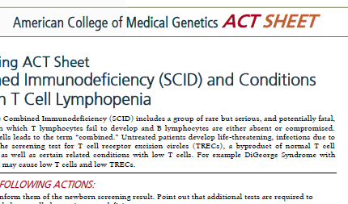
ACMG Clinical Decision Support Tools

Slide 49
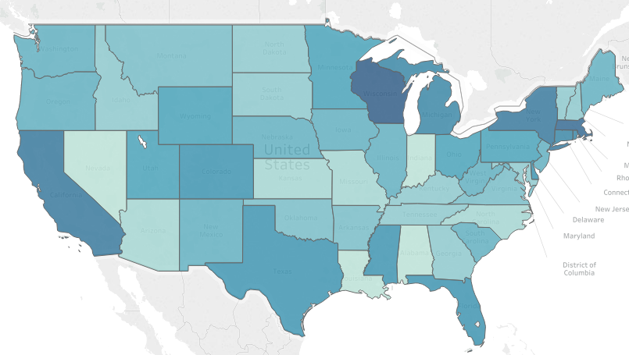
Percent of Births Screened by Year
Year of Each State’s Implementation
2008
2009
2010
2011
2012
2013
2014
2015
2016
2017
2018
Notes:
SCID and related T-cell lymphocyte deficiencies are a group of disorders
Characterized by lack of functioning immune system
Known as the “Bubble Boy Disease”
Babies born with SCID appear healthy
Classic SCID is universally fatal in the first two years without immune reconstitution*

Slide 50
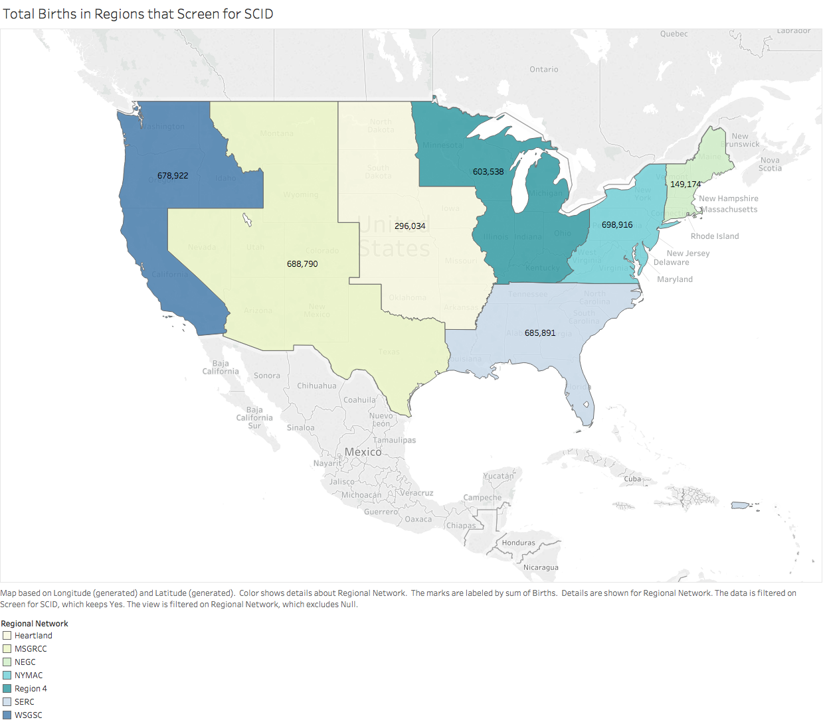
Number of Births Screened for SCID by Regional Genetic Network
Notes:
SCID and related T-cell lymphocyte deficiencies are a group of disorders
Characterized by lack of functioning immune system
Known as the “Bubble Boy Disease”
Babies born with SCID appear healthy
Classic SCID is universally fatal in the first two years without immune reconstitution*

Slide 51
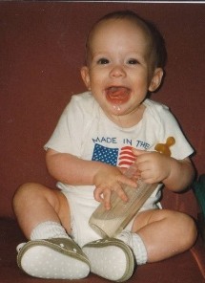
Translating Research into Practice: NBSTRN’s SCID Newborn Screening Initiative
NICHD’s Hunter Kelly Newborn Screening Research Program
NBSTRN Focus on Pilots
NBSTRN Focus on Long-Term Follow-Up
Discussion

Slide 52
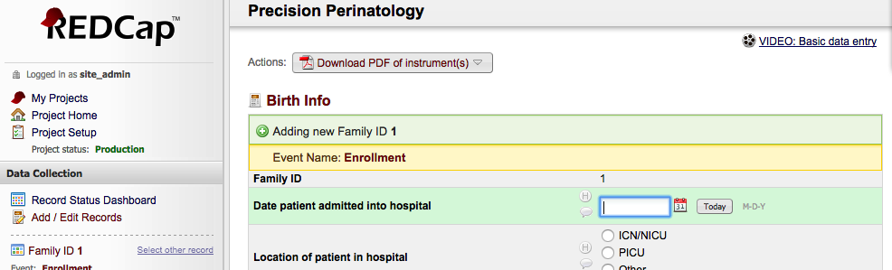
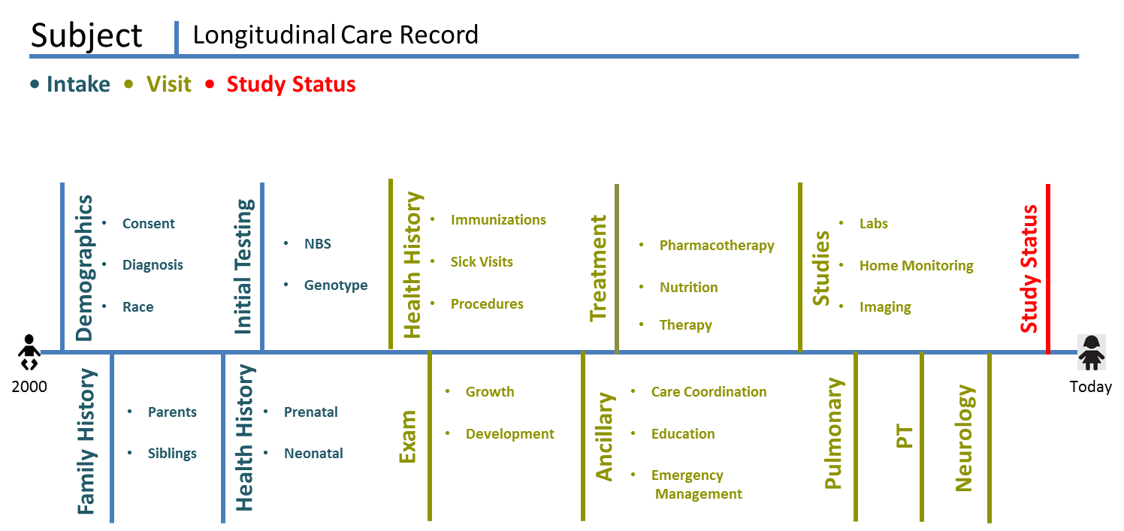
Clinical Data Collection
SCID LTFU
Notes:
The LPDR utilizes REDCap as the data collection tool which is in use by hundreds of academic institutions across the US.
Click – the idea is to begin to capture information shortly after birth for diagnosed cases and continue to collect key data elements to answer important research questions.

Slide 53
LPDR Statistics
RUSP
SMA
SCID
2K Subjects
8K Visits
6K CDEs
730K Data Points
648 Subjects
10K Visits
4K CDEs
219K Data Points
52 Subjects
4 Visits
88 CDEs
9K Data Points
Krabbe
PCH
SCD
165 Subjects
500 Visits
194 CDEs
12K Data Points
351 Subjects
220 Visits
24 CDEs
6K Data Points
5K Subjects
5K Visits
26 CDEs
114K Data Points

Slide 54
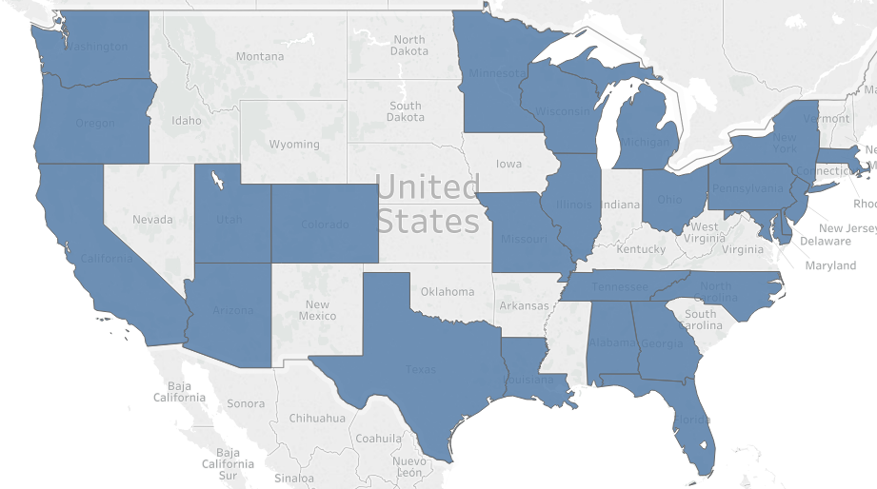
States with a Primary Immune Deficiency Treatment Consortium Participating Clinical Center
Notes:
SCID and related T-cell lymphocyte deficiencies are a group of disorders
Characterized by lack of functioning immune system
Known as the “Bubble Boy Disease”
Babies born with SCID appear healthy
Classic SCID is universally fatal in the first two years without immune reconstitution*

Slide 55
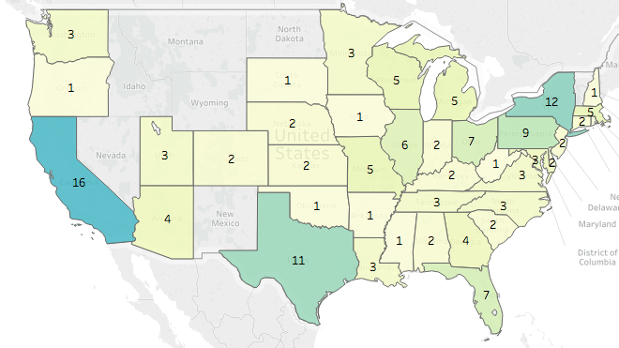
Number of Stem Cell Transplant Centers by State*
*http://bonemarrow.org/resources-for-patients-and-families/transplant-centers/
Notes:
SCID and related T-cell lymphocyte deficiencies are a group of disorders
Characterized by lack of functioning immune system
Known as the “Bubble Boy Disease”
Babies born with SCID appear healthy
Classic SCID is universally fatal in the first two years without immune reconstitution*

Slide 56
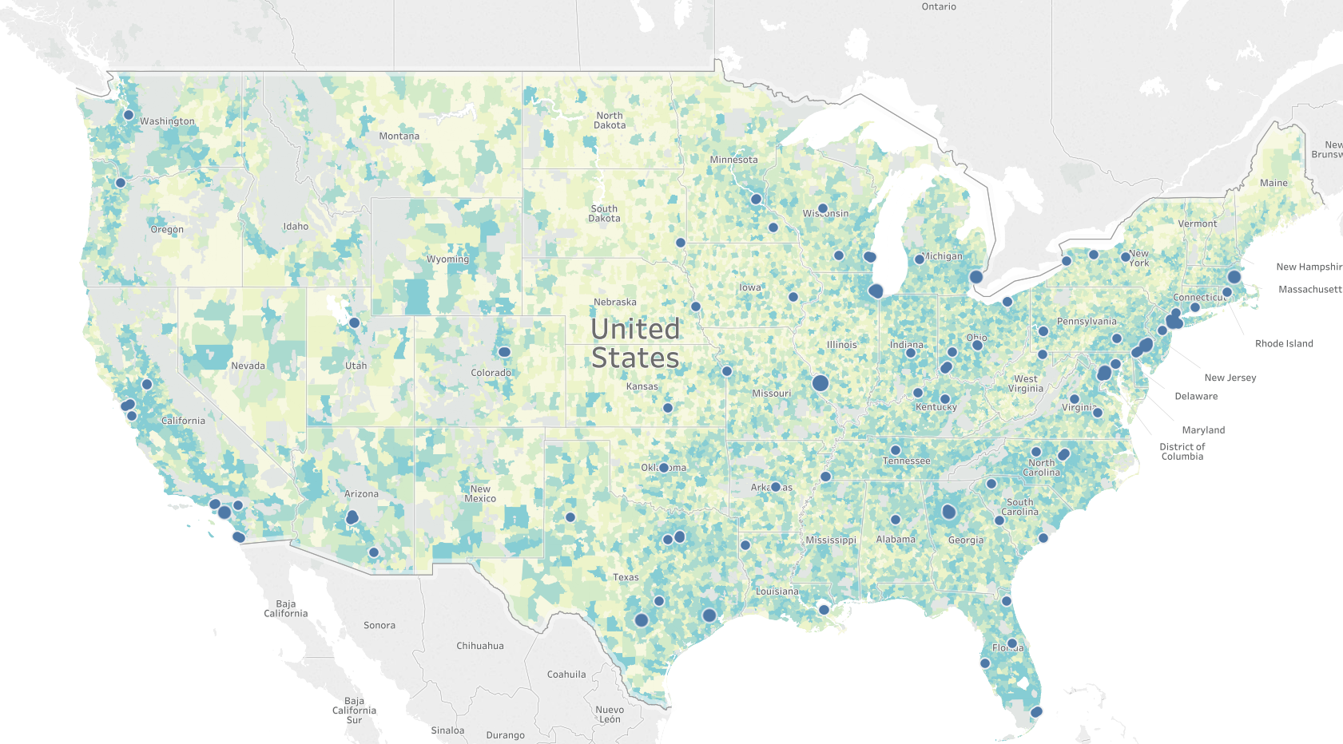
Location of Transplant Centers by Zipcode*
*http://bonemarrow.org/resources-for-patients-and-families/transplant-centers/
Notes:
SCID and related T-cell lymphocyte deficiencies are a group of disorders
Characterized by lack of functioning immune system
Known as the “Bubble Boy Disease”
Babies born with SCID appear healthy
Classic SCID is universally fatal in the first two years without immune reconstitution*

Slide 57
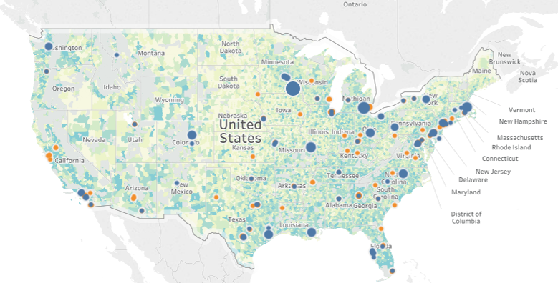
Location of Transplant Centers and Immunology Centers by Zipcode*
*http://bonemarrow.org/resources-for-patients-and-families/transplant-centers/
Notes:
SCID and related T-cell lymphocyte deficiencies are a group of disorders
Characterized by lack of functioning immune system
Known as the “Bubble Boy Disease”
Babies born with SCID appear healthy
Classic SCID is universally fatal in the first two years without immune reconstitution*

Slide 58
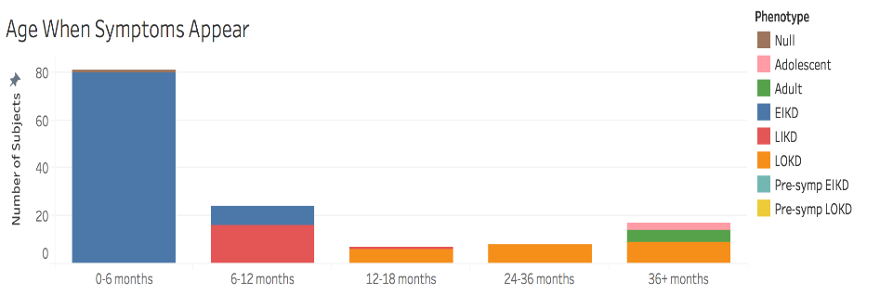
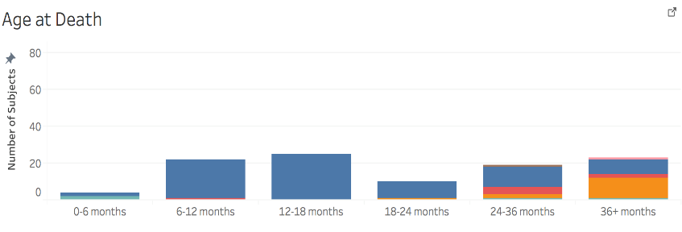
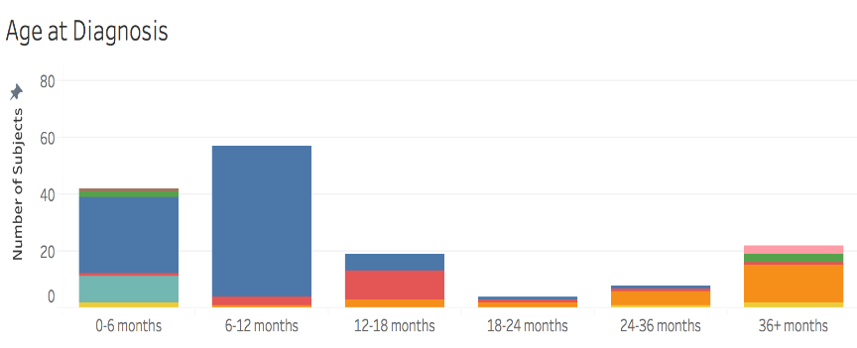
Tracking Outcomes
Age at death distribution
Age diagnosed distribution
Age symptoms distribution
Phenotype distribution
% dead for each phenotype
% Loss of Hearing
% Loss of Vision
% Loss of Milestones
% had MRI brain and then % abnormal
% poor feeding
% seizures
% was the child transplanted before or after symptoms

Slide 59
Discoveries After RUSP Implementation
Newborn screening has dramatically changed the clinical presentation of SCID
Incidence of SCID increased from 1 in 100,000 to 1 in 58,000
Over 300 Primary Immune Deficiency conditions have been characterized
13 genes to over 50 genes now associated with SCID
IL2RG was thought to cause the majority of SCID cases but that is no longer true after population based screening
de novo pathogenic variants are the norm
The incidence of SCID across racial and ethnic groups is different than previously thought
Gene therapy may have better outcomes when a matched sibling is not available

Slide 60
Findings that Impact Clinical Care and Outcomes
There is a significant variability in how states and clinicians conduct second tier (flow cytometry, functional studies) and diagnostic tests (genetic analysis)
This variability may have a direct impact on outcomes; studies of overall versus activities of daily living compromise-free versus neurologic event-free have shown differences between NBS identified, family history and clinically identified cases
A uniform set of diagnostic criteria is needed for surveillance, assessing clinical utility, and determining health outcomes
Clinicians need genotypes to be available to guide treatment choice
There is a lack of providers who specialize in treating newborns diagnosed with SCID
Transplant and gene therapy centers are located primarily in large urban areas
Gene therapy currently requires enrollment in a clinical trial

Slide 61
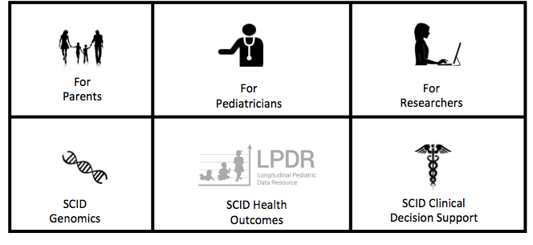
NBSTRN SCID Focused Resources

Slide 62
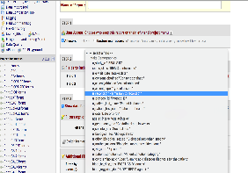
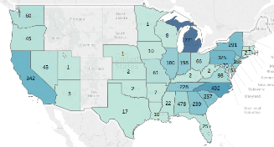


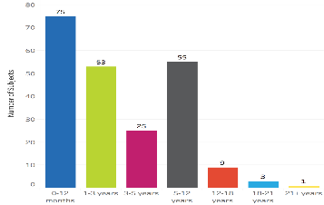
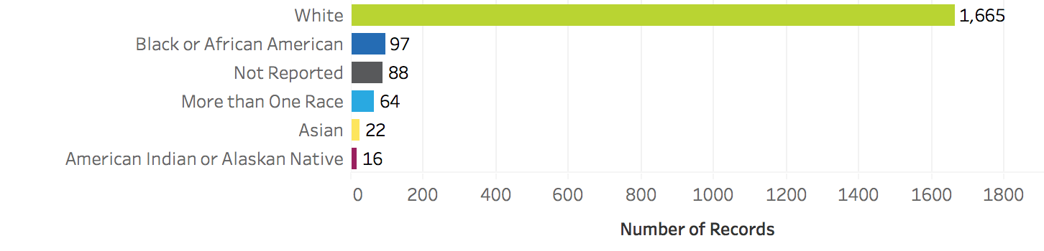



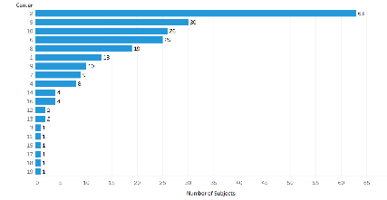
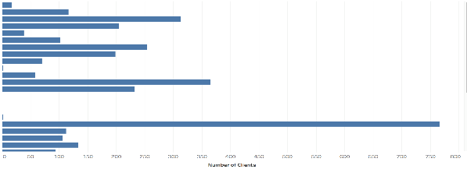
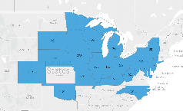
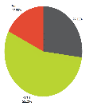
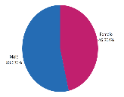
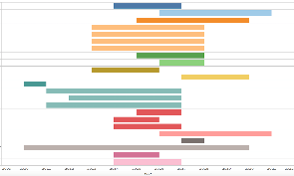





Data Aggregation, Analysis and Reporting
Data Collection
Case Report
Case Count
Monthly Status Check
Enrollment Age
Self Identified Race for Iowa
Data Analysis
Case Count Detail
Case Characteristics
Cases Per Center
Number of Records Per Center
Disease Severity
Gender
Data Aggregation and Reporting
Timeline for All Projects
Case Count by Region
Annual Status Check
Number of Records Total
Self Identified Race for US
January
December

Slide 63

Translating Research into Practice: NBSTRN’s SCID Newborn Screening Initiative
NICHD’s Hunter Kelly Newborn Screening Research Program
NBSTRN Focus on Pilots
NBSTRN Focus on Long-Term Follow-Up
Discussion

Slide 64



Acknowledgements
Eunice Kennedy Shriver National Institute of Child Health and Human Development, National Institutes of Health
NBSTRN -- HHSN275201300011C

Slide 65
Questions/Discussion
Press *7 on your phone to unmute
Press *6 to mute your line

Slide 66

Discussion – Dr. Sontag & Dr. Brower
Assess and Consolidate Efforts
Update to JAMA Paper
States – NewSTEPs – States – LPDR – FILL – PIDTC

Slide 67
SCID NBS
RUSP Recommendation 2010
National Pilot 2010 to 2011
2010 to 2018 State based Implementation
Over 95% of newborns are screened for SCID (1 in 58K)
~70 newborns are diagnosed with classic SCID each year (1 in 20K)
~200 newborns are diagnosed with non-SCID T-cell lymphopenia (TCL) each year
Path from suspected SCID to diagnosed SCID and treatment varies across state NBS programs
Screening has led to areas needing improvement
differences in the type and timing of confirmatory tests;
the availability of genotypes to guide treatment choice;
the lack of providers who specialize in treating newborns diagnosed with SCID;
transplant and gene therapy centers being located primarily in large urban areas;
an explosion of technology and information in immunology and genomics;
and a continued lack of awareness of SCID.

Slide 68
Future Calls
Next call is Monday, July 16th at 3:00 pm ET
Please submit topics for discussion
Welcome presentations from groups and efforts

