Slide 1
Virginia nbs program experience
Tuesday September 14, 2021
Notes:
Need 11 voting members

Slide 2
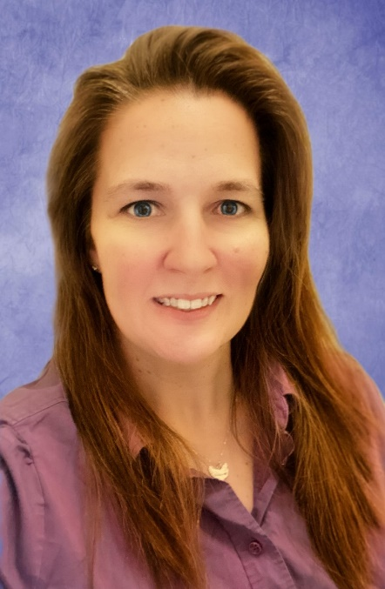

Speakers
Tobin Joseph
Technical Project Manager
Office Of Information Management and Health IT
Virginia Department of Health
Christen F. Crews, MSN, RN
Newborn Screening and Birth Defects Surveillance Programs Manager
Virginia Department of Health

Slide 3
Discussion Points
Overview of Virginia Newborn Screening Program
Project Review: CCHD and the Electronic Birth Certificate
Future Projects
VVESTS: Virginia Vital Events and Screening Tracking System

Slide 4

Overview of Newborn Screening in VA
Amino Acid Metabolic Disorders
Fatty Acid Metabolic Disorders
Organic Acid Metabolic Disorders
Galactosemia
Biotinidase
Congenital Hypothyroidism
Congenial Adrenal Hyperplasia
Cystic Fibrosis
Sickle Cell Disease
Severe Combined Immunodeficiencies
Lysosomal Storage Disorders
Hearing Loss (and targeted cCMV)
Critical Congenital Heart Disease (CCHD)
100,000
births in Virginia each year
33
Core RUSP Conditions Screened
Notes:
33 of 35 core disorders on the RUSP being screened, SMA and X-ALD in regulatory process
Also screen targeted CMV as of Sept 2020

Slide 5
Overview of Newborn Screening in VA
Virginia Department of Health
Newborn Screening
Dried Blood Spot Follow-Up
Early Hearing Detection and Intervention (EHDI)
Birth Defects Surveillance and CCHD
Department of General Services
Division of Consolidated Laboratory Services
NBS Laboratory
Notes:
Multiple agencies, causes complications- do we want to add EI agency?

Slide 6
Cross-Programs and Agency Collaboration
Department of General Services
Division of Consolidated Laboratory Services
NBS Laboratory
Department of Education
Early Intervention
Virginia Department of Health
Newborn Screening
Vital Records
OIM
Notes:
Multiple agencies, causes complications- do we want to add early intervention agency?

Slide 7

Project Review: CCHD and the EBC
On January 1st, 2014 CCHD screening and the Newborn Screening Dried Blood Spot Device ID Number were added to the Virginia Electronic birth certificate.
Notes:
At the start of 2014 CCHD screening and NBS dried blood spot device ID number to Virginia’s electronic birth certificate.
the EBC is part of VVESTS which is a web-based application where hospitals can submit birth certificate data.
Goals: capture CCHD screening results, refer to services
Identify infants screened for DBS with device ID

Slide 8
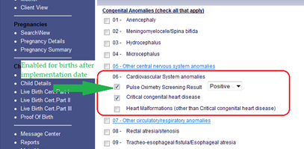
Coordination with Vital Records and OIM
Coordinate training and implementation
Identify new stakeholders (birth registrars)
Identified barriers with process workflows
Developed process map for data needed to be captured
Notes:
Lesson Learned: Positive vs Negative and Pass/Fail

Slide 9
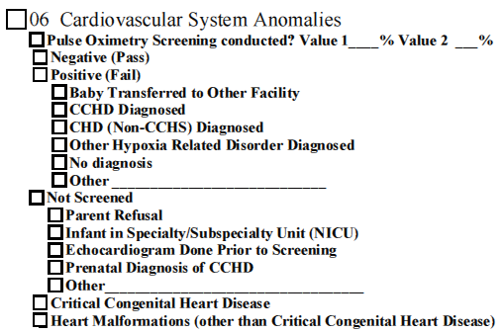
Coordination with Vital Records and OIM
Updates to Critical Congenital Heart Disease (CCHD)
Reporting on the Electronic Birth Certificate (EBC)
Enter both pulse oximetry values ex: Value 1 99 % Value 2 100 %
***If infant had multiple CCHD screens, enter last values***
Negative (Pass) (i.e. Preductal 99%, Postductal 98% SpO₂)
Positive (Fail): If this is selected, please provide additional
information related to interventions or diagnosis as applicable
CCHD Screening Results:
Interpretation of screen by clinical staff
Not Screened: Any infant without a CCHD screen must have this box checked with the reason as to why the screen was NOT completed
***Parent refusal form must be signed and sent to VDH Newborn Screening Fax 804-864-7807***
These boxes are available for infants not screened with CCHD or other heart malformation diagnosis
11/1/2016
Notes:
Review data added
Because this was an optional field, it was important to engage the birth registrars in the fact that this screening can save babies’ lives and to show that their hospital was doing this.
On issue that came up was that a lot of registrars were used to submitting data within 24 hours of the baby’s birth and of course CCHD screening results were not available until after 24 hours. Most registrars found that their work flow wasn’t changed too much by saving all of the other data early like they normally would and just waiting to submit the certificate once the CCHD screening results were available.
Because each hospital has a different way of charting CCHD screening results, we could not train them on where to find this data. Nurses were encouraged to work with their registrars to develop a process for this. It is much easier for the registrars if the screening results are entered into the electronic medical records, but not all hospitals had this capability.

Slide 10
Lessons Learned
Identify internal and external stakeholders
Accommodate other programs/agency timeframes for implementation
Coordinate training/communication

Slide 11
Future Projects
Automatic EBC Match for NBS-DBS
  Ensure 1:1- all infants born have documented NBS
  Challenges:
    Different agencies and technology
    Potential fiscal impact

Slide 12
VVESTS
Virginia Vital Events and Screening Tracking System
Notes:
Need 11 voting members

Slide 13
A Quick Introduction to VVESTS
VVESTS enables authorized users to register and manage vital events and infant screenings via a secure, web-based environment
A Suite of Applications serving multiple user groups across Virginia
Used by Facilities across the Commonwealth to record and recall
  Vital events
  Newborn hearing screenings
  VaCARES screenings
      The Virginia Congenital Anomalies Reporting and Education System (VaCARES) is a registry of children under age two with birth defects.

Slide 14
VVESTS - Stakeholders
Office of Vital Records – OVR
Division of Health Statistics
Office of Family Health Services - OFHS
Birth Registrars at the Birthing Facilities
Local HD and Medical Examiners offices
Hospitals, Funeral homes, doctors offices etc.
Various VA state agencies
Audiology Facility staff
Rescreeners
Early Intervention facilities
Child Hearing Screening Coordinators at the hospitals
VaCARES users at hospitals

Slide 15
Virginia Infant Screening and Infant Tracking System (VISITS)
VISITS supports:
Virginia Congenital Anomalies Reporting and Education System (VaCARES)
Virginia Early Hearing Detection and Intervention Program (VEHDI)
VISITS was integrated with VVESTS during 2010 in order to improve Data collection
And Security aspect. It enables to
  Collect complete and integrated infant and child health information to improve:
    Early identification and treatment
    Follow up activities
    Coordination of care and referrals
    Surveillance activities mandated by federal and state law
    Grant reporting requirements
    Data sharing enables data collected in one Systems by a Facility staff is made possible to the other System to other Facility Staffs/Stakeholders with authorized access.

Slide 16
External Interfaces
State & federal agencies; and divisions within VDH receive data in a more timely and more accurate fashion – for example
  Data is transmitted from the VVESTS module to CDC on a daily basis
  Child Screening information is exchanged between Virginia Division of Consolidated Laboratory Services (DCLS) for Cytomegalovirus (CMV)
  Vital Events information is Exchanged between VDH and DMV
  Data is transmitted to the Division of Health Statistics
  Data is verified by the Department of Social Services (DSS) for the appropriate management of benefits to the citizens
  The system transmits paternity information to DSS
  Data is transmitted to the Social Security Administration (SSA) electronically
  The system makes referrals to the Child Care Connection-System Users Network (CCC-SUN)
All Data exchanges abide by the Code of Virginia

Slide 17
HISTORY
VVESTS used by more than one business unit
Originally, EBC and VISITS envisioned to be separate systems
OIM proposed the “One Record Per Resident” concept
All business units; made a cumulative effort to make it happen
Changes to § 32.1-69.1 of the Code of Virginia, permitted demographic sharing of data
VISITS and EBC integrated into one system
VDH benefited as an agency from the integration of VISITS & EBC into one system

Slide 18
Contact Information
Tobin Joseph
Technical Project Manager
Office Of Information Management and Health IT
Virginia Department of Health
Tobin.Joseph@vdh.virginia.gov
Christen F. Crews, MSN, RN
Newborn Screening and Birth Defects Surveillance Programs Manager
Virginia Department of Health
Christen.Crews@vdh.virginia.gov

