Slide 1
Building Connections to Improve Outcomes
Amy Gaviglio, MS, LCGC

Slide 2
Disclaimer
Some work presented here was completed during my employment at the Minnesota Department of Health, Newborn Screening Program.

Slide 3
Why NBS Needs to be More Connected
  Accurate demographics = accurate results (aka “Junk In, Junk Out”)
  Provides more accurate denominator
  Allows assessments of number of refusals
PRE-ANALYTICAL
  Accurate application of cut-offs/screening protocols (e.g., age or birthweight-based cut-offs; LBW serial screening protocols)
  Reduce testing/interpretation delays
  Obtain accurate point-of-care screening results
ANALYTICAL
  Reduce reporting errors between program and birth facility
  Help find newborns with actionable NBS results
  Allows assessment of outcomes (e.g., is NBS as effective as it can be?)
POST-ANALYTICAL

Slide 4

Vital Records
Matching specimens to birth certificates can help programs know who has and hasn’t been screened and facilitate more timely follow-up
Important to understand state statutory requirements re: filing of birth certificates
Understand limitations with out-of-hospital births and births attended by relatives
For matching to be most effective, it must be timely enough to allow for quick intervention by program staff

Slide 5




Vital Records to LIMS Connection
Sends daily birth certificate information filed from previous day
Information contained within .csv file and placed on network
OVR
Internal Exchange Hub
Program staff manually import .csv file into LIMS each day
LIMS

Slide 6
Making the Match
Program staff perform query within LIMS to match birth certificate against received NBS specimens
Infant’s DOB
Infant’s Birth Time
Mother’s First Name
Mother’s Last Name
Yes
No
Do Data Match?
Birth certificate number added to patient record (automatic)
Non-matched records are manually reviewed
Match Found?
Yes
No
Birth certificate number added to patient record (manual)
Hospital/Midwife contacted and follow-up process initiated

Slide 7
By the Numbers
2018 to mid-2019:
  Median time from DOB to Birth Cert Match in LIMS = 5.3 days
  Median time from Birth Cert Filed Date to Match in LIMS = 2.3 days
    Allows program to obtain specimens on missed children before most symptoms might occur
What did we learn in 2018:
  248 refusals
  158 infants born in MN, screened by border state
  43 infants whose specimens were “lost” and needed follow-up
  27 infants born to relative attendants
  42 infants “missed” - no refusal or specimen obtained after contact

Slide 8
NANI
Newborn Admission Notification Information (NANI)
  Describes information needed for timely communication of a newborn admission
  Utilizes an HL7 ADT feed (ADT = Admission, Discharge, Transfer)
4 specific ADT messages are received:
  A01 = Patient admitted
  A08 = Patient information updated (inpatient)
  A03 = Patient discharged/end visit
  A31 = Person information updated (outpatient)
Does not address out-of-hospital births

Slide 9



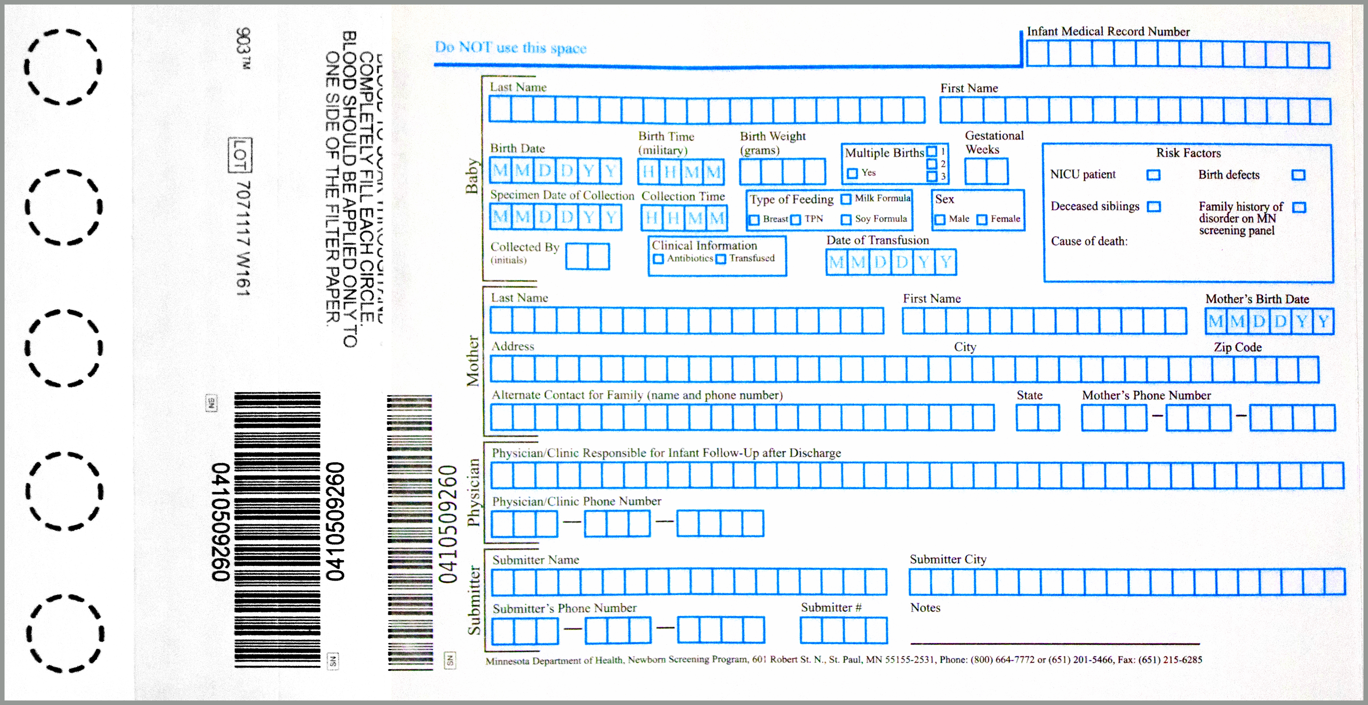
OZ NANI™: EMR to NBS
A01
A08s
EMR
A03
Internal Exchange Hub
A32
LIMS
ELO

Slide 10
Other Connections…
Birth Defects Registries
  Understand missed cases (e.g., CCHD)
  Understand co-morbidities and impact on screening (e.g., Down syndrome and Congenital Hypothyroidism)
WIC, CYSHN, and Local Public Health
  Ensure access to care and resources
  Medical Foods and Formula
Reference/Clinical Laboratories
  Obtain follow-up clinical labs
Subspecialist EMRs
  Obtain post-diagnostic follow-up information
  Alerted to new cases (e.g., false negatives)
  Alert to change in clinical status (e.g., X-ALD now symptomatic)

Slide 11
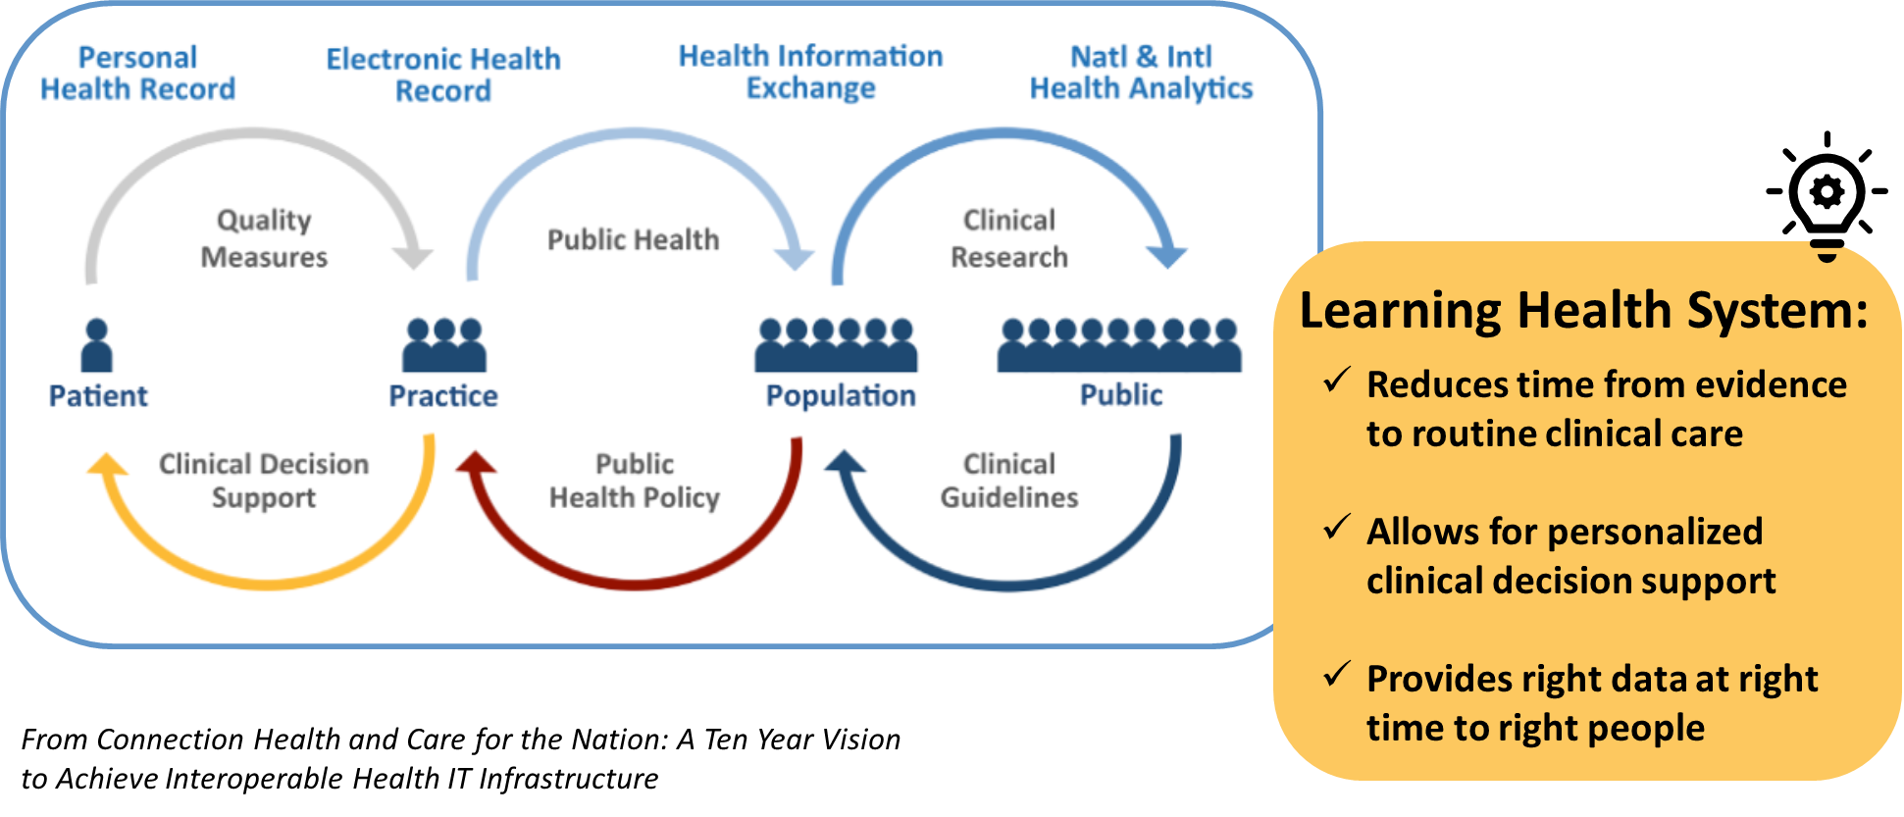
Back to the Why: Health IT in Rare Disorders

Slide 12
Considerations
How does interoperability fit into other program priorities?
  Adding new disorders; maintaining day-to-day; providing access to treatments; long term follow-up; etc.
The interoperability Catch-22
  May save staff time and money, but need staff time and money up front to achieve this
There are lots of ways to become more connected – each program’s starting point will be different.

Slide 13
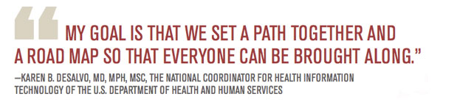


Next steps/Needs
Funding
Standards/National Initiatives
Technical Assistance/
Knowledgeable Staff

Slide 14
Thank You!
Acknowledgements:
Heather Brand
Amy Dahle
Kaitlin Houlihan
Mark McCann
Jill Simonetti
Tory Whitten
Matthew Zerby
Amy Gaviglio, MS, LCGC
agaviglio@cdc.gov
MN NBS Program
Health.newbornscreening@state.mn.us

