Slide 1
Newborn Screening ETOR in Texas
Electronic Test Ordering and Reporting Successes and Challenges

Slide 2
Newborn Screening (NBS) Interoperability Xanadu

Slide 3
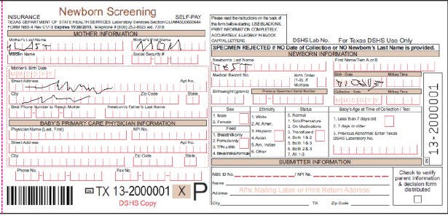
Electronic Orders

Slide 4
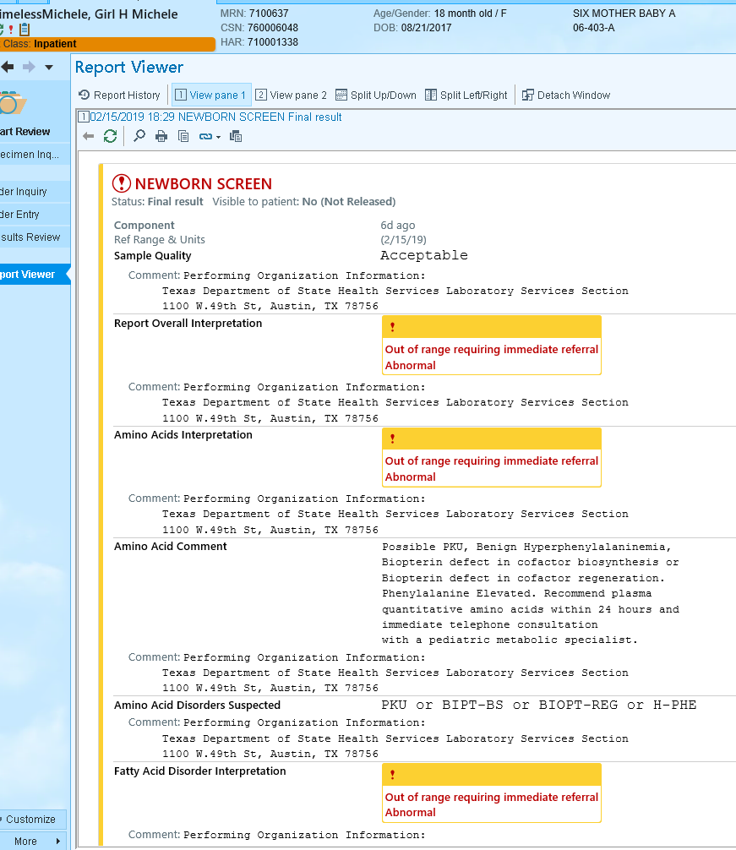
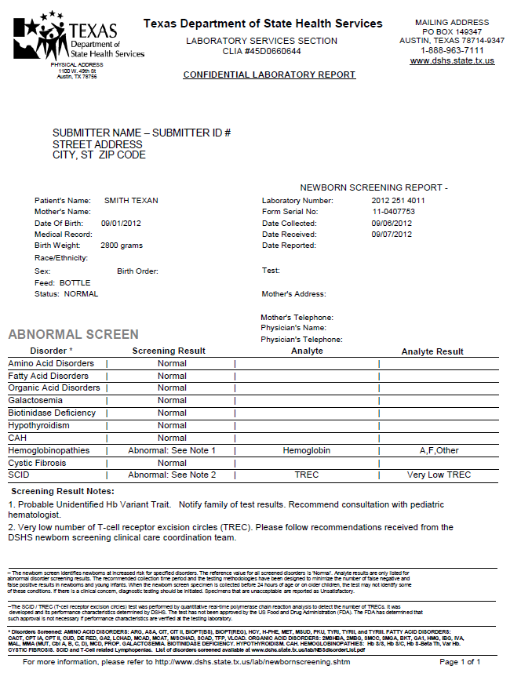
Electronic Results

Slide 5
NBS ETOR in Texas
Web / HL7 Solution Project
2 Projects
26 Facilities
HL7 implementation guides
Revised Electronic Results
4 Projects
24 New Facilities
2008
2009
2010
2011
2012
2013
2014
2015
2016
2017
2018
2019
2020
2 Projects
15 Facilities
PHII NLM implementation guides
Revised Orders
15 New Facilities
Revised HL7 Pilot Project
Notes:
Disorder Expansions, Upgrades, Timeliness

Slide 6
Revised Message Solution Goals
Adhere to HL7 and LOINC standards
Encourage partner organization adherence
Allow partner flexibility
Single interface design

Slide 7
Successes
Using ETOR to Improve Quality and Efficiency

Slide 8
Electronic Test Ordering and Reporting (ETOR)
Test Ordering
Reporting
~130,000 per year
(17.5% of NBS)
~117,000 per year
Electronic Reporting Only

Slide 9
ETOR Lab Data Entry Time Savings
130,000 Specimens
X 2 Minutes
____________________________________
4,333 Hours saved per year
2,080 hours per FTE
X .75 of time for actual tasks
____________________________________
____________________________________
1560 Hours of work per FTE
4,333 / 1,560 = 2.75 FTEs

Slide 10
ETOR – Data Accuracy
Manually entered data from a label
vs.
Same data electronic via HL7
Field Name | Differing Data | Percent Differences
Mother Street Address | 28 | 5.8%
Mother City | 21 | 4.4%
Medicaid Number | 16 | 3.3%
Baby Last Name | 15 | 3.1%
Baby First Name | 12 | 2.5%
Birth Order | 12 | 2.5%
Medical Record Number | 12 | 2.5%
Mother First Name | 12 | 2.5%
Ethnicity | 10 | 2.1%
Status | 9 | 1.9%
Mother Last Name | 8 | 1.7%
Mother Phone Number | 8 | 1.7%
Mother Zip | 6 | 1.2%
Physician Phone | 5 | 1.0%
Mother Birth Date | 4 | 0.8%
Birth Time | 3 | 0.6%
Feed | 3 | 0.6%
Mother SSN | 3 | 0.6%
Collection Date | 3 | 0.6%
Collection Time | 3 | 0.6%
Birth Date | 1 | 0.2%
Mother State | 1 | 0.2%
Differing Data | Total Specimens | Percent Specimens
1 Field | 95 | 19.8%
2 Field | 22 | 4.6%
3 Field | 7 | 1.5%
4 Field | 6 | 1.2%
5 Field | 1 | 0.2%
>5 Field | 1 | 0.2%
1+ Field | 132 | 27.4%
N = 481 specimens
Important Note: In many cases, standard operating procedure for data entry allows for minor changes or omissions of data elements which may account for some differences in the data .

Slide 11
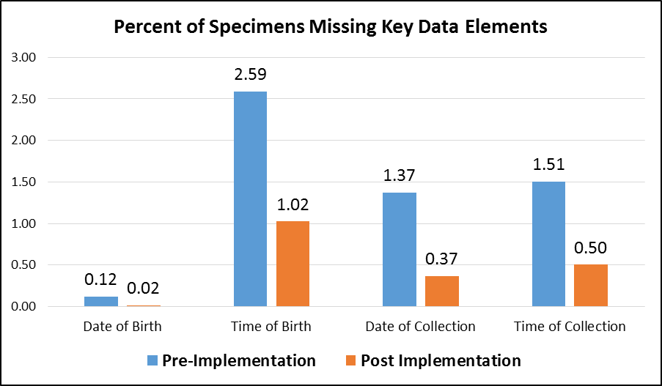
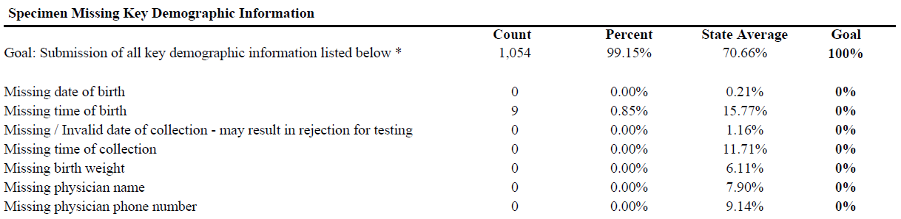
ETOR - Data Completeness
Quality Improvement for 10 Hospitals that Implemented Electronic Ordering
HL7 Provider Report Card

Slide 12
Challenges
How do we get and keep healthcare providers engaged?

Slide 13





Agency Xanadu
Laboratory
EHDI
CCHD
Immunizations
Vital Statistics
NBS
Clinical
Micro
Env.
Cancer Registry
Agency Data Hub
Birth Defects

Slide 14

NBS Bloodspot Silo
Laboratory
Hearing Screening
CCHD
Immunizations
Vital Statistics
NBS
Clinical
Micro
Env.
Cancer Registry
Birth Defects

Slide 15
Electronic Order – Standard Test

Slide 16
Electronic Order - NBS

Slide 17
New Approach?

Slide 18
Electronic Result - NBS
Gaps between published standards and healthcare provider LIS capabilities
Agreement on interpretation of standards
“Data standards are like toothbrushes. Everyone agrees they are a good thing but everyone wants to use their own.”

Slide 19
Electronic Result - NBS
Disorders w/ Positive markers
LOINC =57131-5
CAH
(LA12533-8)
√
X
Galactosemia
(LA21165-8)

Slide 20

Conclusions
Make it easier
Design / pilot new approaches
Engage Healthcare LIS vendors
Awareness of NBS
Develop NBS order
Agree on standards

Slide 21
Thank you
Brendan Reilly
Brendan.Reilly@dshs.texas.gov

