Slide 1


Spinal Muscular Atrophy
New Disorder Resources and Tools

Slide 2
This publication is supported by the Health Resources and Services Administration (HRSA) of the US Department of Health and Human Services (HHS) as part of an award totaling $1,500,000 with 0% financed with non-governmental sources. The contents are those of the author(s) and do not necessarily represent the official views of, nor an endorsement, by HRSA, HHS or the US Government. For more information, please visit HRSA.gov.

Slide 3
Insert State Information
Please enter any relevant program information on this slide including your state program name and other details.

Slide 4

What is Newborn Screening?
Key Points of Newborn Screening:
NBS is comprised of three different parts: dried blood spot, hearing and critical congenital heart disease
NBS programs are essential public health programs that perform laboratory screening, conduct follow-up on abnormal newborn screening results and refer infants to clinical care
NBS programs are state-based
NBS programs are opt-out programs*
NBS programs are designed to detect treatable conditions of the newborn
*in most states

Slide 5
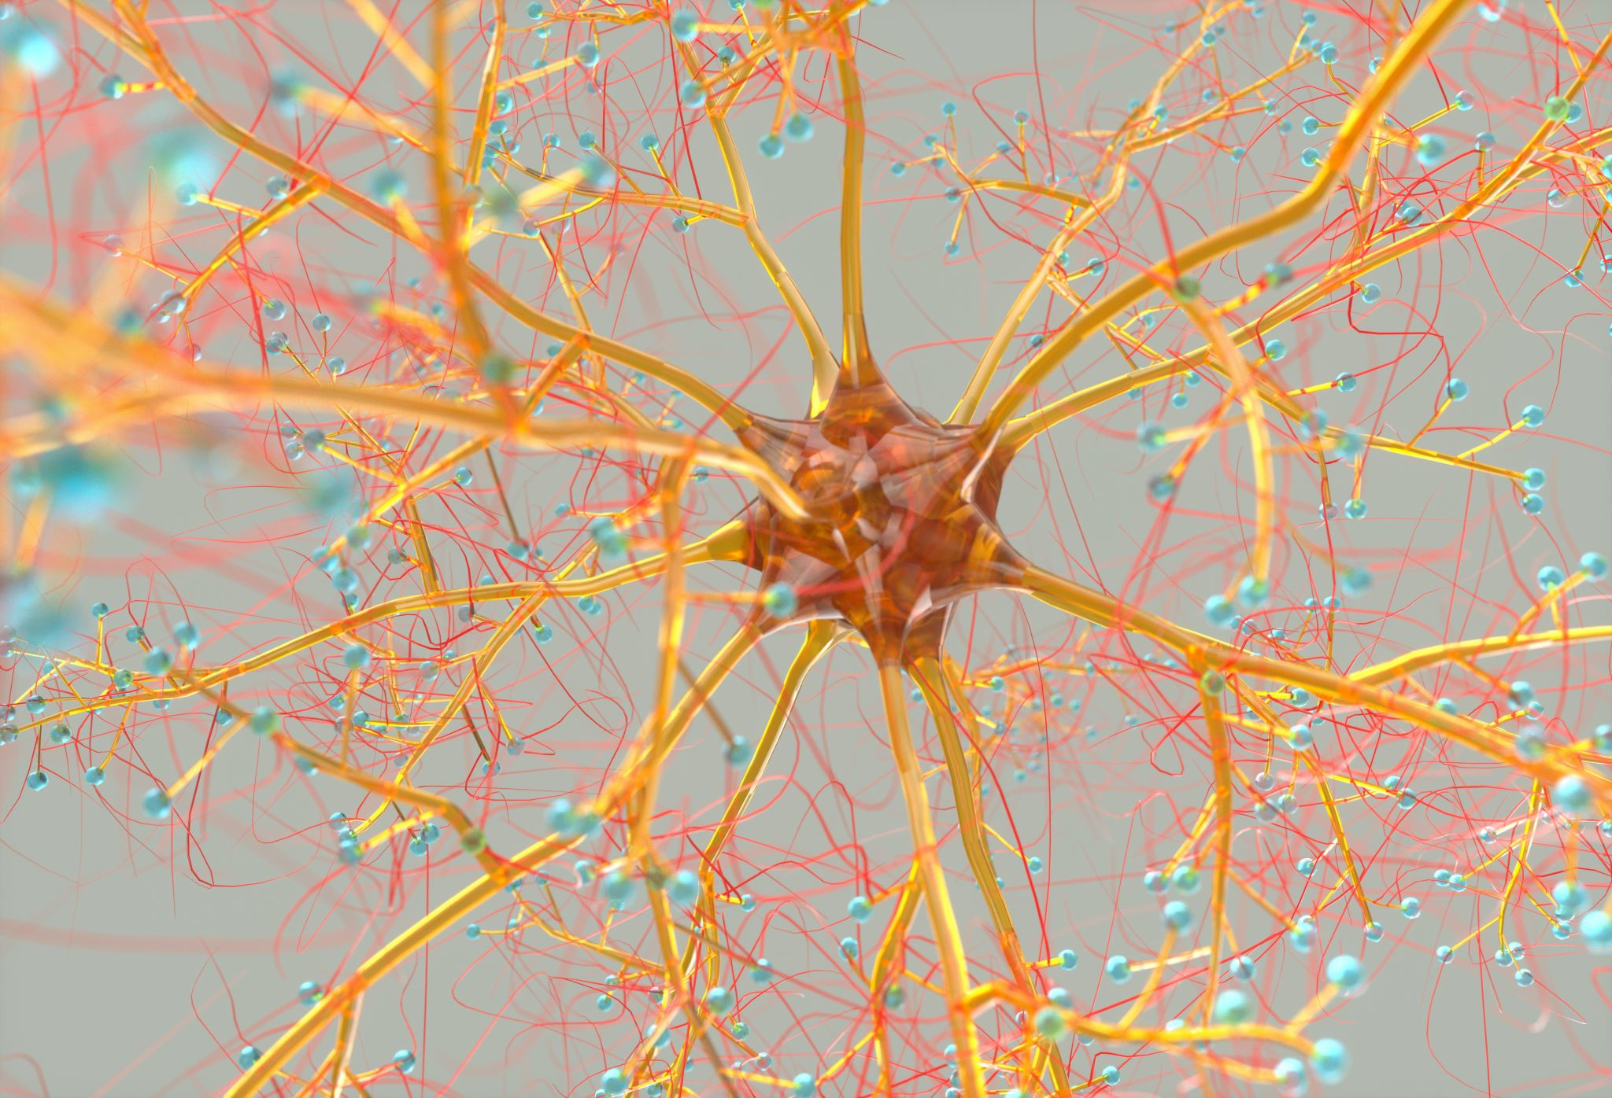
Spinal Muscular Atrophy

Slide 6
What is SMA?
Spinal Muscular Atrophy (SMA) is a progressive muscular dystrophy caused by mutations in the Survival Motor Neuron (SMN1) gene. The SMN1 gene encodes for an essential protein called Survival Motor Neuron (SMN). The SMN protein is essential for motor neuron function. A deficiency of the SMN protein results in progressive muscle atrophy and weakness.

Slide 7
Severity of SMA
There are five types: type 0, I, II, III and IV
Type 0 being the most severe and lethal with symptoms appearing right at birth
SMA type I is the most common form, accounting for 60% of cases
Patients with SMA type I develop significant hypotonia of the limbs and truncal muscles by six months of age with progression of the muscle weakness resulting in breathing problems, respiratory infections, difficulty feeding and eventually death by age two

Slide 8
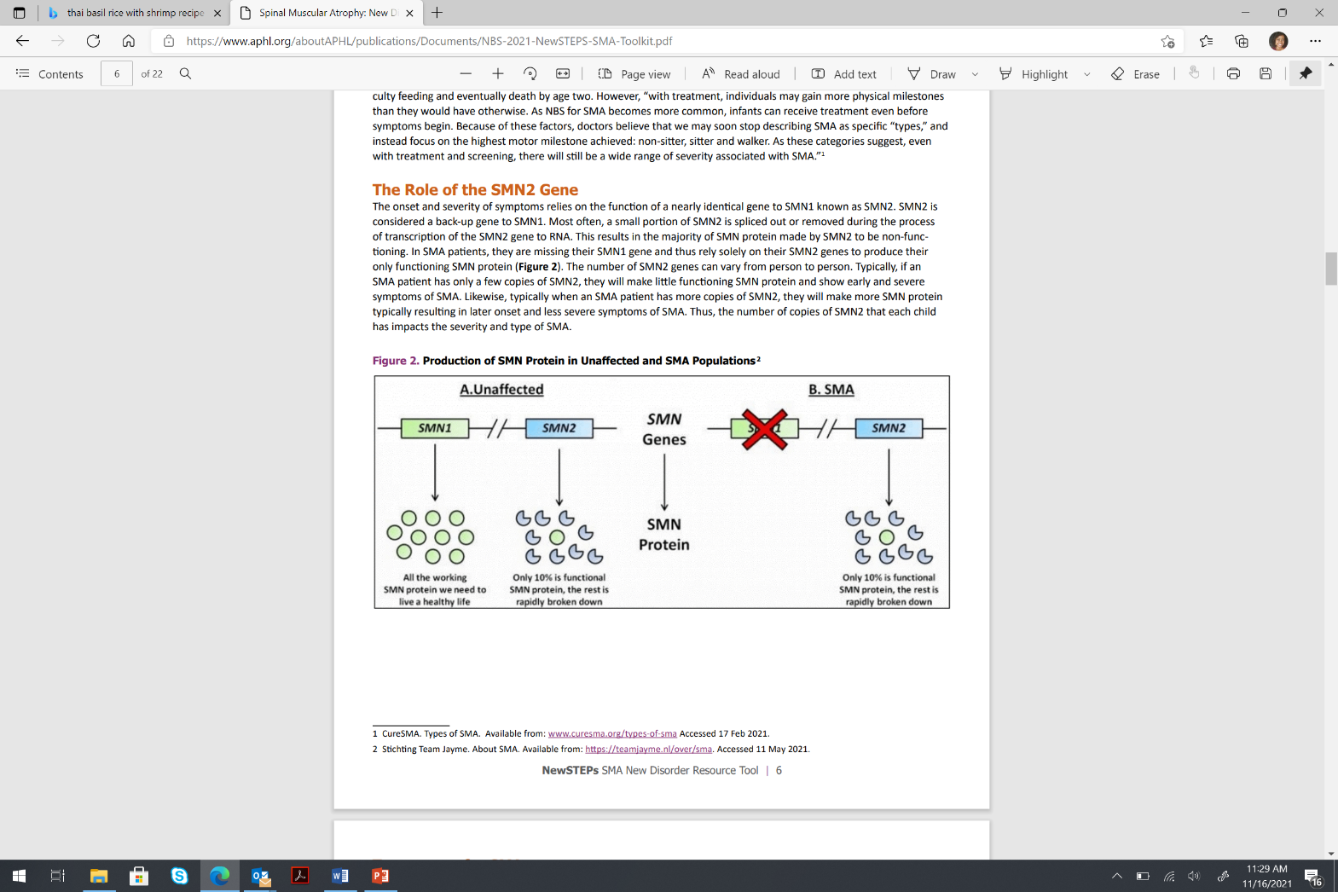
The Role of the SMN2 Gene

Slide 9
The Role of the SMN2 Gene
The onset and severity of symptoms relies on the function of SMN2
SMN2 is considered a back-up gene to SMN1
SMA patients are missing their SMN1 gene and thus rely solely on their SMN2 genes to produce their only functioning SMN protein
The number of SMN2 genes can vary from person to person
Typically, if an SMA patient has only a few copies of SMN2, they will make little functioning SMN protein and show early and severe symptoms of SMA
When an SMA patient has more copies of SMN2, they will make more SMN protein typically resulting in later onset and less severe symptoms of SMA

Slide 10
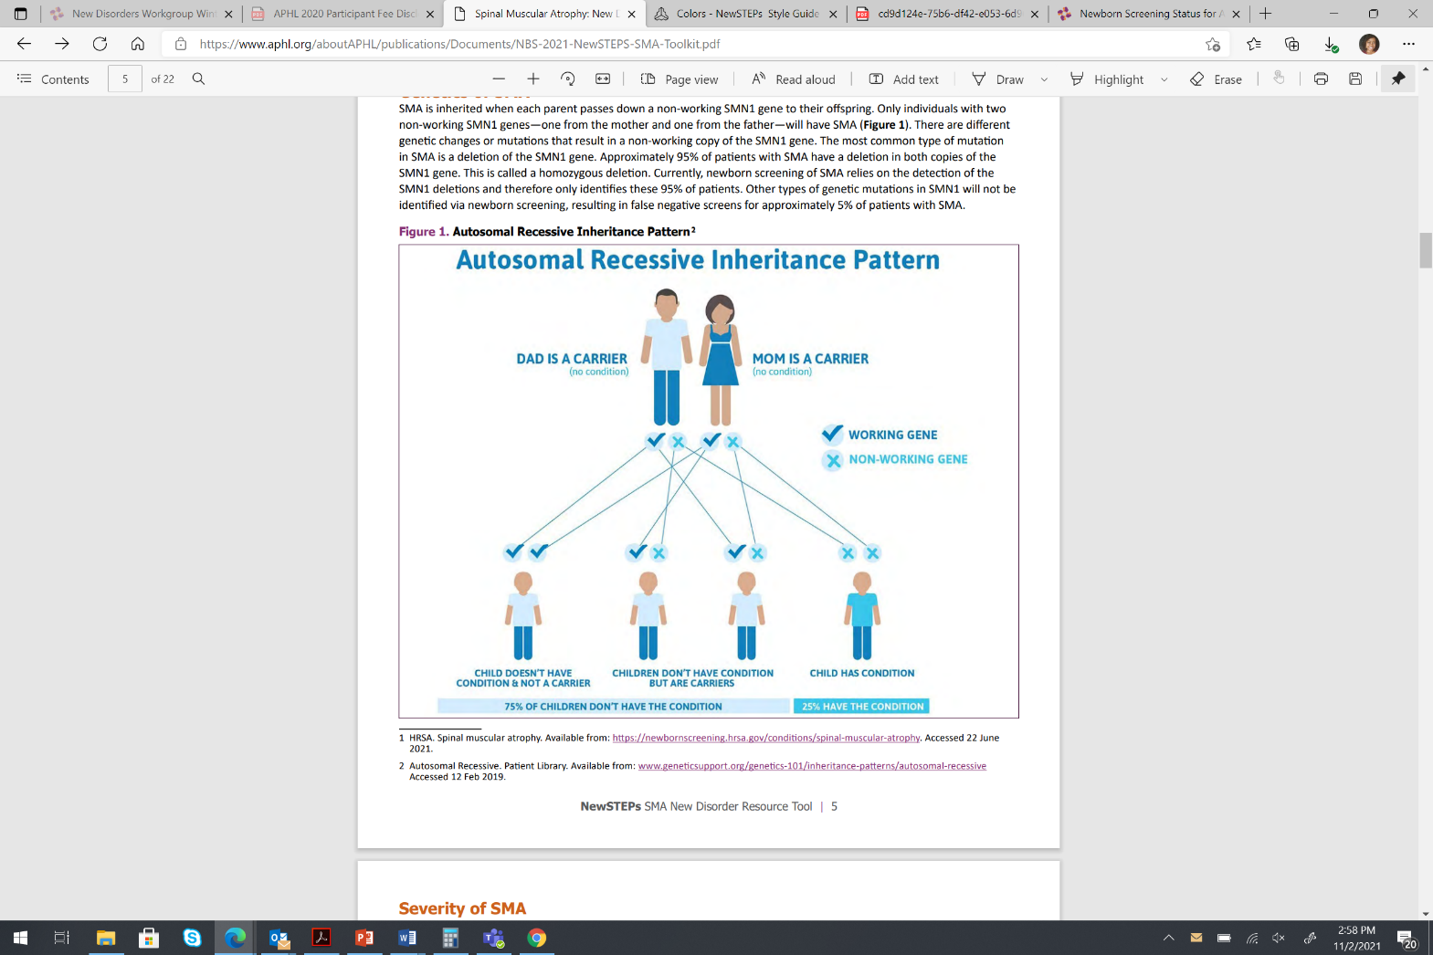
SMA is an Autosomal Recessive Disease
Autosomal Recessive. Patient Library. Available from: www.geneticsupport.org/genetics-101/inheritance-patterns/autosomal-recessive Accessed 12 Feb 2019.

Slide 11
Treatment of SMA
Patients with SMA receiving treatments early in life often meet their motor milestones including sitting and walking. The new treatment options prevent respiratory involvement allowing children with SMA to live for many years. Therefore, timely diagnosis and early treatment are essential for changing the course of affected patients. NBS is leading the way in achieving this goal.
Spinraza® (nusinersen)
Approved by the US Food and Drug Administration (FDA) in 2016
Treatment option for patients diagnosed early in the disease course (notably less than two years of age)
Does not reverse muscle damage that has already occurred
ZOLGENSMA® (onasemnogene abeparvovec-xioi)
Approved by the FDA In 2019
Gene therapy option for patients diagnosed with SMA less than two years of age
Evrysdi®(risdiplam)
Approved by the FDA in 2020
Medication that is approved for all types of SMA
Patients are able to take the medication by mouth

Slide 12
Newborn Screening

Slide 13
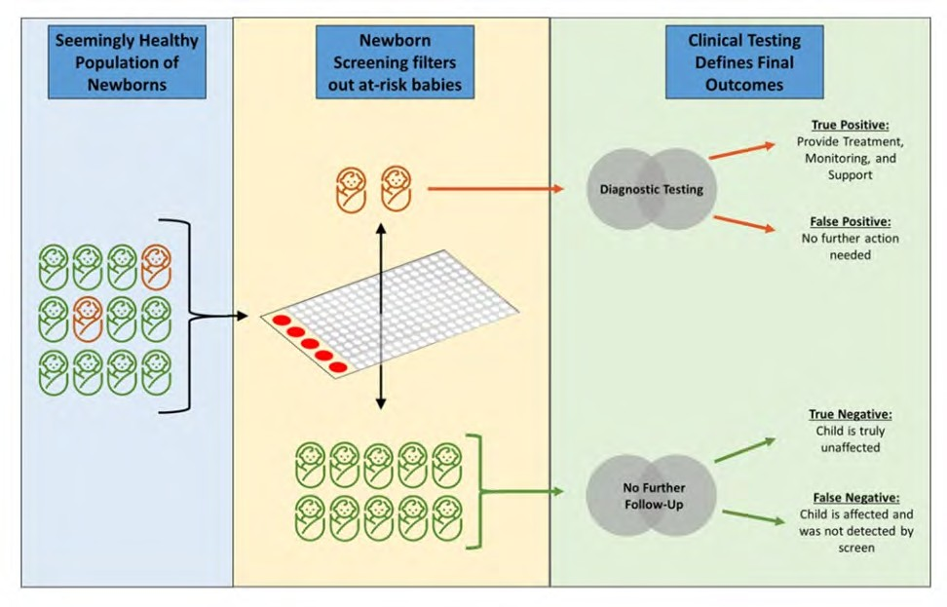
The Newborn Screening Process

Slide 14
Screening vs. Diagnostic Tests

Slide 15
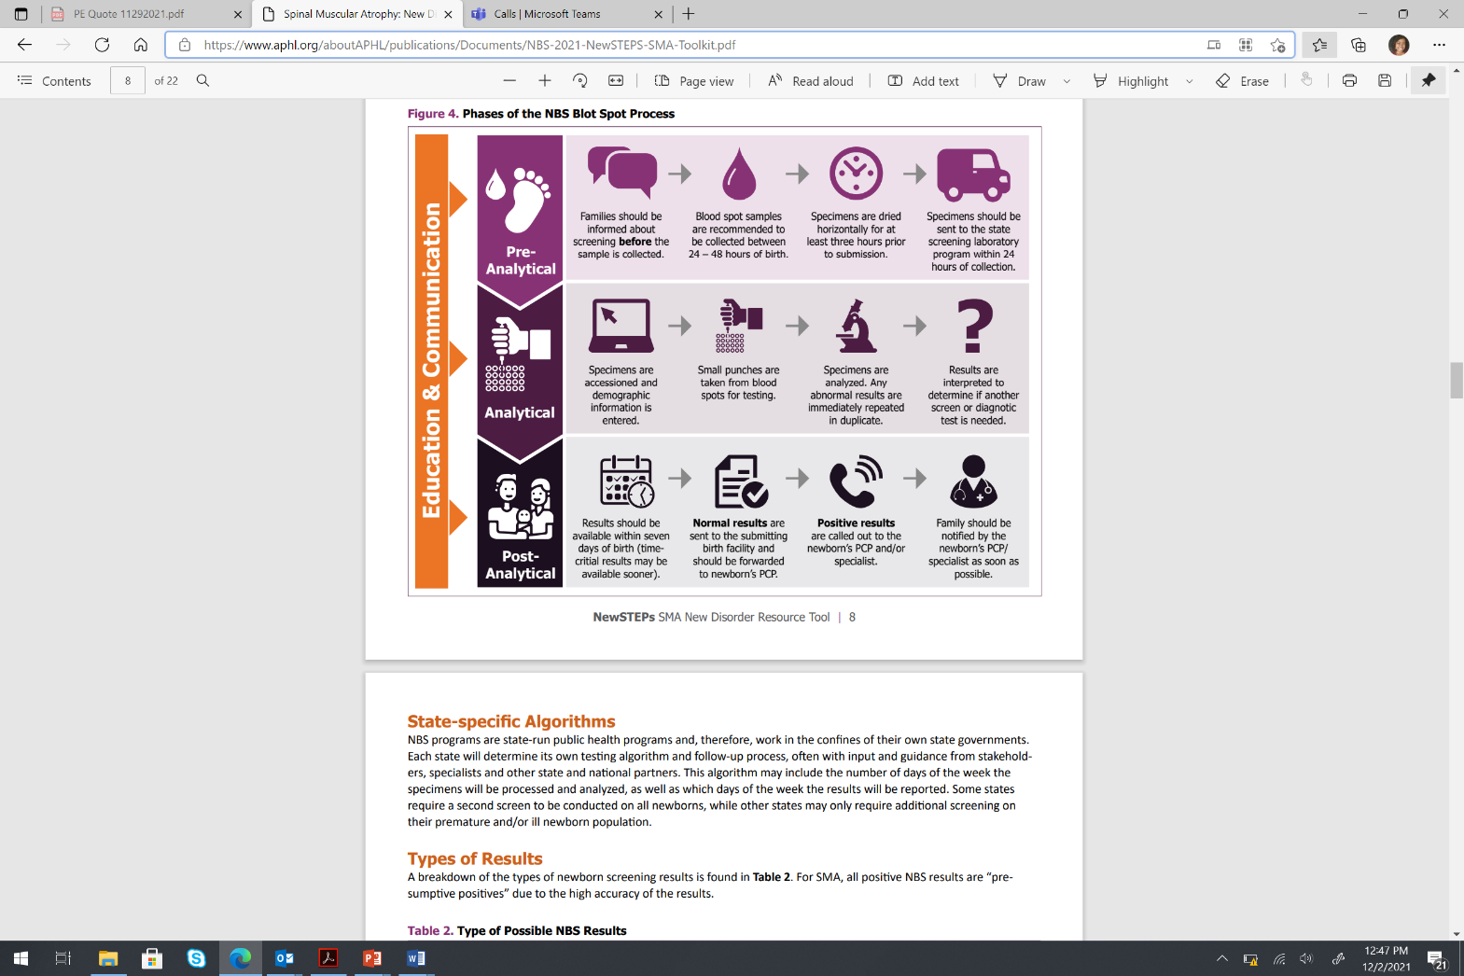
Phases of the NBS Blood Spot Process

Slide 16
Insert State Specific Algorithm

Slide 17
Types of SMA Screening Results
Insert State Specific Information

Slide 18
Screening Performance Metrics
True Positives
Infants identified through screening who are confirmed to be affected with the disorder.
False Positives
Infants identified through screening who are confirmed to not be affected with the disorder. This category typically includes unaffected carriers of the disorder who sometimes get picked up on the screening test and need to obtain further diagnostic testing to rule out the presence of the disorder.
False Negatives
Sensitivity
The ability of correctly identifying those with the disease (True Positive Rate).
True Negatives
Infants with in-range newborn screening results who are not affected with the disorder.
Infants affected with a disorder that are not identified through newborn screening. Most screens are designed to minimize false negatives (maximizing sensitivity).
Specificity
The ability of correctly identifying those without the disease (True Negative Rate).
Predictive Value Positive (PPV)
The proportion of true positives among all positive screens.
Negative Predictive Value (NPV)
The proportion of true negatives among all negative screens.
Accuracy
Proportion of patients correctly identified (True positives and True Negatives/All tests).
Prevalence/Incidence/Detection Rate
The number of true positives per number of births.

Slide 19
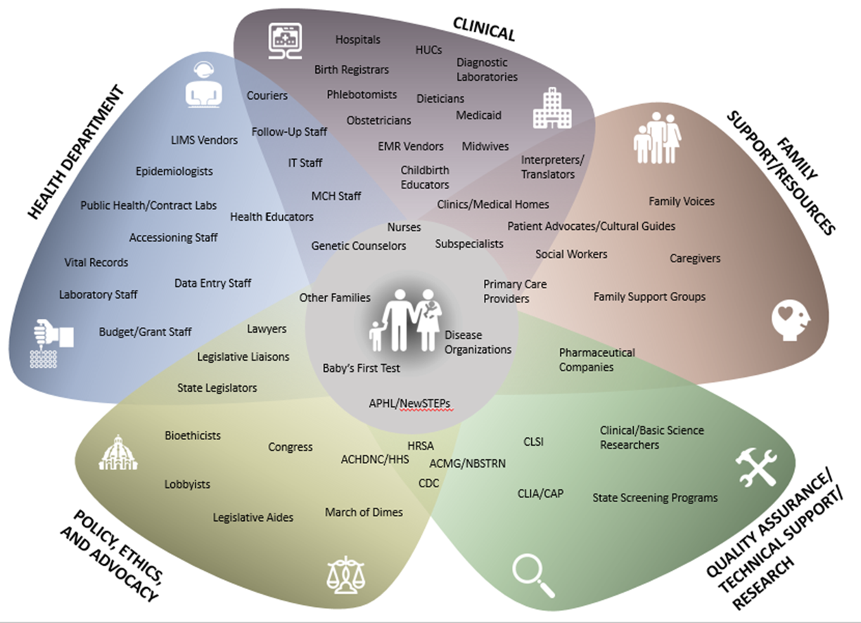
Stakeholders

Slide 20
NBS Cost Considerations
Adding additional laboratory and/ or follow-up staff
Creating new positions within state government can be difficult during poor state revenue, hiring freezes and other fiscal scenarios
Laboratory equipment needed to screen
Physical capacity of laboratory, how much additional lab space is required
Testing materials and reagents needed to screen
Startup costs for development and validation. Sometimes the NBS fee cannot be increased until after the program has gone live with testing and reporting
Creating and distributing education materials
Revisions to or added information technology (IT) components
Medical specialist contracts

Slide 21
Timeline Hurdles
Obtaining appropriate approval for the disorder’s official addition to State panels, including fee increases and revision of rules/regulations as needed
Working through all of the program considerations
Completing pilot testing and finalizing screening cutoffs and decision algorithms
Education of stakeholders regarding SMA, the plan for screening, and available treatment options within the state

Slide 22
Getting Ready to Screen for a New Disorder
Before a state can implement statewide screening of a new disorder, many things need to happen
In many states, there is a well-established process to get approval to add a condition to the state newborn screening panel
In some states, the addition of new disorders is achieved through legislative action, relying on the effort of advocates and legislators
In other states, the process includes changes to rules and regulations that govern the newborn screening program through actions by the state board of health or the newborn screening advisory committee
Some states rely on national guidance through ACHDNC, utilizing their process of adding disorders to the RUSP
The RUSP lists disorders that have passed scientific evidence review and are recommended for universal screening in the US
Although the RUSP provides recommendations and not requirements, most states look to the RUSP when determining whether to screen for a disorder
please provide your state specific process

Slide 23
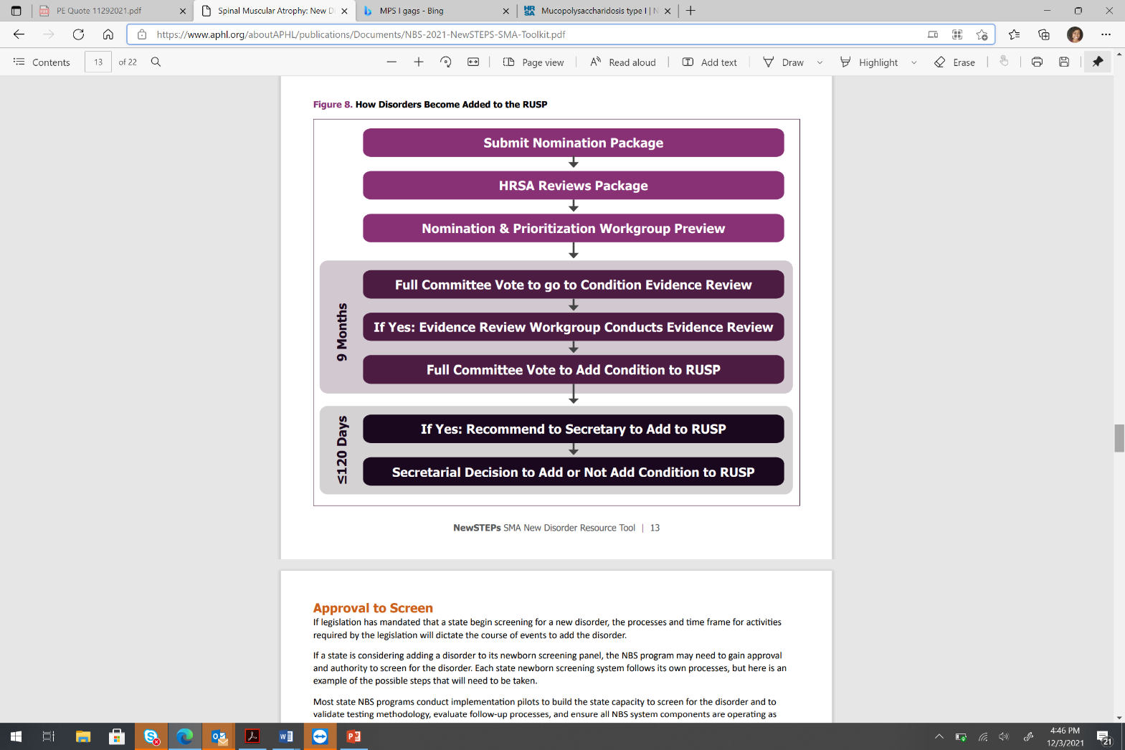
How Disorders Are Added to the RUSP

Slide 24
Approval to Screen
Please provide the steps that your program takes to gain approval/authority to screen

Slide 25
Laboratory Readiness to Screen for SMA
Readiness Steps for NBS Laboratory Screening:
Identify which screening method to use
Obtain needed equipment for testing
Have space needed for testing equipment
Ensure testing method performance validations and verifications to meet regulatory requirements
Ensure testing cutoffs and decision schemes meet specificity/sensitivity and other performance targets
Define true and false positives for measurement of the screen's performance metrics once full population testing begins
Obtain adequate lab staffing for full population screening
SMA testing workflow integrated with all NBS lab workflow
Communication algorithm established with short term follow-up program (phone, IT, messaging)
Please add any program specific steps

Slide 26
Laboratory Readiness to Screen for SMA
Testing Methodology
What are pros/cons of possible testing methods?
What equipment is needed?
Purchasing versus reagent rental?
Is more/different facility space needed?
Is additional power/construction needed?
Will the program utilize a tiered testing algorithm?
Will the program contract out for additional tiered testing?
How does the proposed algorithm affect timeliness metrics?
Please add any program specific considerations

Slide 27
Laboratory Readiness to Screen for SMA
Validation of testing strategy
Prospective (current specimens) versus retrospective (stored specimens)?
Identified, de-identified, or anonymized specimens?
If identified, how will results be confirmed? Who will call out abnormal results?
What is the availability of positive specimens, Quality Assurance (QA), reference, proficiency testing materials?
Please add any program specific considerations

Slide 28
Laboratory Readiness to Screen for SMA
Lab and Follow-Up Staff Needs
Are new hires needed? At what level?
Is training needed for existing and new staff?
Include educational needs on new disorders, new testing methodology, clinical expectations, etc.
Will additional staff be needed on weekends?
Will new specialist contracts be needed?
Please add any program specific considerations

Slide 29
Laboratory Readiness to Screen for SMA
After Screening Starts: Heterogeneity of Conditions/Spectrum of Findings
Will family members be detected?
What else is being detected?
What is the distribution/prevalence of mild versus severe patients and is that different than what was expected?
How is the screen performing?

Slide 30
Follow-up Readiness
Key components of follow-up readiness for SMA screening include:
Integration of SMA follow-up workflow with all follow-up workflows
Identification and communication with medical specialists and/or treatment centers for infants with positive SMA newborn screen
Development of action plan templates for PCP and parents, including any confirmatory testing needed
Development of a communication plan for follow-up coordinator and family/PCP
Development of a procedure for referral from short term follow-up program to neuromuscular specialist
Informing some third-party payors of SMA pilot and ensuring understanding of the need for coverage for treatments/ therapies

Slide 31

For SMA, there remain unanswered questions regarding the long-term effectiveness of new treatments and the outcome of the patients that receive these treatments at an early age. Data collection will be essential to fully answer these questions.

Slide 32
Information Technology (IT) Readiness
Key components of IT readiness include:
Integration of disorder into LIMS Testing & Reporting
Integration of disorder into CIMS Reporting System
Integration of disorder into Electronic Orders and Results Protocol

Slide 33
Establishing Relationships with Specialists
It is important for state NBS programs to establish partnerships and strong relationships with specialists
Relationships start during consideration and implementation of a new disorder
It is beneficial for state programs to form a task force/subcommittee with all the specialists across the state
Work groups should include laboratory, follow-up, specialists and parent advocates
As the process evolves, these task forces/subcommittees can begin discussing contracts, continuous quality improvement during and following implementation, development of educational materials, technical assistance and content expertise
SMA is among the first muscular dystrophies added to newborn screening and therefore neuromuscular specialists are often new to the process

Slide 34
Educational Tools for SMA
Develop educational and support materials for PCPs, hospitals and families
Translate educational materials for families into appropriate languages
Develop script for PCPs to use with families
Establish a communication plan between NBS program, specialists and PCP
Educational materials are often shared between state programs or materials are developed for national use through Expecting Health or CureSMA
With SMA, older educational materials sometimes show patients that are significantly impacted by SMA and may not reflect patients that were identified shortly after birth and treated early

Slide 35
SMA Performance Metrics & Continuous Quality Improvement
Timeliness Performance Measure | Timeliness Metric Goals
Birth to specimen collection | 24-48 hours
Specimen collection to receipt by lab | 24-48 hours
Time from specimen receipt to reporting out of results | 5-7 days
Birth to referred to specialist | 8 days
Birth to seen by specialist | 10 days
Birth to diagnostic blood collection | 11 days
Birth to diagnosis | 16 days
Birth to therapeutic planning and, as needed, intervention(s) | 16 days

Slide 36
Pilots Studies vs. Full Statewide Implementation
Please indicate whether you will conduct or have conducted pilot studies for SMA. If your program went directly to full implementation or if your program is planning to go straight to full implementation of screening for SMA, please indicate that as well
Please also include your process here

Slide 37
Conclusion
The intent of this SMA resource has been to provide an overview of information regarding the many aspects that are involved in the addition of a new disorder to a state NBS panel
Please direct any questions regarding implementation or technical assistance needs to NewSTEPs at newsteps@aphl.org.
Learn more about SMA on HRSA's website: newbornscreening.hrsa.gov/conditions/spinal-muscular-atrophy.

Slide 38
Contact Information
Please add your contact information

