Slide 1
Hot Topic Webinar on the Public Health Laboratory Fellowship Program: an APHL-CDC Initiative
Tuesday, March 5, 2024
2:00 – 3:00 pm ET

Slide 2
Objective
During this webinar, participants will have a comprehensive overview of APHL's Career Pathways in Public Health Laboratory Science initiatives, including our Public Health Laboratory Fellowship Program, newborn screening project examples and its key features and application process. Participants will also hear stories from fellowship program alumni who will share their experiences as fellows working in newborn screening.

Slide 3
Speakers
Christine L. Bean, PhD, MBA, MLS(ASCP), Chief Learning Officer, APHL
Ashley Smith, MS, Senior Specialist, Public Health Laboratory Fellowship Program, APHL
Courtney Sumby, MS, Senior Specialist, Newborn Screening & Genetics, APHL
M. Christine Dorley, PhD, Division Director, Tennessee Department of Health
Charles Lechner, MS, former APHL NBS Bioinformatics and Data Analytics Fellow

Slide 4
Christine L. Bean, PhD, MBA, MLS (ASCP)
Chief Learning Officer, APHL
Notes:
Revisit Design

Slide 5
Career Pathways in Public Health Laboratory Science
An APHL-CDC Initiative
Academic Partnerships, Fellowships, Internships and Leadership Programs
Christine Bean, Chief Learning Officer
www.aphl.org/Career-Pathways
Notes:
Revisit Design

Slide 6
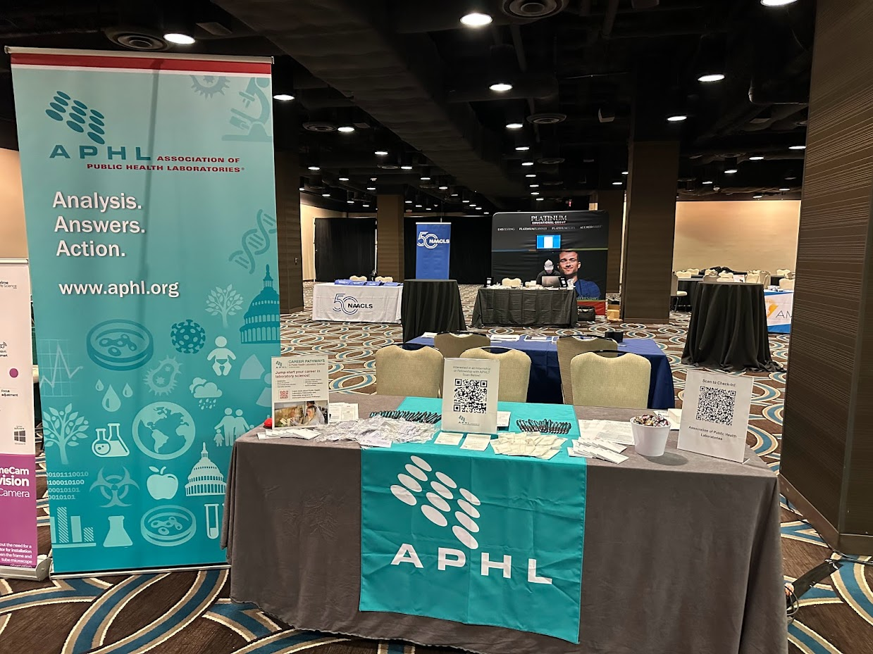
Academic Partnerships
Academic partnerships are essential in supporting the recruitment and retention efforts for the public health laboratory workforce.
Our Mission
Outreach Activities
The APHL Academic Partnerships program seeks to:
Foster partnerships in the promotion of career pathways in public health laboratory science
Support programmatic efforts and build connections between public health laboratories and academic institutions
Strengthen partnerships with organizations who prioritize DEIA
Campus Visits
Career Fairs (Onsite and Virtual)
Exhibit Booths at Conferences
Job Board Posts
Newsletters/Publications
Social Media Engagement
Speaking Engagements
STEM Advocacy
Notes:
Up first is our Academic Partnerships program, which supports the fellowship, internship, and leadership programs. It is actively involved in establishing and sustaining collaborative relationships between public health laboratories and academic institutions. Recognizing the essential role of diversity, equity, and inclusion, the program is dedicated to integrating these principles into its outreach and recruitment initiatives. The team is very busy with various outreach activities including participation in career fairs, hosting exhibit booths at conferences, job board posts, publications, social media engagements, STEM advocacy and promotional speaking engagements.

Slide 7

Connect with Us
Find us on Handshake!
Handshake is the preferred job board platform for a majority of college campuses
Post fellowship and internship opportunities
Host virtual career fairs and other virtual events
Job Board Posts
Actively promoting fellowship and internship opportunities across job board sites including (but not limited to):
APHL Laboratory Network, Public Health Jobs (ASPPH), and Public Health Careers (ASTHO)
Social Media (@APHL)
Facebook, Instagram, LinkedIn, TikTok and X (formerly Twitter)
Notes:
The academic partnership program has developed a multi-prong approach in the promotion of public health laboratory fellowship and internship opportunities in a variety of ways. Handshake is used to connect to thousands of students and alumni affiliated with higher education institutions. Additionally, we have leveraged multiple job board platforms such as the APHL Laboratory Network, Public Health Jobs, and HBCU Careers in the promotion of these opportunities. We have partnered with our MarCom team to leverage APHL social media accounts to highlight program activities and events from the Academic Partnerships team.

Slide 8

Public Health Laboratory Ambassador Initiative
The Ambassador initiative was developed by Cohort 16 of the Emerging Leader Program (ELP) to support outreach and recruitment efforts.​
To develop the laboratory workforce by promoting public health laboratory careers to students.
To learn more, please visit the Ambassadors section located on the APHL Academic Partnerships webpage
Questions?
Please email us at academic.partnerships@aphl.org
Notes:
To help with the recruitment of the next-generation public health laboratory workforce, the Public Health Laboratory Ambassadors initiative was developed in 2023 by cohort 16 of the Emerging Leader Program. These volunteers support outreach and recruitment efforts by participating in regional outreach events such as classroom presentations, local career fairs, and more. It is open to those with a background in public health laboratory science or experience supporting the public health laboratory field. If you would like to learn more about the ambassador program, please visit the Academic Partnerships webpage on the APHL website (within Career Pathways). Please let me know if you would like more information about our ambassador program.

Slide 9
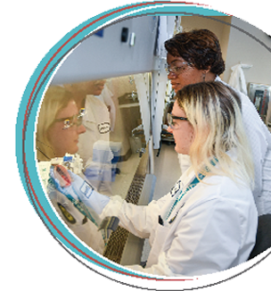
Public Health Laboratory Fellowship an APHL-CDC Initiative
Eligible candidates
Completed bachelor’s, master’s or doctorate degree
Applications: Accepted year-round
Start and End Dates: Flexible
Hours and program length: Approximately 40 hours a week, and one-to-two-year terms
Applications are currently being accepted and reviewed on a rolling basis. There is no deadline to apply!
Fellowships support a wide spectrum of public health laboratory science program areas, such as: bioinformatics, biosafety and biosecurity, emergency preparedness and response, environmental health, infectious disease, informatics, food safety, newborn screening and quality management.
Each fellow is matched with an experienced mentor and will work on a program-specific projects at the host laboratory.
Requirements
Benefits
US citizen or permanent resident
Undergraduate and/or graduate transcripts
Resume/CV
Completed interest and experience survey
Narrative submissions for screening interview
Experienced mentor actively working in the public health field
Hands-on skills in laboratory techniques
APHL student membership
Competitive stipend and benefits package
www.aphl.org/Career-Pathways
Notes:
Next up is a quick overview of the fellowship program. Here you will see some important aspects of our fellowship program. Fellows are matched with mentors in host labs. This first bullet here lists the program areas for our nine current fellowships. Fellows work on program specific projects and are one year in length with an optional second year.
Next, I want to turn it over to Cherie Estrada with the internship team to talk a little about the internship program before we talk a little more about mentorship. Cherie

Slide 10

Current Fellowships (as of 3/4/2024)
138 Currently Active Fellows!
Bioinformatics - 20
Biosafety and Biosecurity - 3
Environmental Health - 33
Food Safety - 9
Infectious Diseases - 56
Informatics - 4
Quality Management - 10
Newborn Screening - 3
Emergency Preparedness and Response - 0
Brand new as of Feb 2024!
78 1st year fellows
60 2nd year fellows
in 35 host laboratories
across 23 states!

Slide 11
Get Involved and Learn More!
Join our upcoming and new recurring webinar series!
(New!) Public Health Laboratory Core Function Webinar Series with Q&A Panel
First of a new quarterly series will be March 6, 12:00 PM EST, Registration link
(New!) Mentor Application Webinar
March 20, 1:00 PM EST, Registration link
(New!) Fellowship Projects Presentation Webinar Series
Beginning in April, quarterly, registration coming soon!
Fellows will present on-going progress with projects
Registrations
will be open
to all to join
and learn more!
Webinar recordings available in the APHL Learning Center

Slide 12

Public Health Laboratory Internship an APHL-CDC Initiative
Eligible candidates
Current student enrolled at an accredited institution and in pursuit of a relevant certificate, associate’s, bachelor’s, or master’s degree
Start and end dates: Flexible
Hours and program length: An average of 20 hours a week for 12 to 16 weeks
Application period is open each quarter
Mentor applications are accepted on a rolling basis
Interns are introduced to a public health laboratory team and see how they make an impact on protecting the health of our communities. They learn to assist scientists working on meaningful projects, while building skills such as general lab practices (e.g., pipetting, calibrations, etc.), data analysis, problem solving, teamwork, and effective communication.
Requirements
Benefits
US citizen or permanent resident
Completed application form
Work history
Reference (either academic or professional)
College transcripts
Gain experience in public health laboratory initiatives
Competitive stipend
Build transferable skills
www.aphl.org/Career-Pathways
Notes:
Cherie

Slide 13

Genomic Data Internship an APHL-CDC Initiative
Eligible candidates
Current student enrolled at an accredited institution and in pursuit of a relevant master’s or doctoral degree
Start and end dates: Flexible
Hours and program length: 10 or more hours per week with a maximum of 80 hours per month. Placement runs for 12 months
Application period is rolling
Mentor applications accepted on continuous basis
Graduate student interns will join a public health laboratory team to assist scientists working on applying their bioinformatics skills to various public health problems in infectious disease surveillance, outbreak detection, newborn screening and more! Projects can include assisting with bioinformatics analyses, data visualizations and uploading sequence data to public repositories.
Requirements
Benefits
US citizen or permanent resident
Completed application form
Resume/CV
2 References (either academic or professional)
All relevant unofficial transcripts
Network with public health laboratory professionals
Professional mentor
Build transferable skills
Competitive stipend
Remote or in-person placement
www.aphl.org/Career-Pathways
Notes:
Cherie

Slide 14
APHL Mentorship Opportunities
Guide a fellow or an intern on their journey in the Career Pathways program!
Mentorship Benefits
Enhance communication, leadership and training skills
Have an eager learner assist with a host laboratory project that needs attention
Expand professional networks with other labs
Learn best practices from other mentors
Rewarded by helping educate the next generation of public health laboratory scientists!
Request up to $10,000 from APHL per project term to assist with fellowship project supplies!
Coming soon – project supply funds of up to $1000 for intern projects
Notes:
In certain areas, we actually have an overabundance of fellow and intern applicants. We always can use more host laboratories and mentors. So I’d like you to think about something-- does your laboratory have a project that you haven’t been able to get to? Perhaps it is something that a fellow or intern could do? Besides that, is there someone on your laboratory staff that would make a great mentor? Here are just some of the mentorship benefits. In addition, we have mentor fliers for you to take back to your lab, and we can arrange 1:1 informational calls with any of your staff who are interested in learning more. Please reach out to anyone here who has participated, and Cherie can give you details about the implementation of the programs at your lab.

Slide 15
Leadership Programs
Emerging Leader Program (ELP) 12-month hybrid program for skill development, networking opportunities, leadership exercises and project development
Target Participants: Mid-level and upcoming supervisory and non-supervisory laboratory leaders
Number of Participants: In Fall 2024, expanding cohort size from 15 to 30 participants
Laboratory Leaders of Today (LLOT)
12-month hybrid program that addresses critical operational issues in member laboratories while enabling
networking and leadership training
Target Participants: New laboratory directors and assistant directors
Number of Participants: 15 participants in Cohort 2
Laboratory Director Board Examination 'Boot Camp' Multi-week virtual program to jump-start the studying process for the Board Exam, which is required to direct high complexity laboratory testing
Target Participants: Future laboratory directors
Number of Participants: Not limited. Observing 30-50 per weekly session.
Emerging Leader Alumni Network (ELAN)
Ongoing professional development and networking
Laboratory Leaders of Today Alumni (LLOTA)
Ongoing professional development and networking

Slide 16
Additional Questions?
Contact: fellowships@aphl.org
internships@aphl.org
academicpartnerships@aphl.org
leadership@aphl.org
Thank you!

Slide 17
Ashley Smith, MS
Senior Specialist, Public Health Laboratory Fellowship Program, APHL
Notes:
Revisit Design

Slide 18
Overview of the Public Health Laboratory Fellowship Program: an APHL-CDC Initiative
March 5, 2024

Slide 19
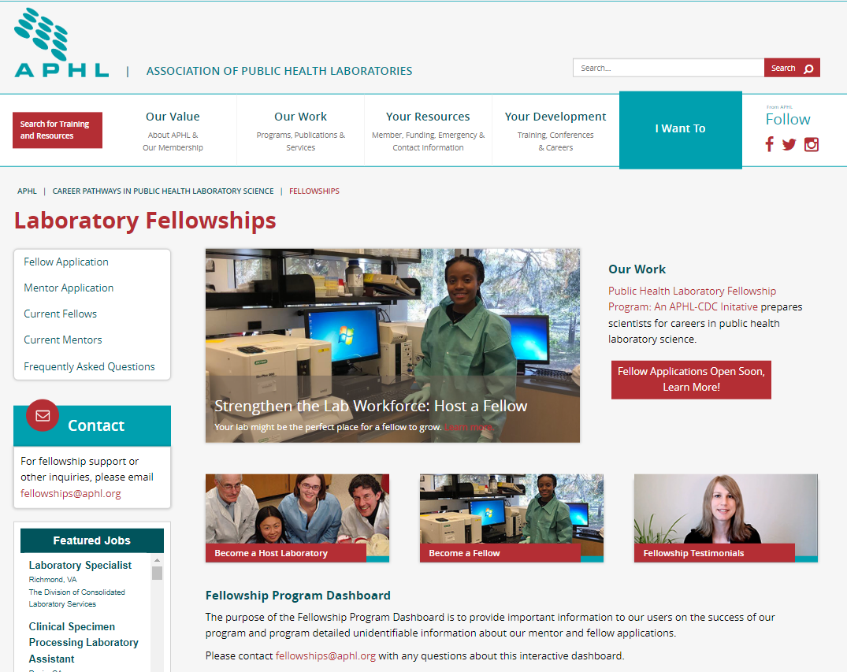
Public Health Laboratory Fellowship Program: Webpage
General program information
Link to mentor and fellow applications
Resources for current mentors and fellows
Laboratory Fellowships (aphl.org)
(aphl.org/fellowships)
Contact us at: fellowships@aphl.org
Notes:
Rob

Slide 20
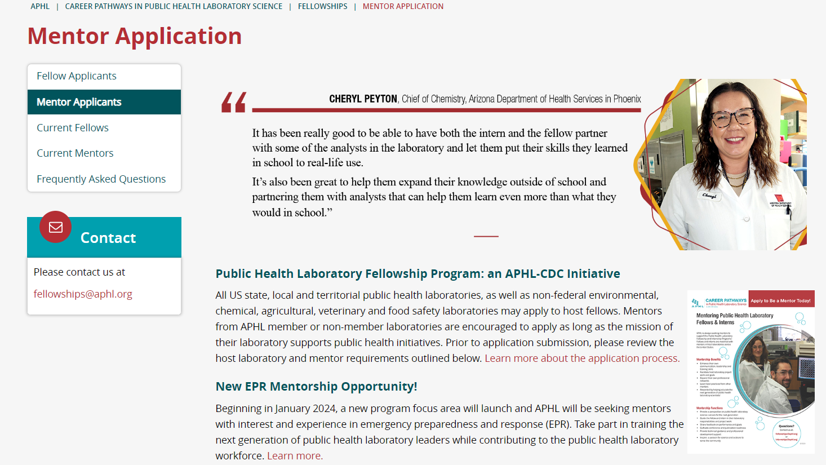
Fellowship Application Highlights
Rolling application allows mentors and fellows to apply anytime!
1 project per application
Can request 1-3 fellows per project
Can submit multiple applications per mentor and per host laboratory
Approval from the laboratory director/program administrator
Project must support a public health initiative
Application Process:
Submitted application reviewed by APHL Fellowship Team
Once approved, mentors receive access to candidate pool
Currently over 250 candidates in the pool!
Mentor Application Webpage

Slide 21
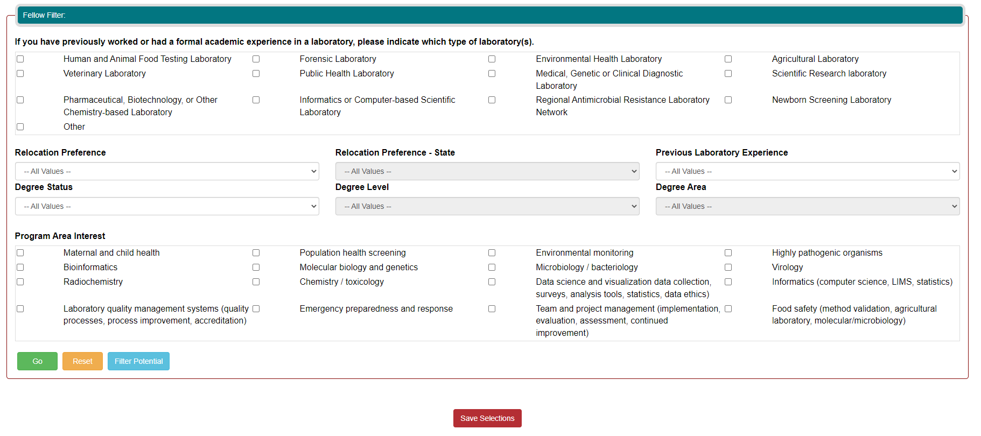
Fellowship Application Highlights: Filtering Pool
Mentor Application Webinar - March 20, 2024 - 1pm ET
Notes:
You can sort by multiple criteria (degree, degree area, interest) at one time

Slide 22
Fellowship Program Overview
Fellowships are for one year (52 weeks), with the possibility of an extension up to an additional year maximum.
Fellows are not considered employees of APHL nor the host Laboratory.
Fellows will not have access to ‘Employee Assistance Programs’ and other staff benefits.
APHL requires fellows to have health insurance coverage while in the program.
Fellows are treated like employees so same rules, regulations, expectations apply to fellows as they do staff.
Fellows are paid a monthly stipend distributed by APHL on the last working day of the month.
Fellowship is full-time. Work schedule and hours are established between the fellow and mentor.
Fellows receive 12 days of Paid Time Off (PTO) per year. PTO tracking is done by mentor.
Fellows observe the same holidays/closures as those observed by the host laboratory.

Slide 23
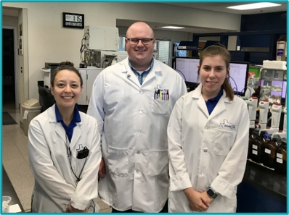
Fellowship Program Overview Continued
Prior to the fellow's arrival:
Notify host laboratory personnel of arriving fellow and establish laboratory-specific onboarding process and requirements.
Notify fellow of any necessary requirements to complete prior to arrival (vaccinations, background checks, etc.).
Once the fellow arrives, the mentor and fellow will complete the following throughout the fellowship:
First day arrival confirmation
Plan of Action
Quarterly reports
Fellowship training curriculum (fellow only)
Post-experience survey

Slide 24
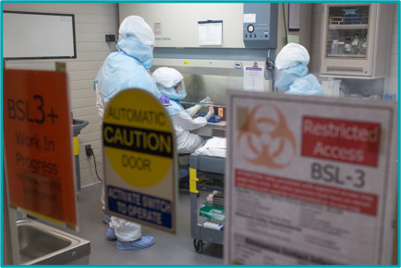
Host Laboratory Roles and Responsibilities
Provide the fellow with the appropriate:
Workstations
Badges
Security clearance
Building access
A laboratory email
Other laboratory requirements and resources as needed
Communicate with APHL as needed for any issues or concerns related to hosted fellows or mentors.
Provide fellow with any necessary, and site-specific, safety trainings.

Slide 25
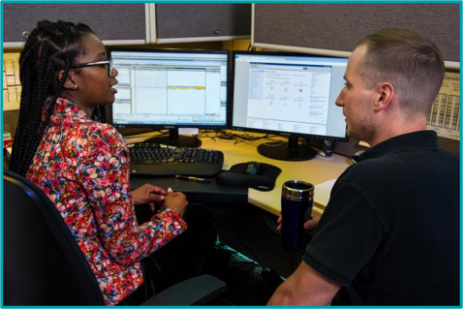
Mentor Roles and Responsibilities
Routinely meet with fellow to monitor project progress, provide direction and to encourage discussions.
Train the fellow on relevant techniques, practices and policies pertaining to the fellowship project.
Collaboratively develop a Plan of Action with the fellow to use as a guideline for the fellowship project expectations.
Establish daily work hours and weekly working schedule with fellow.
Monitor, track and approve fellow’s time off or 'flex' time.
Complete quarterly reports and post-experience survey.

Slide 26
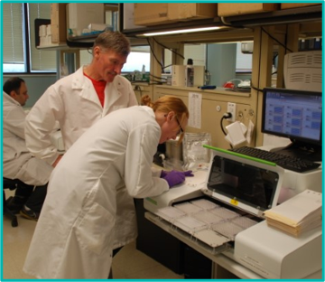
Mentor Roles and Responsibilities Continued
Support and provide professional development opportunities.
Assist with developing professionalism, networking, navigating conference attendance and other leadership attributes.
Encourage and assist with helping the fellow develop and submit abstracts, posters and presentations.
Work with the fellows towards a publication.
Advise fellow on professional career options.
Enjoy the mentorship experience!

Slide 27
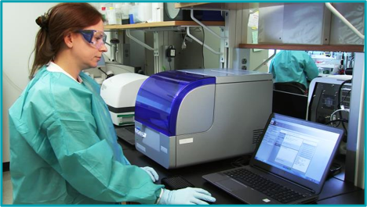
Fellowship Project Supply Funding
Mentors are eligible to request up to $10,000 per fellow, each fellowship term for the reimbursement of approved project supplies and consumables.
Federal government laboratories will not be approved to request the funding.
Equipment and any individual item with a value of $5,000 or more is not eligible for reimbursement.
Mentors must make their supply request within the first 6 months of the fellowship term for which they are applying.
An approved request and its accompanying reimbursement submission must be submitted in the same fellowship term.
Additional information is on the Current Mentor webpage under the drop down titled "Fellowship Project Supply Funding."
Notes:
Rob

Slide 28
Fellowship Program Conclusion
Significant goal of the fellowship program is to prepare fellows for public health laboratory careers.
Consider hiring the trained fellow for a position in the host laboratory!
Contact the fellowship team
General fellowship program email
fellowships@aphl.org
Join the weekly, virtual office hours on Wednesdays from 3:00 - 4:00 pm ET
Personal setting with the fellowship team
Address questions, comments, or concerns
THANK YOU!

Slide 29
Courtney Sumby, MS
Senior Specialist, Newborn Screening & Genetics, APHL
Notes:
Revisit Design

Slide 30
Newborn Screening Fellowship Program
Courtney Sumby
Courtney.sumby@aphl.org

Slide 31
Examples of NBS Fellowship Projects
Development and Validation of a pipeline for the analysis of Next-generation sequencing data in Newborn Screening
Validation of New Instruments, Methods, and Establishing Cut Offs
Improving NBS Quality with Business Intelligence Software
Implementation of second-tier testing to reduce the rate of false-positive results in NBS
Validation and Implementation of a 2nd Tier NGS Assay for Cystic Fibrosis
Development Of NBS Techniques: Methods to Improve Sensitivity and Specificity

Slide 32

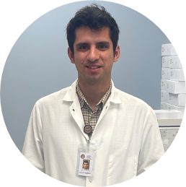

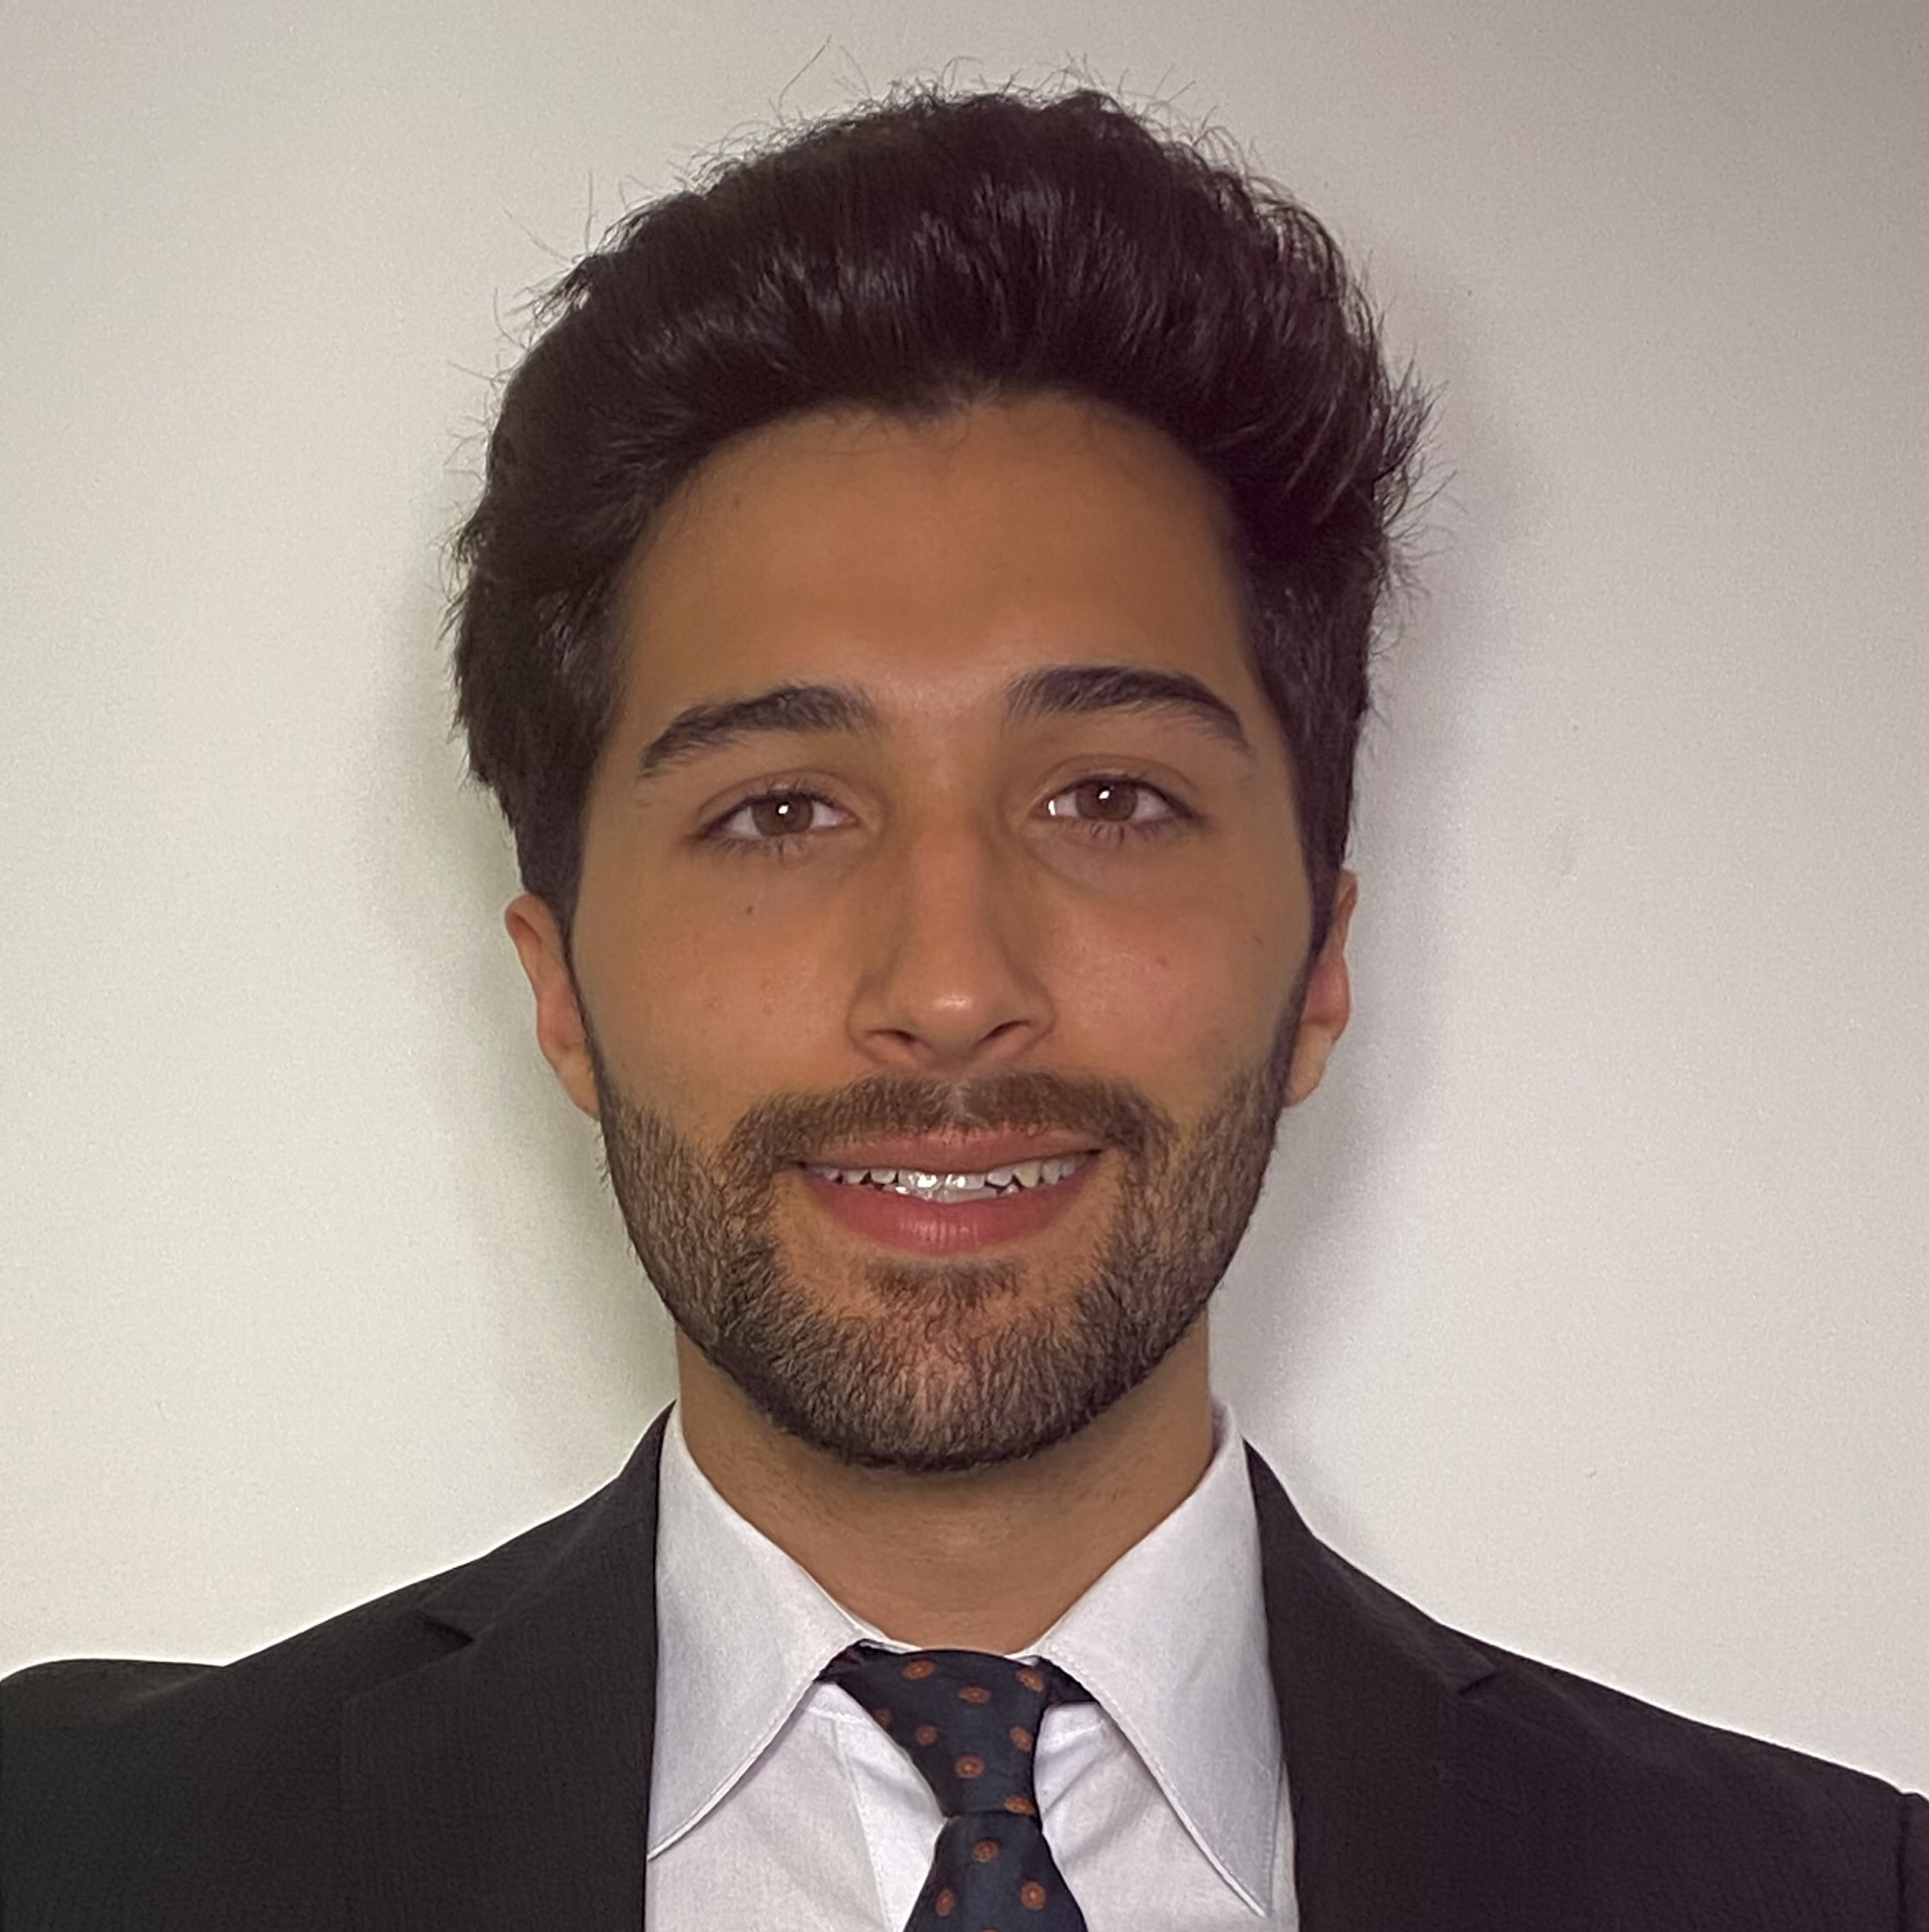
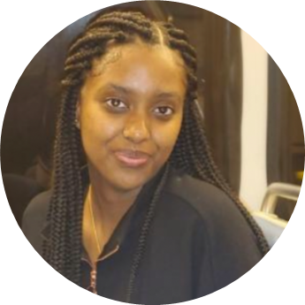
Former Fellows
Cullan Kirwan, BS
Colorado Department of Health and Environment Newborn Screening
Validating X-linked adrenoleukodystrophy for mass spectroscopy
Paul Millet, MS
Texas Department of State Health Services
Improving Biotinidase Deficiency Screen and Preparing for Screening of MPS
Erika Ruskie, BS
North Carolina State Laboratory of Public Health
Develop a multiplex second-tier genetic screen using LC-MS/MS
Joseph Chavez, MPH
Virginia Department of Consolidated Laboratory Services
Implementing and validating a custom next-generation sequencing (NGS) assay that will target all mutations to the CFTR gene listed in the CFTR2 database
Sarah Solomon, BS
California Department of Public Health
Develop Next-generation sequencing protocol to reduce false positives and false negatives for Spinal Muscular Atrophy

Slide 33

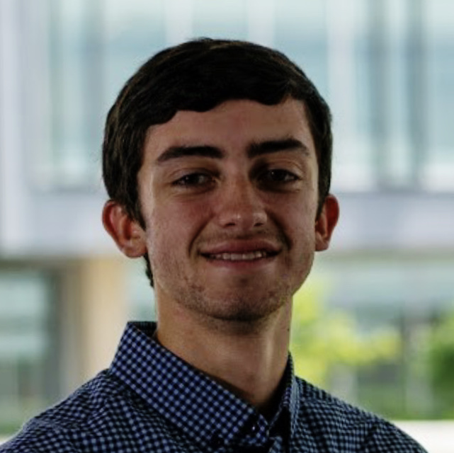

Current Fellows
Marie-Line Kam, MS
New Jersey Department of Health
Develop an improved screening algorithm for cystic fibrosis and determine the efficacy of switching over to the Illumina 139 panel
Dylan Hendricks, MPH
Illinois Department of Public Health
Implement and Validate a Next Generation sequencing (NGS) assay for Cystic Fibrosis (CF)
Daniel Fang, BS
Alabama Department of Public Health Bureau of Clinical Laboratories
Performing a verification study of the laboratories new QSight 225MD Mass Spectrometer using the NeoBase 2 kit

Slide 34



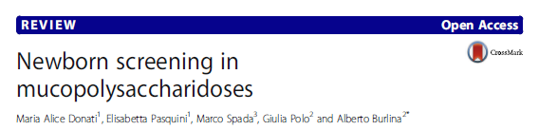
Journal Club

Slide 35
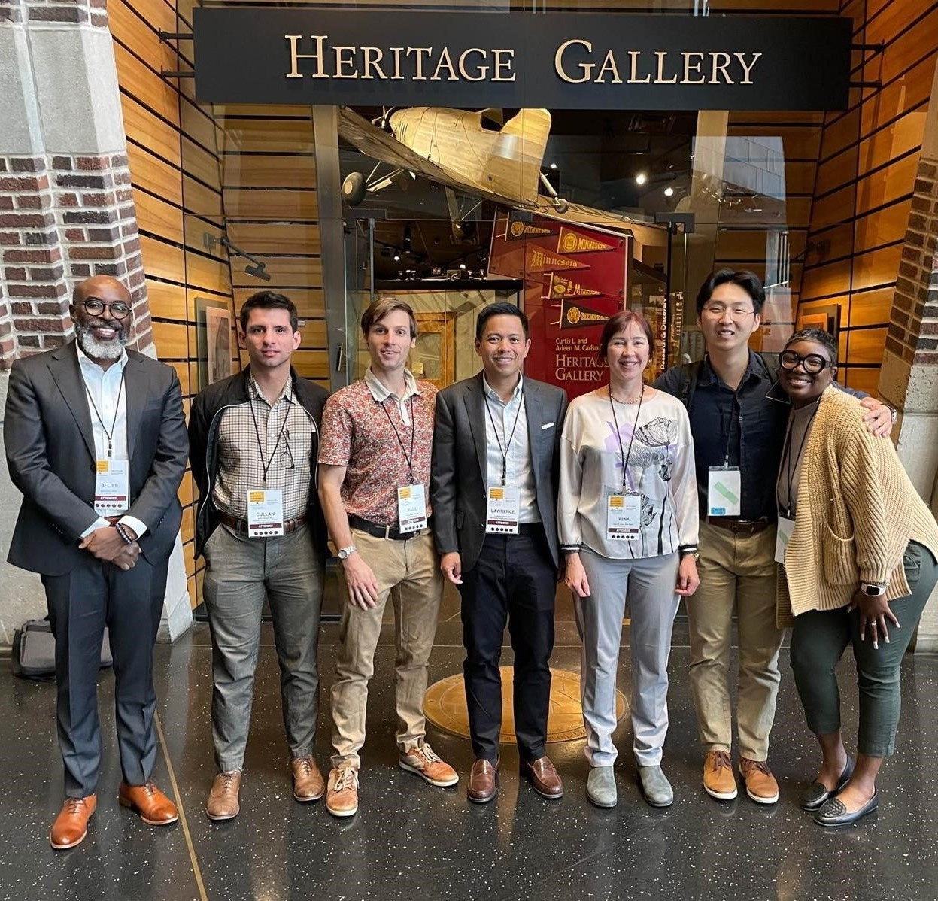
Professional Development Opportunities
APHL Newborn Screening Symposium
Continuous Quality Improvement National Meeting
Mucopolysaccharidosis Newborn Screening Meeting
International Conference on Newborn Sequencing

Slide 36
M. Christine Dorley, PhD
Division Director, Tennessee Department of Health
Notes:
Revisit Design

Slide 37
A Host Lab: What’s in it for you?
Tennessee’s NBS Fellowship Experience
M. Christine Dorley, NBS & ENV Division Director, March 5, 2024

Slide 38

Started with an IDEA
Supervisor had an idea shared with TN Follow-up Team
ACHDNC recommendations for timeliness
Monthly reports sent to birthing facilities
Wanted something that could supplement reports
User friendly
Discussed with the team - Bioinformatics project

Slide 39

What made us apply?
Limited Resources
State Informatics
Stretched thin
Get in line
$$$$
Could any of us develop it? Maybe uh NO!
APHL Fellowship to the rescue

Slide 40

What we wanted out of the fellowship?
Bioinformatics Project
Create an External Dashboard
Capture hospital trends
Unsatisfactory collections
Birth to collection
Transit time
Allow user hospital comparisons
Based on # of births/size of hospital
Regional comparisons
Comparison to State of TN baseline
Capture Laboratory Reporting Trends
Day of Life 5 for time critical PP
Day of Life 7 for time sensitive and all NBS tests
This Photo by Unknown Author is licensed under CC BY-SA-NC

Slide 41
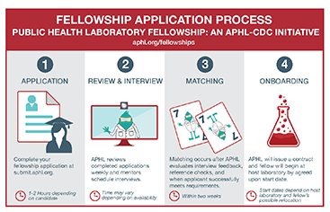
Application process
Applied for the NBS Bioinformatics and Data Analytics Fellowship
Easy to become a Host Lab
Descriptively outline your project
Detail expectations
Timelines for completion
Process is even easier now
$10K in reimbursement costs
After approval
Review & interview candidates
Match
Fellow begins – Ours started July 2021

Slide 42
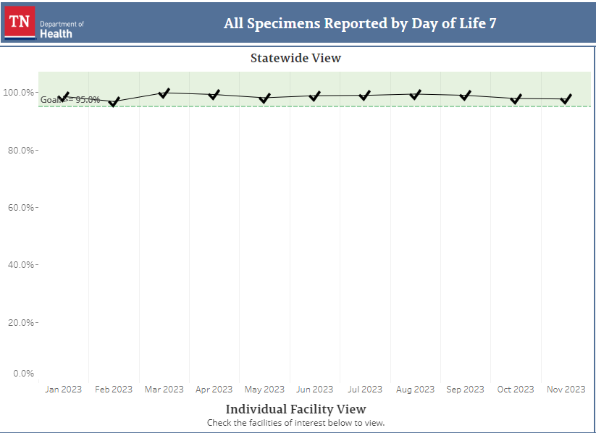
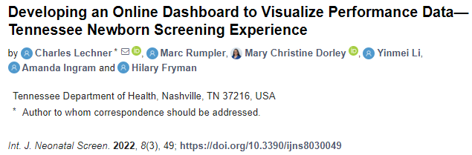
Fellowship benefits
Our project was successful
External and Internal dashboards created
Birthing centers love the dashboard
Able to customize their reports and print
Lab and follow up love it
Easy to track trends
Presentations and publication

Slide 43
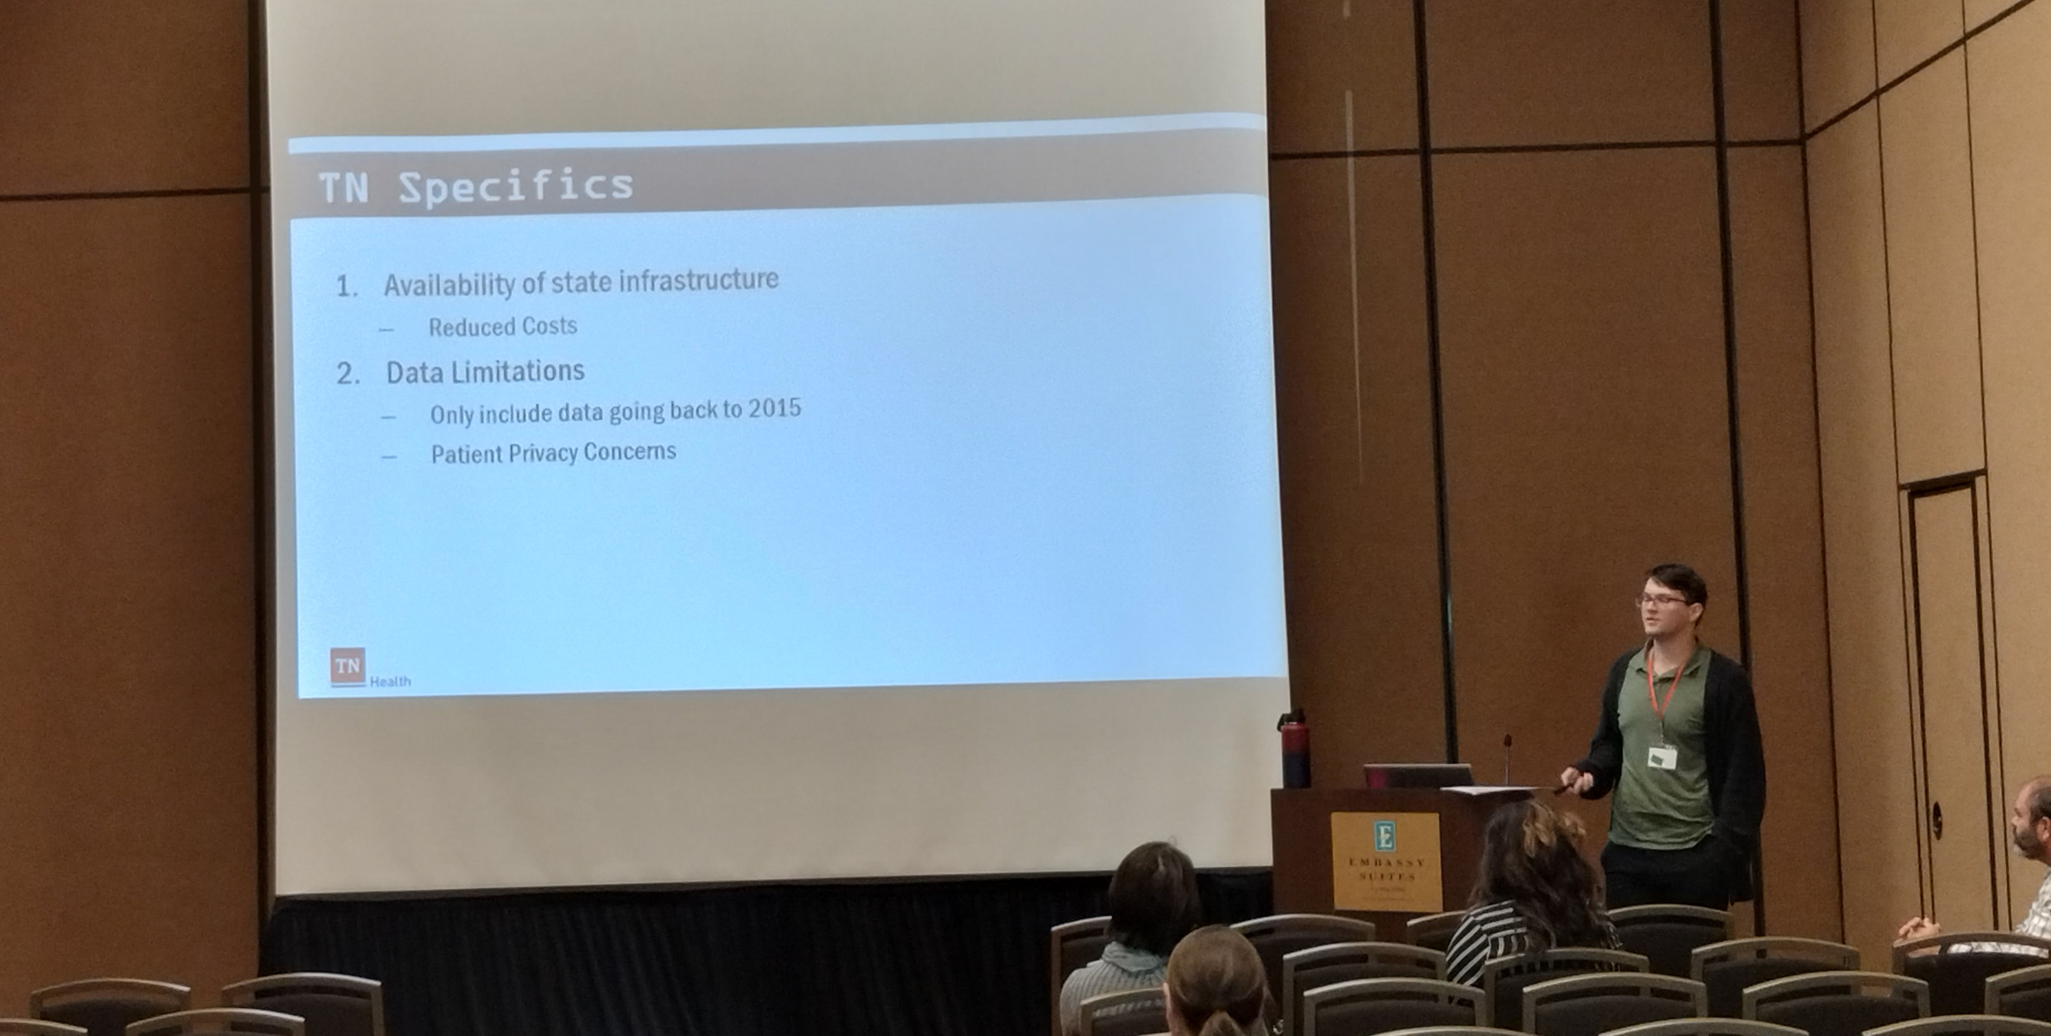
Conclusion
Rewarding experience for us all
Team of mentors: Amanda Ingram, Dr. Yinmei Li, Dr. Marc Rumpler and me
Our fellow was driven
Have a great employee that is doing great things!!!!

Slide 44
Charles Lechner, MS
former APHL NBS Bioinformatics and Data Analytics Fellow
Notes:
Revisit Design

Slide 45

Questions?
Please unmute your lines or use the chat box to comment or ask questions.

Slide 46
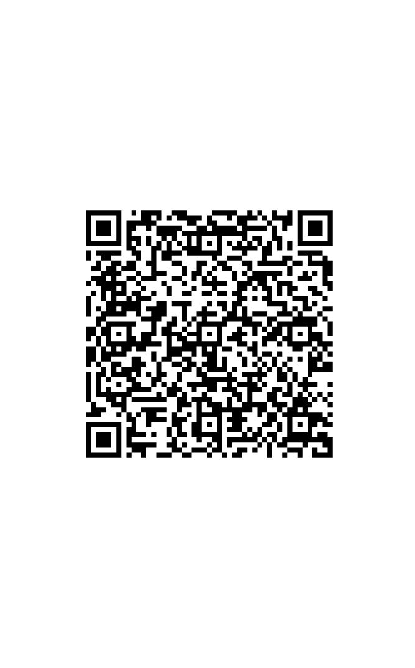
Share your feedback
Please let us know what other topics you would like us to consider for future webinars!

Slide 47
Thank you!
Notes:
Add photo/options

