Slide 1
Vital Statistic Sharing in Minnesota
Newborn Screening: Heather Brand and Kristen Bye
Office of Vital Records: Neeti Sethi

Slide 2

How it Started

Slide 3
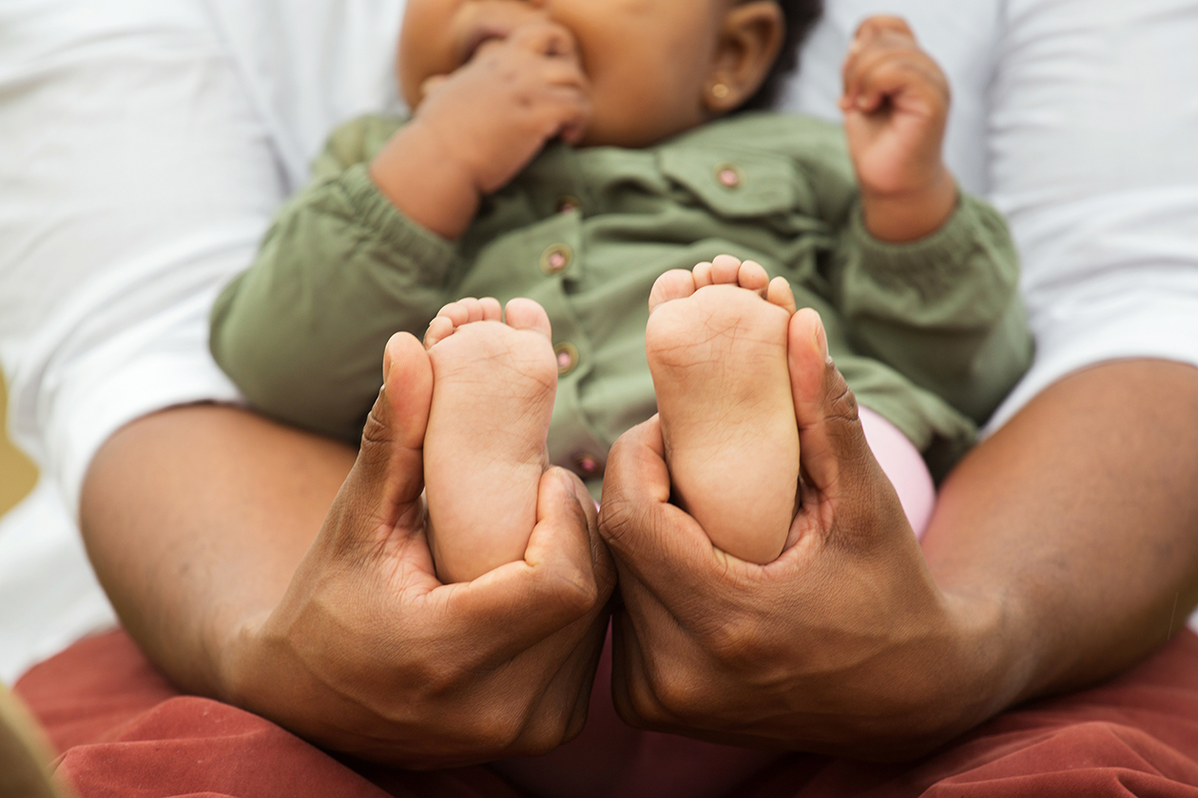
How it Started
“How many children in Minnesota have been screened?”

Slide 4
How it Started
Elevator pitches really work!
Data sharing from OVR to NBS begins in 2004 for MN
IDUA: Internal Data Use Authorization *Reviewed, updated every 3 years

Slide 5
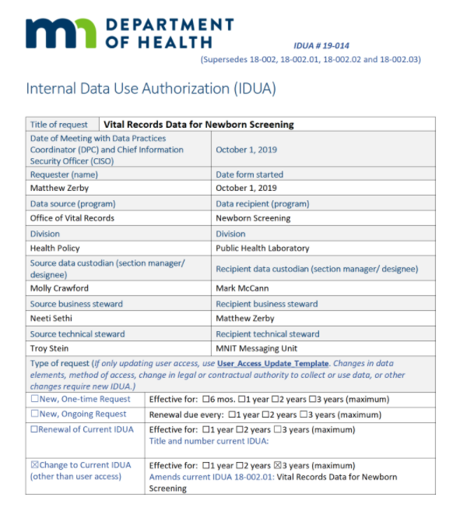
Internal Data Use Authorization (IDUA)
Required for private and confidential vital event data
Agency developed a standard template for IDUA’s
IDUA is reviewed and updated every 3 years
Separate process for adding/removing users whose work relies on OVR data
Paperless workflow via SharePoint

Slide 6

Office of Vital Records

Slide 7
Births in Minnesota
MN Births
Approximately 70,000 live births annually
98% of deliveries are at a facility attended by a medical professional
Registration
State law requirements
Data Classification
Classification varies for birth records & birth data
Health Data: pregnancy, delivery, newborn is private
Demographic/legal data
Confidential if the birth is to an unmarried mother
Public if the parents are married
Births are to be registered within 5 days of the event
Delayed Birth Registration requires OVR review

Slide 8
MN Birth Data and Registration
What
MN uses the standard U.S. Birth Certificate data elements established by the CDC National Center for Health Statistics (latest revision 2003) with a few state-specific data items
MN vital records collects several different data items related to the parents, newborn, pregnancy, and delivery
Who
The woman who gives birth (mother) completes a “worksheet” at the hospital for demographic and legal information
Hospital birth registrars collect health data from medical records for the mother and newborn
How
Hospital birth registrars enter the data into the electronic birth registration system 24/7
Birth records are “filed”, assigned a number, and available immediately after the data entry is finalized
The midwife or parent registering the birth occurring outside of a birthing facility must contact OVR
Home births unattended by a health professional are filed by OVR

Slide 9
MN Death Data and Registration
MN Deaths
About 45,000 deaths annually
Registration
State law requires fact of death be registered within five days of the event
Classification
Data classification for mortality records is public
Approximately 260 infant deaths annually
Cause of death on non-natural deaths could take up to six months to finalize
Vital records staff monitor death records and follow-up with funeral homes and certifiers

Slide 10
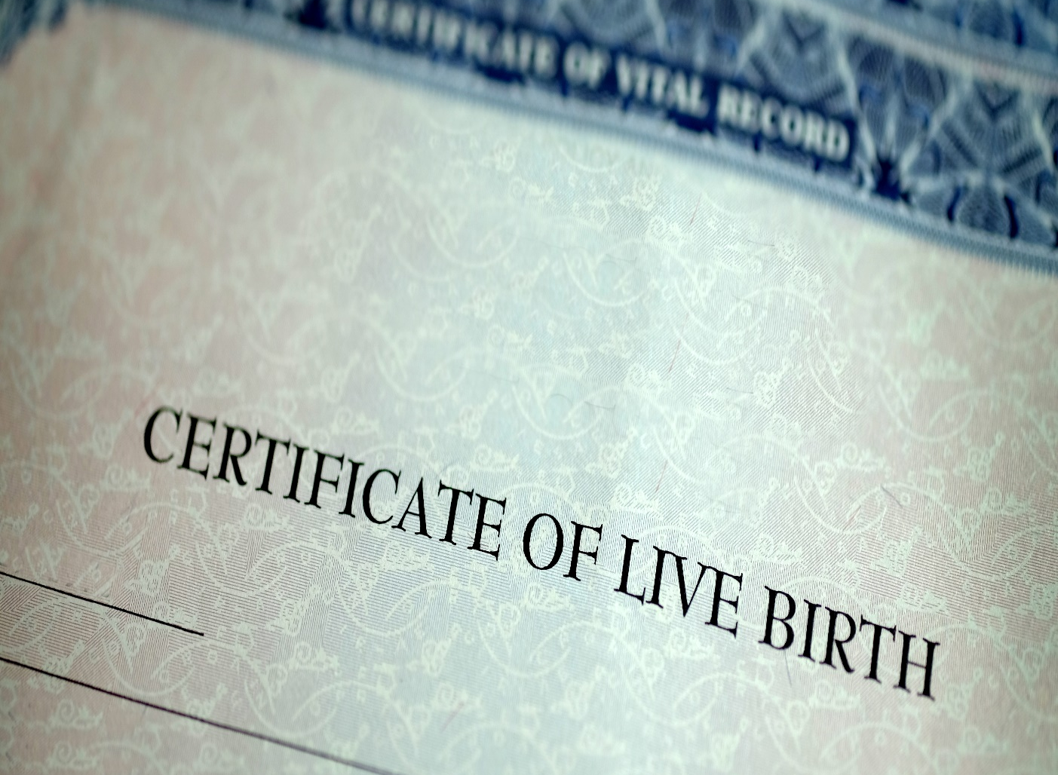
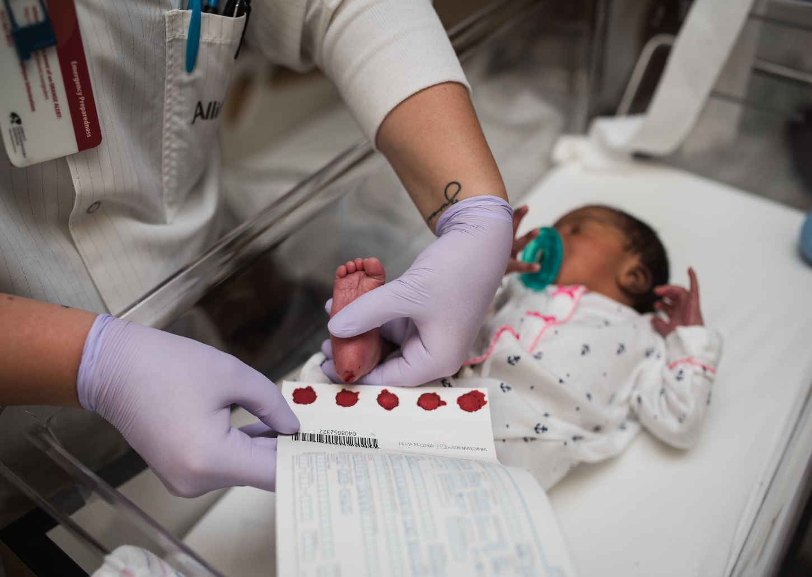
Birth Certificates and Blood Spot Specimens

Slide 11
Matching Birth Certificates to Blood Spot Specimens
Why Do we Match?
To ensure every baby born in MN has newborn screening completed or document a family’s refusal of screening
When & What Do We Get?
MN has been matching birth certificates to blood spot specimens since 2004
How Do We Get It?
A .csv file is sent from OVR to the MDH Data Exchange Monday – Friday.
The MDH Data Exchange sends the file to our LIMS vendor, Natus Medical Inc.
We request 86 data fields per vital record for blood spot specimens
Notes:
Data fields: race can be more than 1 field.

Slide 12
Blood Spot Matching Process
File Uploaded (Monday- Friday)
Automatic Match Upon Upload based on Infant DOB, Time of Birth, Mother’s Last Name and Mother’s First Name
Possible Outcomes
Match is found: data available on the vital record tab of patient record.
No Match Found
Select/de-select matching criteria to find possible matches.
Case Created: actions are mapped for follow-up
Match is not found: goes in the un-matched log

Slide 13
Creating a Case From the OVR Record
Allows for notifications of missing specimen to the birth facility or midwife based on information provided on the birth certificate. Transfer Facility also listed.
Specimen may be lost in transit, not yet collected (missed).
Complete actions/close case: infant expired before collection, family refused screening, screening done elsewhere.

Slide 14
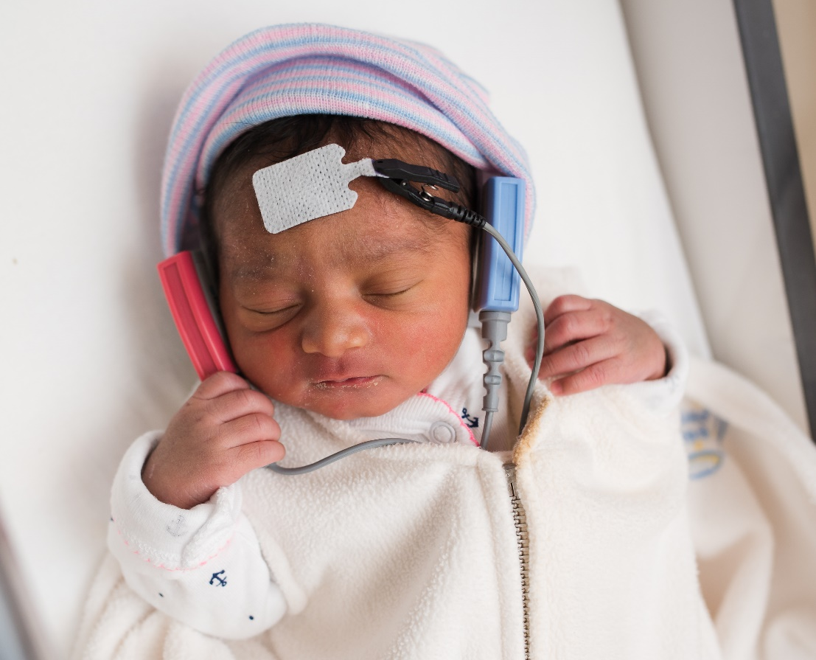
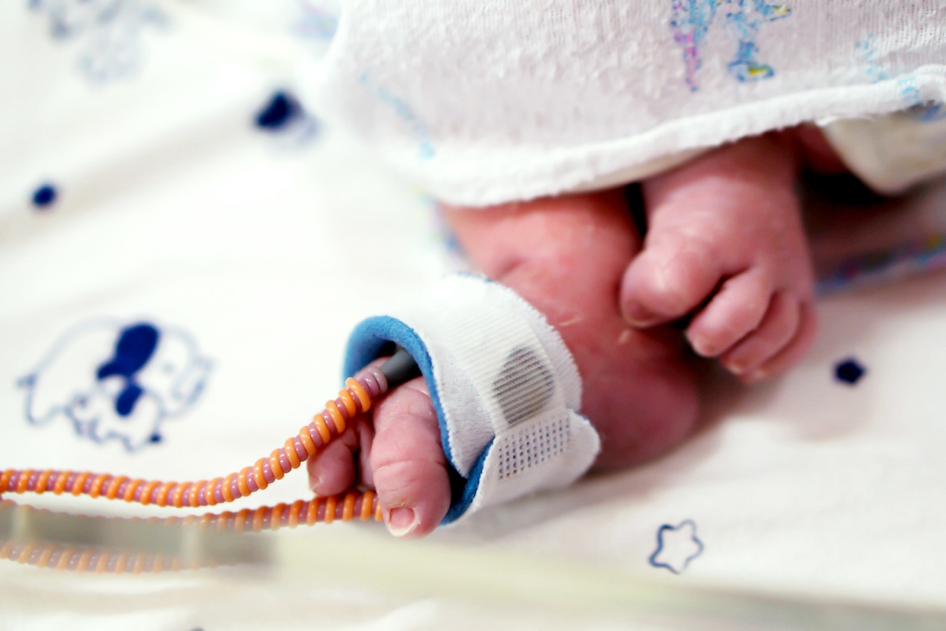
Birth Certificates to Hearing & CCHD System

Slide 15
Comprehensive matching follows an established path
OVR sends file
MN.IT
LIMS
Auto-matches
Manual Match
Daily file (.csv format) is sent via automated transmission process
MN IT services internal data exchange receives file and routes directly to LIMS
OZ Systems (Third Party Vendor) processes via Vital Records Module
OVR data automatically matched to patients using specific matching criteria
Remaining records that were not auto-matched are manually reviewed and matched
START

Slide 16
Successful matches require five criteria
Date of Birth
Mother’s First Name
Time of Birth
Mother’s Last Name
Gender

Slide 17
We request 146 data fields from OVR
CONGENITAL ANOMALIES
Includes hearing risk factors that support CDC reporting efforts
RACE/ETHNICITY
Allows for desegregation of data down to specific populations and equity related analyses
BIRTH ATTENDANT
Provides information for births occurring outside of hospitals
DECEASED STATUS
Surfaces knowledge of infant deceased status

Slide 18

How it’s Going

Slide 19
Connecting with OVR Provides Long-term Value to NBS
COMPREHENSIVE DATA
ANALYTICS SUPPORT
OPERATIONAL EFFICIENCY
MUTUALLY BENEFICIAL
Ensures every baby born in MN has either been screened or has a refusal form from their family
Provides data elements needed for annual CDC data reporting (e.g. annual iEHDI data submission)
OVR includes birth certificate ID, which allows bridging patient records across multiple NBS systems
Enables OVR to verify their records against NBS data

Slide 20
Connecting with OVR Provides Long-term Value to NBS
SUPPORTS FOLLOW-UP ACTIVITIES
ANALYTICS SUPPORT
COMMUNICATION
ACCURATE DATA
Provides data elements needed for testing analysis that may have been left blank or is not requested on the specimen card.
Allows the Genetic Counselors to have the baby’s legal name for notification to primary care providers.
Aides NBS Staff to make data entry corrections before a result report is generated.
Assists both short-term and long-term follow-up staff in their quest to help affected babies.

Slide 21
Teamwork Makes the Dream Work
Parents & Families
Office of Vital Records (OVR)
Hospital Birth Registrar
Newborn Screening (NBS) Business Operations
Legal Support
Minnesota IT (MN.IT)
Laboratory Information Management Systems (LIMS)
Follow-Up

Slide 22
Thank you to:
APHL & NAPHSIS
Natus Medical Inc.
OZ Systems
MDH Data Exchange & MNIT
MN Newborn Screening Staff
MN Office of Vital Records
Newborn Screening: Heather Brand: heather.brand@state.mn.us
Kristen Bye: kristen.k.bye@state.mn.us
Office of Vital Records: Neeti Sethi: neeti.sethi@state.mn.us

