Slide 1
Overview
Gerrit Bakker, Senior Director Public Health Preparedness
Association of State and Territorial Health Officials

Slide 2
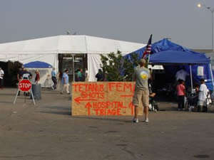
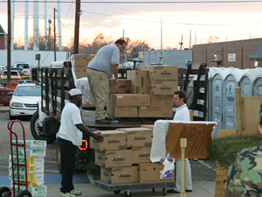
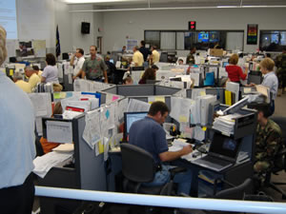

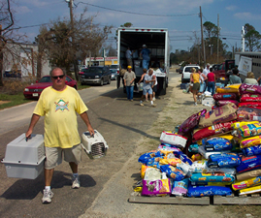
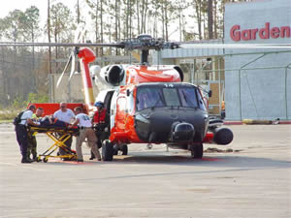
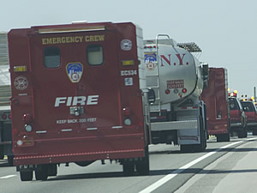
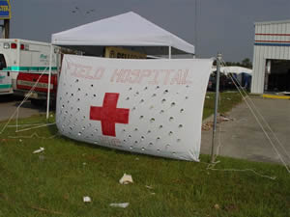

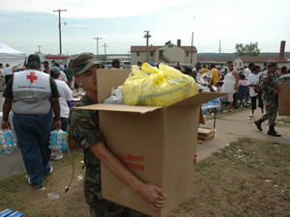
What is EMAC?
The Emergency Management Assistance Compact (EMAC), is a state-to-state mutual aid compact that facilitates the sharing of services, personnel and equipment across state lines during times of disaster and emergency.
Notes:
EMAC is a nationally adopted mutual aid agreement that establishes a national system to facilitate the sharing of state and local government publicly-owned resources across state lines during times of emergency or disaster as long as there is a State of Emergency declared by the governor of the affected EMAC Member State.

Slide 3
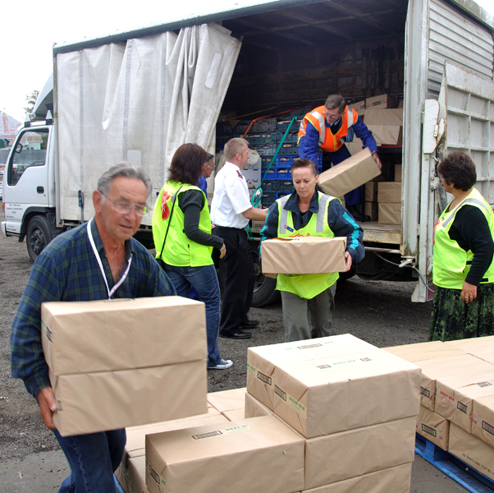
How Can You Use EMAC?
National Guard
  Title 32
  State Active Duty
Transfer of Services
(newborn blood screening)
Medical
Public Health
EMS
Law Enforcement
Incident Management
Communications
(transfer of 911 calls, deployment of 911 operators, or equipment)
Commodities
Search & Rescue
Public Works
Water/Wastewater personnel/equipment
EOC Support
Public/Individual Assistance
Debris Management
Donations Management
Human Services
Sheltering
And More…
Any Resource/Capability Can Be Deployed
Notes:
You can request resources, commodities, and services under EMAC.
If you need it, ask – chances are – another state will have that resource.

Slide 4

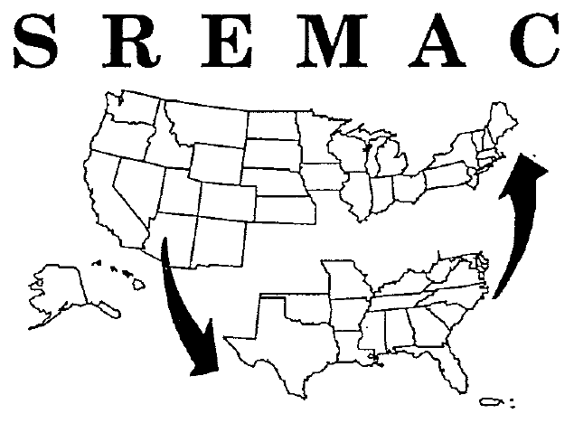
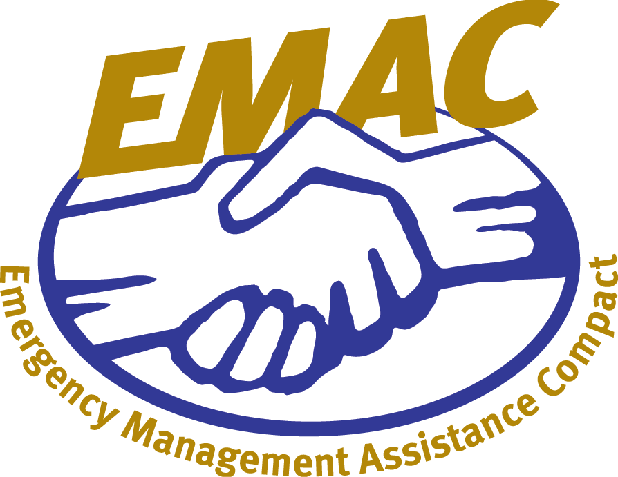

EMAC’s Origins
SREMAC
adopted by
Southern Governors’ Association
SREMAC becomes EMAC
System used for the first time
NEMA becomes EMAC administrator
Ratified by U.S. Congress
and signed into law
1993
1995
1996
Notes:
Now that we understand the legal basis of EMAC, let’s look at how the Compact started and how it has changed over time.
In 1992, after Hurricane Andrew, Governor Chiles wanted to find a way where states surrounding Florida could help them should they be impacted by disaster again.
Governor Chiles called upon Georgia, Virginia, and North Carolina for help.
Response exposed the need to create a permanent legal mutual aid agreement between states at risk from major hurricanes.
Thus the process began between the 17 states comprising the Southern Governors Association (SGA) who established SREMAC – or the Southern Regional Emergency Management Assistance Compact
In 1995, SREMAC was broadened to any state or US territory who would want to join.
In 1996, EMAC was ratified by the US Congress and signed into law.
Everything is going along just fine between 1996 and 2003.

Slide 5
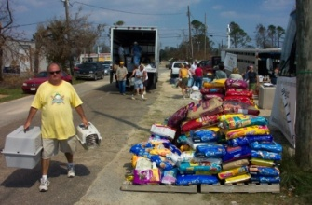
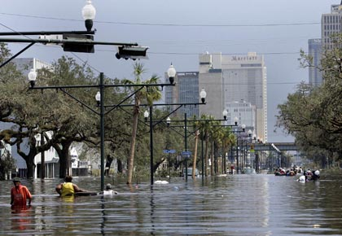
How EMAC Has Evolved
Multi-Discipline Resources Deploy Under EMAC
Hurricanes Katrina, Rita, Wilma
67,000 personnel deployed
2004
2005
Notes:
What happened in 2004 forever changed the face of EMAC.
2004: Multidiscipline personnel were deployed for 1st time during Hurricanes Bonnie, Charley, Floyd, and in FL. Craig Fugate, then the State Emergency Management Director of Florida realized that they needed additional help in fire, law enforcement, medical, EMS, and other areas. He read the EMAC law and saw that it was very broad, allowing for any resource one state would want to share with another to deploy under the Compact.
It was just a year later when the gulf coast was hit by Katrina.
Why is that a big deal?
How can non-state resources deploy under EMAC?
39 of the 54 EMAC member states have intrastate mutual aid agreements that seamlessly allows non-state personnel to deploy under EMAC. Many of the other states use agreements – where they sign once and make that asset deployable under EMAC.
2005: Hurricane Katrina and Rita resulted in the largest deployment in mutual aid history (over 76,000 at an estimated cost in excess of $865 million)

Slide 6
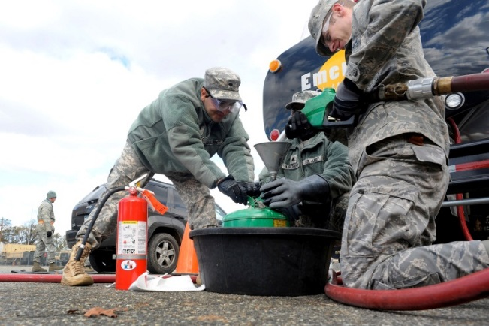

How EMAC Has Evolved
Hurricane Irene
1123 personnel deployed
Hurricane Sandy
2633 personnel deployed
2011
2012
Notes:
What happened in 2004 forever changed the face of EMAC.
2004: Multidiscipline personnel were deployed for 1st time during Hurricanes Bonnie, Charley, Floyd, and in FL. Craig Fugate, then the State Emergency Management Director of Florida realized that they needed additional help in fire, law enforcement, medical, EMS, and other areas. He read the EMAC law and saw that it was very broad, allowing for any resource one state would want to share with another to deploy under the Compact.
It was just a year later when the gulf coast was hit by Katrina.
Why is that a big deal?
How can non-state resources deploy under EMAC?
39 of the 54 EMAC member states have intrastate mutual aid agreements that seamlessly allows non-state personnel to deploy under EMAC. Many of the other states use agreements – where they sign once and make that asset deployable under EMAC.
2005: Hurricane Katrina and Rita resulted in the largest deployment in mutual aid history (over 76,000 at an estimated cost in excess of $865 million)
Public Health has more recently become a more prominent member of the EMAC community, developing Mission Ready Packages, different types of deployments and greater situational awareness.

Slide 7





EMAC Membership
All 50 United States
District of Columbia
U.S. Virgin Islands
Puerto Rico
Guam
Notes:
During Katrina, California, the only state of the 50 that had not yet joined EMAC passed EMAC into law.
EMAC has been signed into law by all 50 states, the District of Columbia, the Commonwealth of Puerto Rico, the U. S. Virgin Islands, and Guam.

Slide 8

The EMAC Process
PRE-EVENT PREPARATION
ACTIVATION
5 Phases of the EMAC Process
REQUEST & OFFER
MOBILIZATION, RESPONSE, & DEMOBILIZATION
REIMBURSEMENT
Notes:
We’re going to look at the EMAC process in 5 phases.
Has anyone in this room been on an EMAC deployment?

Slide 9
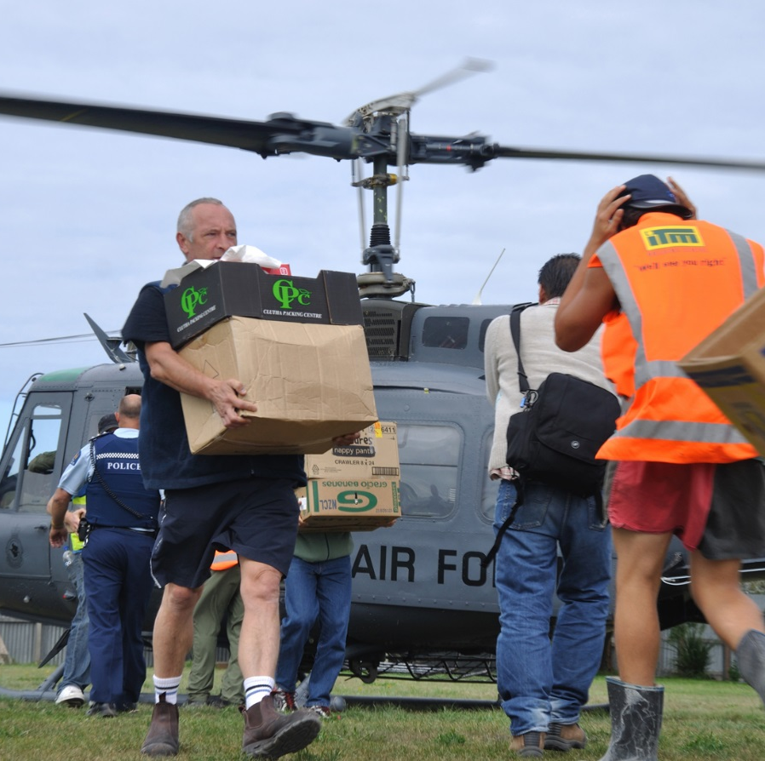
What Is Mission Ready Packaging?
Specific response and recovery capabilities organized, developed, trained, and exercised prior to an emergency or disaster.
MRPs are based on—and the next logical step after—NIMS Resource Typing. The NIMS resource typed equipment are part of the Mission Ready Package.
You do not have to be NIMS resource typed to Mission Ready Package
MRPs are developed by Resource Owners/Providers and coordinated with state EMAs.
Reducing the time from request to mission deployment means knowing what you have and the costs associated with that mission.

Slide 10
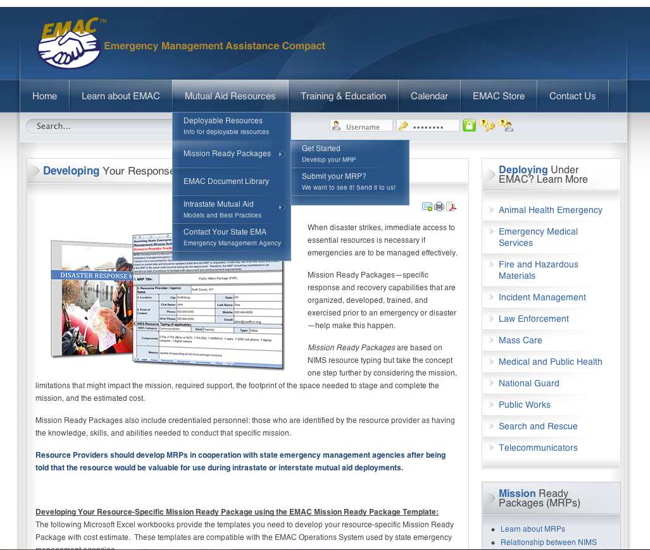
www.emacweb.org
Notes:
Want to learn more about Mission Ready Packages or develop your own?
Go to the Mutual Aid Resources tab on the EMAC website, scroll down to Mission Ready Packages. Over on the right hand side of the page, you will see links to all of the specific disciplines. If you go to those tabs, you will be able to see models for packages. The models identify the types of things you need to think about such as equipment, commodities, personnel to help you develop your own response specific mission ready package.

Slide 11
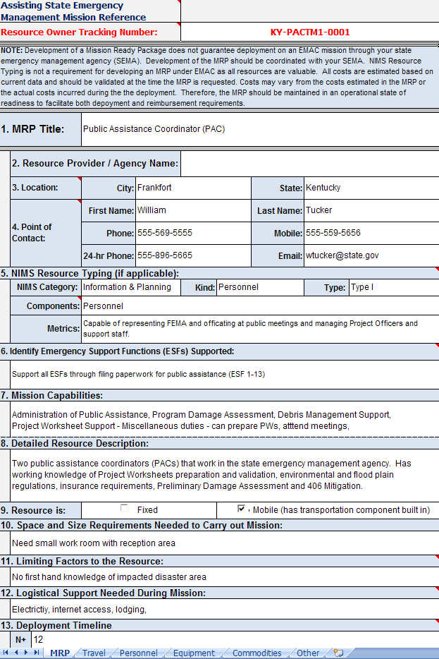
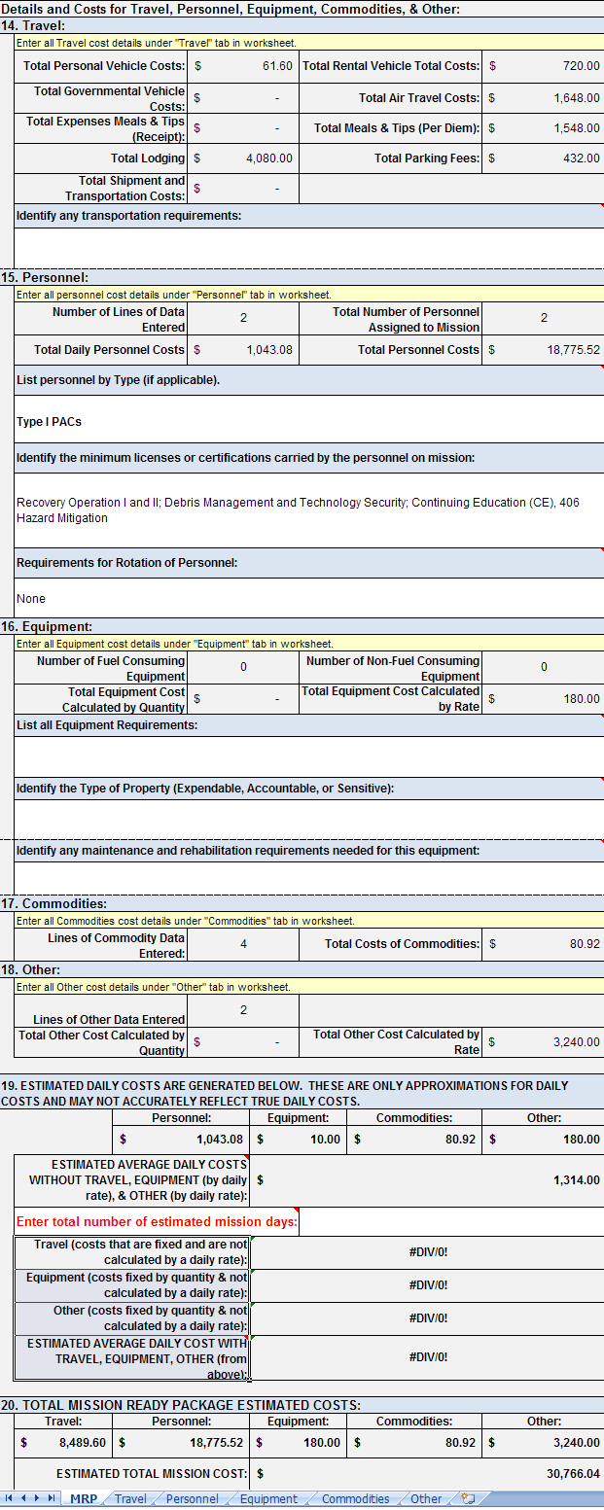
The MRP Worksheet
Notes:
To develop your own MRP, you can download the Excel worksheet and fill it in with all of your information.
has been created as an Excel workbook file and contains 20 “fields” of information
Cost-estimation forms are integrated into the workbook.

Slide 12
EMAC Can be Utilized for
Natural or Man-Made Disasters
local incident
Local resources exhausted
Escalated intrastate response:
local may make intrastate mutual aid request
(depends on state process)
City
County
State
Federal
Private Sector
Volunteer
Intrastate
Other
EMAC
Determine
Resource
Source
Resource Request to State Emergency Management Agency
If EMAC-enters the EMAC Request and Offer Process

Slide 13
(slide from an earlier EMAC presentation showing the request/offer, response, reimbursement process)
EMAC does not “own” resources.
It is the system to move the resources.
Requesting State
Assisting State
EMAC Request/Offer
State Emergency Management Agency
State Emergency Management Agency
Response
Resource Provider: Agency, Department, Local, County, City etc.
Reimbursement
Process
Resource Provider: Agency, Department, Local, County, City etc.
Notes:
Next week, June 25, 2008 EMAC will pilot the first multi-discipline training education course that provides an in-dept understand of EMAC. The course will be taught by the recently hired full time EMAC Training Coordinator. This course will also be delivered as a Train-the-Trainer at EMI (EMAC-430) so response and recovery disciplines can teach about successful EMAC implementation to their organizations.

Slide 14

MASS: Mutual Aid Support System
    MASS is software code that focuses on Mission Ready Packaging
    MASS can talk to your existing resource management software
    MASS pulls your current resource inventory and adds the Mission Ready Packaging fields
    Export a spreadsheet (XML) from MASS that you can upload directly into the offer section of the EMAC Operations System
    You control the data view and who can see
    your resource inventory.
Notes:
What is MASS?
The mutual aid support system focuses on mission ready packaging
MASS can talk to your existing resource management system
MASS pulls your current resource inventory and adds the Mission Ready Packaging fields
Export a spreadsheet (XML) from MASS that you can upload directly into the offer section of the EMAC Operations System
You control the data view and who can see your resource inventory

Slide 15

Training: Understanding & Implementing EMAC
Taught at the FEMA Emergency Management Institute (EMI)
    E431
    Covers all phases of EMAC
    Includes exercise component on Mission Ready Packages
    Completion earns 2.4 CEU credits
Online version of this course on the EMAC website: www.emacweb.org

Slide 16

acopple@csg.org
www.emacweb.org
www.facebook.com/emacweb
http://www.twitter.com/nema_web
Angela Copple
EMAC Program Director

