Slide 1


SPR Abstracts 1995

Slide 2
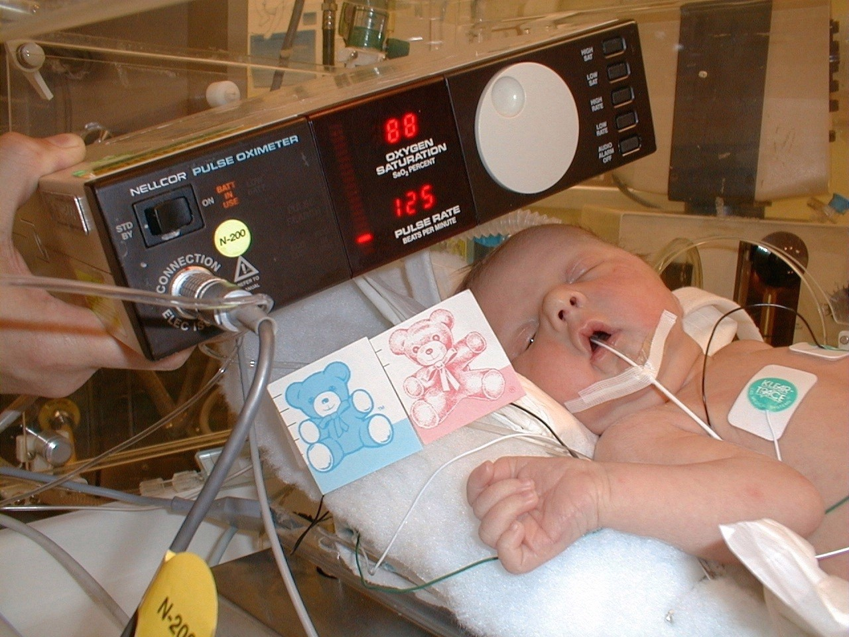

Slide 3



