Slide 1

Newborn $creening
(Budgets and Economics)
Leann Christensen, Fiscal Specialist
John D. Thompson, Director – Newborn Screening Program
Washington State Department of Health

Slide 2
Objectives
Current revenue and expenditures
Tools to assess costs
Look to reallocate money
  Timeliness activities
  Increase staff capacity
Caveat: WA experience – limited, but hopefully helpful

Slide 3
NBS Budget

Slide 4



Budgeting Basics
Notes:
2 major aspects of budgets

Slide 5







Revenue Sources
Notes:
Fee for service
Grants
State funds
Agency funds
Private foundations
Federal funds
Donations from community –some can be restricted to a certain item, some are for general use as see fit

Slide 6
Notes:
12% of dedicated is GFS

Slide 7
Notes:
On the contrary, here is how the NBS is funded.
Of the 98% local, 81% is fees

Slide 8

Newborn Screening Fee
$92.60 per baby*
$84.20 – NBS
$8.40 – Clinic Subsidy
Notes:
Two screen state that charges for 1st screen only (so we are charging per baby)– CLICK – cost is $92.60/baby
CLICK, CLICK
This charge just started 3/1, it was $84.50 ($76.10 NBS and $8.40 Clin Sub)

Slide 9
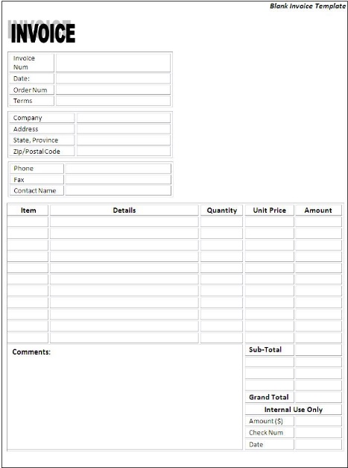



Billing
Facility Billing
96.25% of births
Access program to create invoices that are sent to hospitals/clinics
8-10 hours/month
Private Insurance Billing
3.75% of births
Collect insurance info
Third party biller submits claims because we do not have that expertise
16-20 hours/month
Notes:
Facility Billing = 96.25% Private Insurance

Slide 10

Private Insurance Billing Tip
WA State Health Care Authority is mandating Managed Care Organizations to contract with NBS!
    50% of WA births are on a Medicaid Plan
    Without this in place, we made $55,000 during the second half of 2017

Slide 11
Projected NBS Fee Revenue
Notes:
We use a biennium budget (2 year)
Projected by combination of research and internal knowledge
Our research is gathered from the Governer’s budget office – the state predicts the number of births each yr so we use their data
We do not use out of hospital births in our projections
EXCEL SPREADSHEET – Let’s take a look at the NBS fee budget

Slide 12
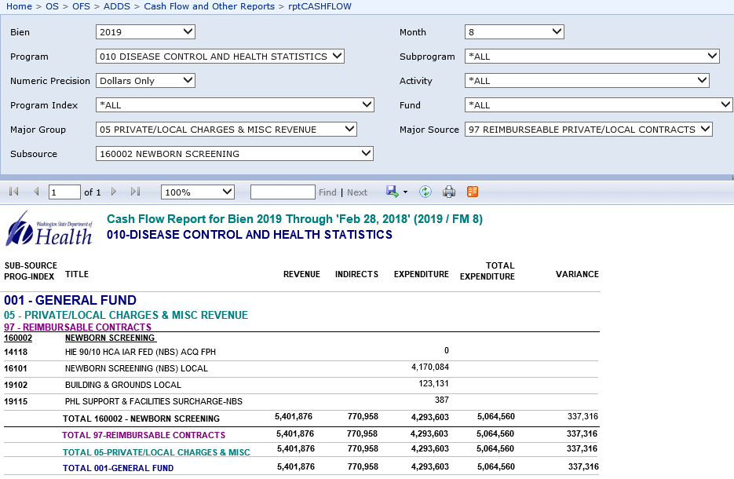

Slide 13
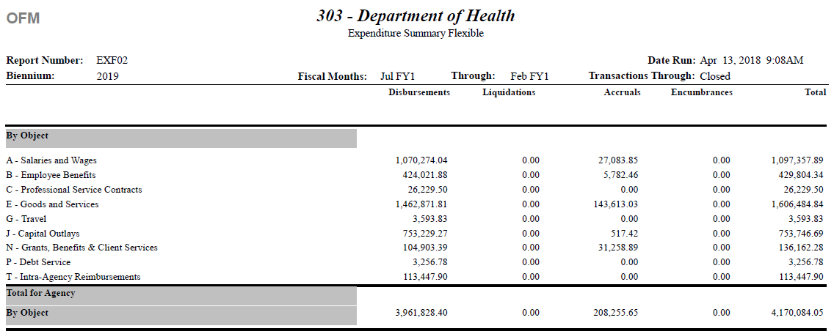

Slide 14
$aving Money by Reducing ¢osts

Slide 15

WA NBS Budget Team
Office Director
NBS financial specialist
  Billing
  Contracts management
PHL budget analyst
  Budget support for five sections within Division
  Other misc. support

Slide 16

Econ 101
Sunk costs
  Money already spent – not working
    Keep sinking money into effort
    Cut losses
Opportunity costs
  What are we choosing not to do/fund?
Public goods
  Information on the internet (NewSTEPs 360 resources)
  Technical assistance

Slide 17

Value of Monthly Budget Reviews
Monthly budget reviews
  Keep a pulse on what’s happening
  Plan for
    COLAs/raises
    Long-term plans
  Good to have someone responsible for monitoring
    bankruptcy example

Slide 18

Strategies to Keep the Ship Floating
Forecasting
  Each year, costs increase
    Kits/reagents
    NBS collection cards
    Service contracts (LIMS, etc.)
  Take this into consideration when budgeting for a new test
    Five-year estimate on costs
    Estimate salaries on the high end - if turn-over, saves money
Prepare for a rainy day (i.e. birthrate lower than predicted, emergencies)

Slide 19

Ways to Save Money
Bundling
  Purchasing in bulk
  Maintenance contracts
  Service contracts – several year agreement (with possible out)
Expensive equipment
  Lease/purchase
  Reagent/rental
Multiplexing
Technology
  Robotics
  IT solutions

Slide 20
Ways to Save on Personnel Costs
Part-time help
Overtime options
Vacancies save money

Slide 21

Audit
Beware of
  “That’s how we’ve always done it.”
  “That’s how I was trained.”
Process improvement
Process elimination?
Takes an initial investment before returns
start coming
Value of fresh perspective

Slide 22

Free! (sort of)
Grant money
  Allows for work that wouldn’t otherwise get done
  Pays for work that would otherwise get done → frees up money for other things
Practicum/Internships
  Synergistic opportunities for progress
Training
  Microsoft academy/online resources
Donations

Slide 23

Getting More Money

Slide 24
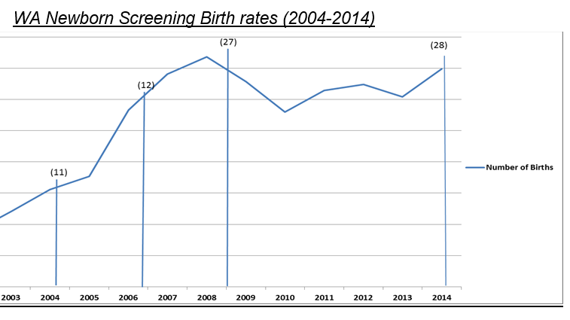
10 year cost analysis
Costs going up over time
Birthrates (9% increase)
Number of tests performed (145% increase)
Cost | increase
1. Avg. FTE salary & benefit | 42%
2. Facilities support cost/FTE | 69%
3. Key contractor costs | 44%
4. Postage | 15%
5. Equipment maintenance & repair | 200%
6. Supplies and reagents | 78%

Slide 25
Operational Fee Increase
Coordinated
  Internal – upper management support
  External – multidisciplinary NBS fee advisory board
Why?
  Personnel – people working out of class
  Aging instruments
  Operating funds to keep up with inflation
WRAP
  Workforce Resource Allocation Project

Slide 26
Budget Impact Analysis for Adding NBS for Pompe disease and MPS-I

Slide 27
New Test Costs
Instruments
Reagents and consumables
  Buffers, wash solutions, testing plates, pipette tips, etc.
Staff time
  Front-line lab technician
  Lead worker
  Follow-up staff
Indirects (23.7% - general agency support)

Slide 28
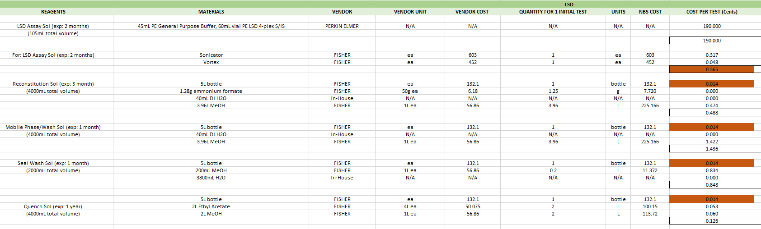
Calculating Cost/Test

Slide 29
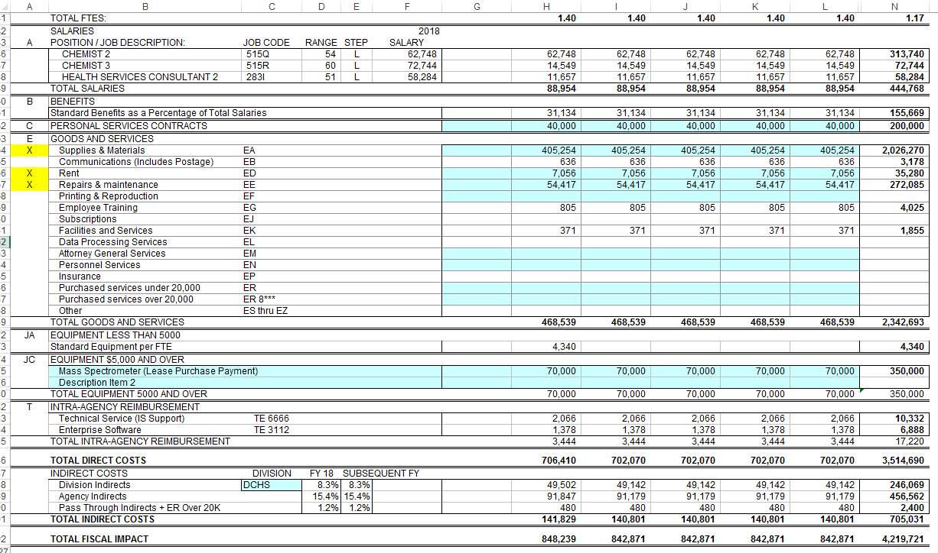
Financial Calculator
$848,239/90,000 = $9.42/baby

