Slide 1
National Newborn Screening Contingency Plan
NewSTEPs webinar
October 22, 2018
Kate Taft, Associate Director, Child & Adolescent Health
Association of Maternal & Child Health Programs

Slide 2
Newborn Screening & Contingency Planning
Nearly all infants born in the U.S. are screened by state NBS programs
Approx. 12,000 are diagnosed with detectable, treatable disorders
Early diagnosis and treatment can help manage or prevent severe (often lifelong) consequences
Contingency planning for an emergency helps to ensure the availability of critical resources, the continuity of operations and sets standards

Slide 3
Developing a National NBS Contingency Plan Framework
2004
APHL Subcommittee framework for PH labs
2005
Hurricanes Katrina & Rita destroyed LA’s PH Lab
2008
Newborn Screening Saves Lives Act of 2008
2008
CDC/HRSA Workshop
2010
CONPLAN plan published
2015–2016
CONPLAN Revision/Update Process
2017
CONPLAN Version II released

Slide 4
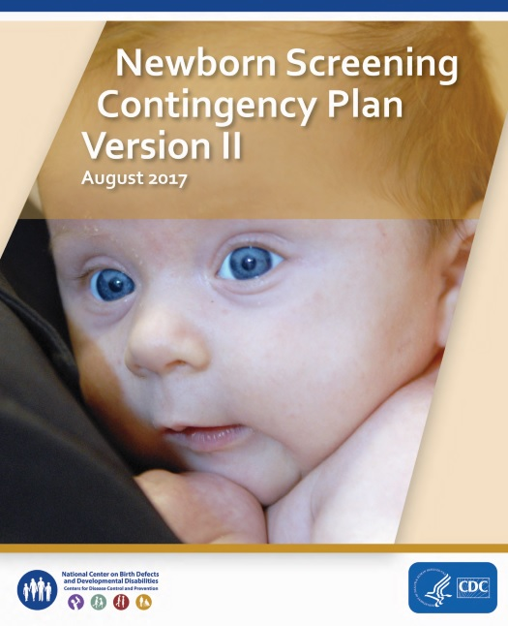
Purpose of the National NBS CONPLAN
Framework to facilitate collaboration among federal agencies and state, local, territorial, tribal, and regional efforts to screen newborns for identified conditions during a public health emergency.
Focused on areas for which the state public health agency assumes an oversight role.

Slide 5
Version II: Update Goals
In 2015, AMCHP partnered with CDC, HRSA, APHL, and expert stakeholders to update the national NBS CONPLAN.
Aims were to:
  Addressing gaps in laboratory, clinical and long-term follow-up;
  Add point-of-care screenings for hearing and critical congenital heart defects
  Include a stronger emphasis on family engagement.
  Acknowledgement: Funded through a subgrant form the March of Dimes Foundation through grant 5U38OT000199-03 from the CDC.

Slide 6
Advisory Committee Members:
Ginnie Abarbanell, MD
Laura Aird, MS
Hans Andersson, MD, FACMG
Gerrit Bakker, B
Stanton Berberich, PhD S
Mary Castro Summers
Tiffany Colarusso, MD, MPH
Pamela Costa, MA
Carla Cuthbert, PhD, FCCMG, FACMG
Sara Denniston
Stephanie Dulin, MBA
Eric Dziuban, MD
Janet Farrell
Lacy Fehrenbach, MPH, CPH
Cori Floyd
Jessica Franks, MPH
Debra Freedenberg, MD, PhD
Marcus Gaffney, MPH
Amy Gaviglio, MS, CGC
Jill Glidewell, MSN, MPH
Arthur Hagar, PhD, HCLD
Cheryl Harris, MPH CLD
Cynthia Hinton, PhD
Patrick Hopkins
Rachel Hulkower, JD, MSPH
Alex Kemper, MD, MPH, MS
Christine Mackie, MPH
Ed McCabe, MD, PhD
Tammy O’Hollearn, LBSW
Jelili Ojodu, MPH
Matt Oster, MD, MPH
Georgina Peacock, MD, MPH
Nikia Sankofa, MPH, MPA
Debi Sarkar, MPH
Scott Shone, PhD
Marvin So, MPH
Catharine Riley, PhD, MPH
Kate Taft, MPH
Janet Thomas, MD
John. D. Thompson, PhD, MPH, MPA
Calondra Tibbs, MPH
Kim Van Naarden-Braun, PhD
Beth Vogel, MS
Johnna Watson, RN, BSN
Carrie Wolf, MBS
Guisou Zarbalian, MS, MPH

Slide 7
Version II Updates
Added point of care screening for critical congenital heart defects and newborn hearing
Streamlined text into a usable checklist tool for emergency planners at the state and local level
  Planning checklist and flowchart
  Updated and included other resources / tools
Added a Strategic Objective and reworded remaining to make more active
Incorporation of EMAC
Expanded section on legal issues

Slide 8
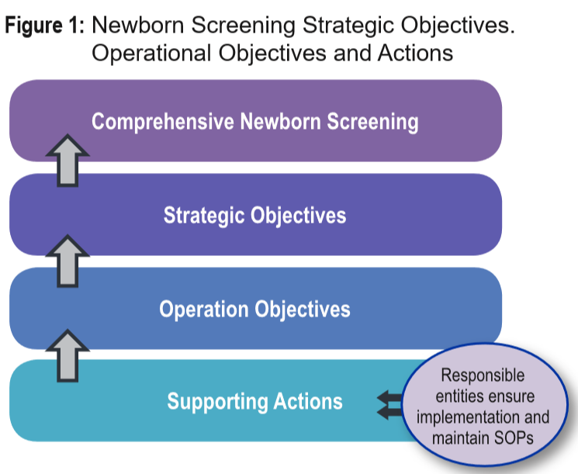
Notes:
This is how the CONPLAN Framework is organized…
The responsible entities for each action are outlined in the Newborn Screening Contingency Planning Checklist. Each responsible entity must develop and maintain specific Standard Operating Procedures (SOPs) that detail how each activity is executed within their jurisdiction or scope of responsibility. SOPs should be reviewed and updated on a regular basis to ensure they reflect the current method the entity operates. The strategic objectives are supported by specific operational objectives, which are further supported by supporting actions (see Figure 1). Each action has an entity that is responsible for ensuring proper implementation of that supporting activity.

Slide 9
New Strategic Objectives
Ongoing communication to families, providers, birth facilities, and agency staff is ensured.
Families are educated about newborn screening.
Screens are conducted; specimens are collected and transported.
Specimens are shipped to the designated newborn screening laboratory site.
Specimens are processed.
Screening results are reported to physicians and families.
Diagnostic testing is performed for infants with urgent positive screening results.
Availability of treatment and management resources is ensured.
Carry out other activities determined appropriate by the HHS Secretary.

Slide 10
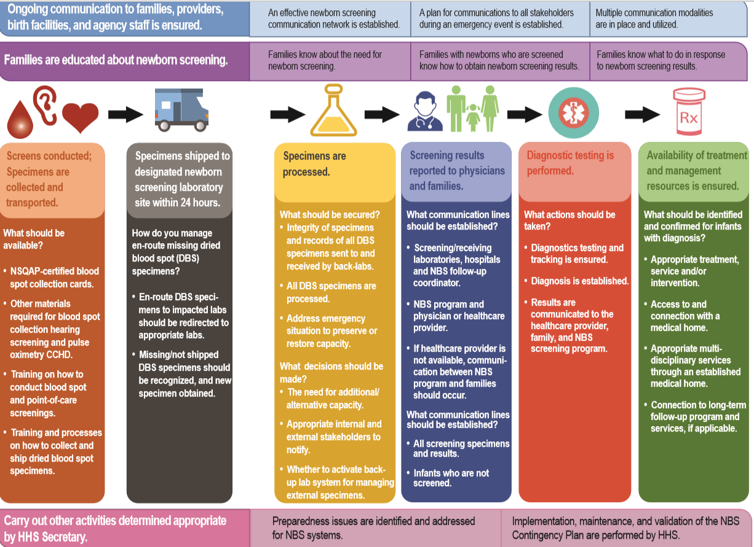

Slide 11
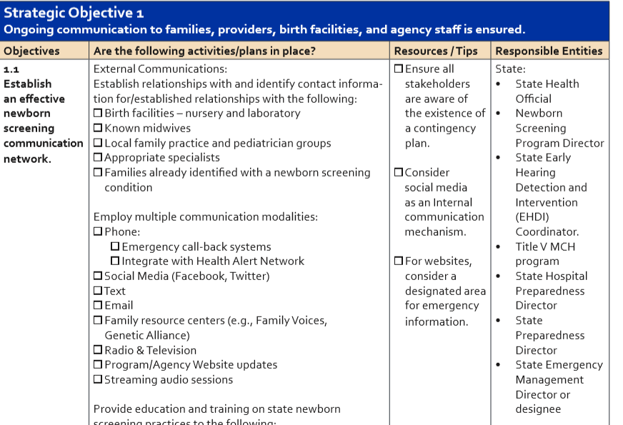
Notes:
.

Slide 12
Additional Resources
Sample template for MOU/MOA
Background resources
Case examples
State examples and templates

Slide 13
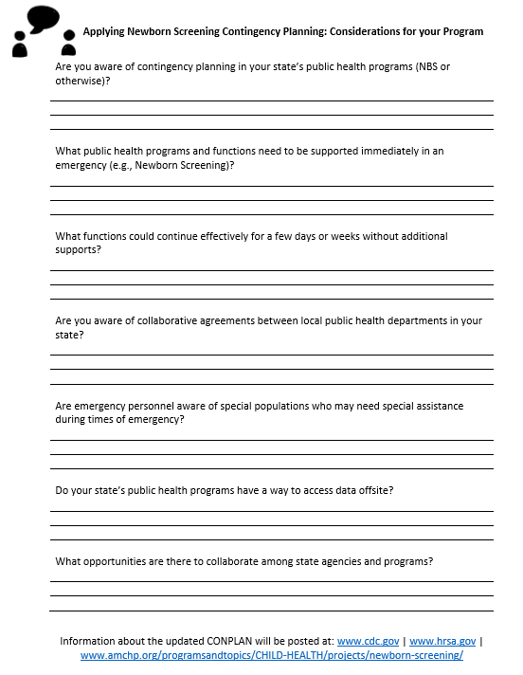
Reflections from the CONPLAN process
Collaboration is key
Provide framework and state examples
Intentionally and appropriately incorporating families
Can apply contingency planning on a smaller scale
Think comprehensive & long-term

Slide 14
Thank you! ktaft@amchp.org
202-266-3056 http://www.amchp.org/programsandtopics/CHILD-HEALTH/projects/newborn-screening/Pages/default.aspx
Download the CONPLAN: https://www.cdc.gov/ncbddd/documents/Screening-Contingency-Plan-Version-II.pdf
Notes:
Thank you very much for your time and I appreciate this opportunity to present an update on this project to update the National NBS Contingency Plan.

