Slide 1
Critical Congenital Heart Disease Newborn Screening
Stakeholder Meeting | September 21, 2018
Parent Perspective
How a “band aid” with a red light saved my son’s life

Slide 2
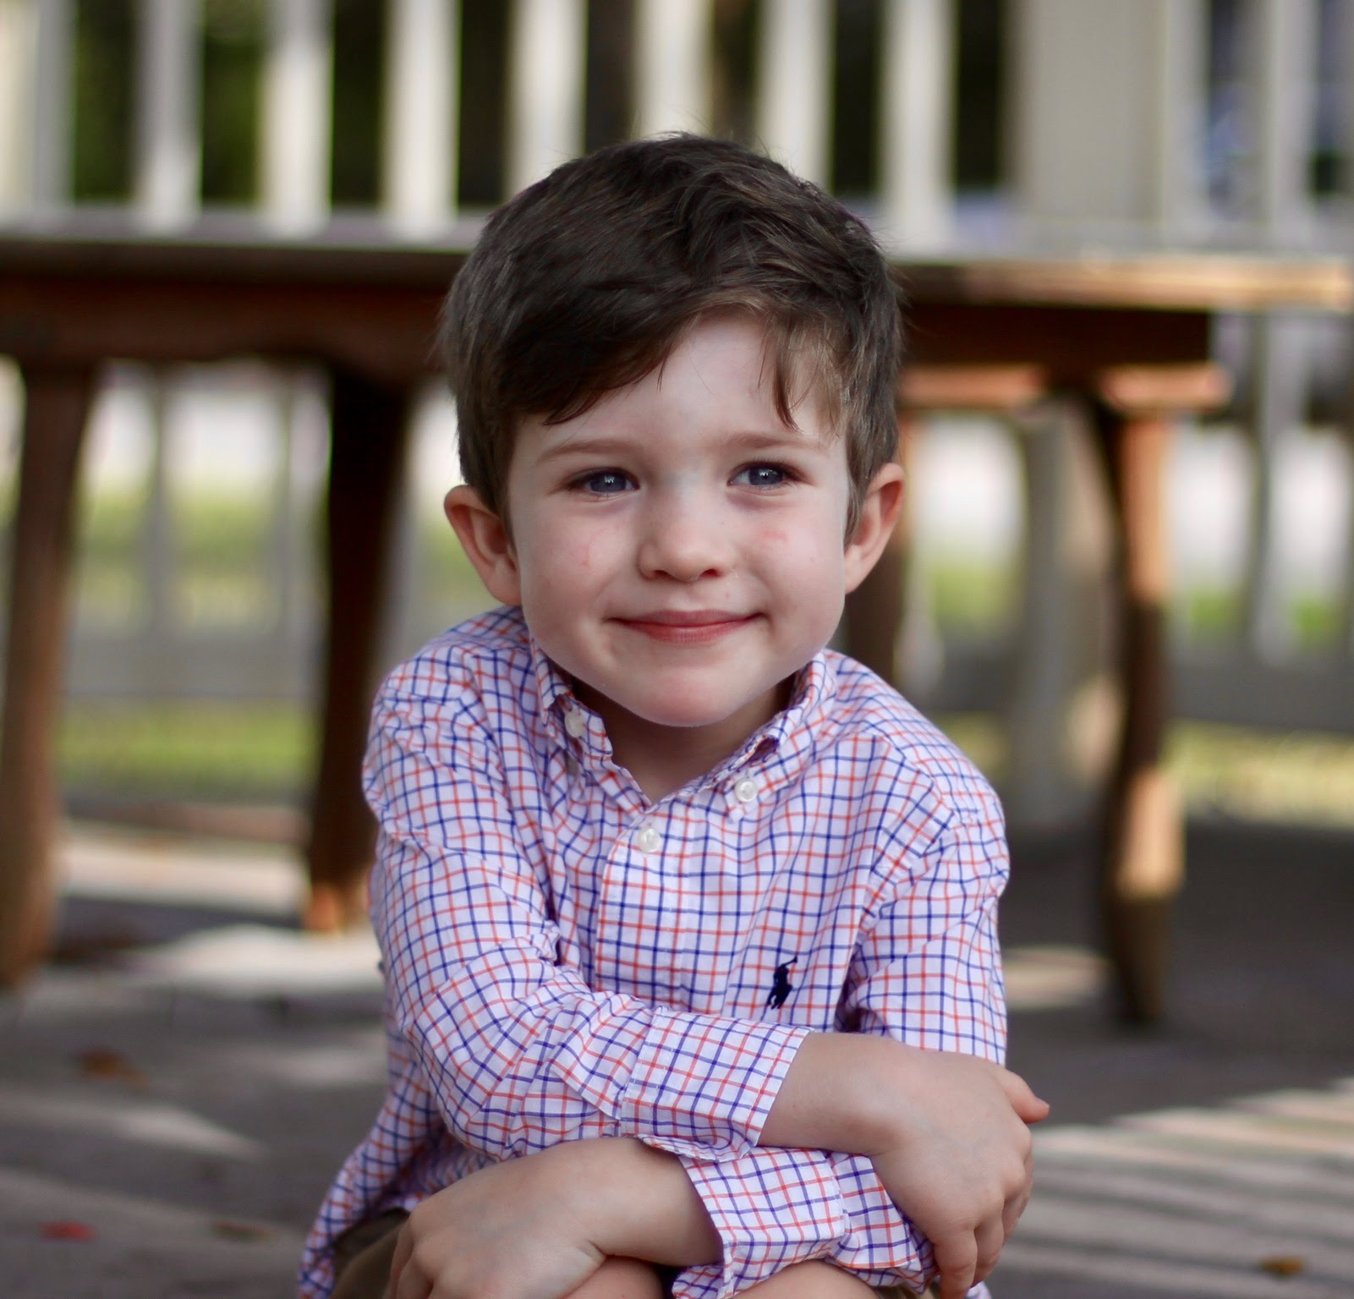
Heart Hero: Dylan Coleman

Slide 3
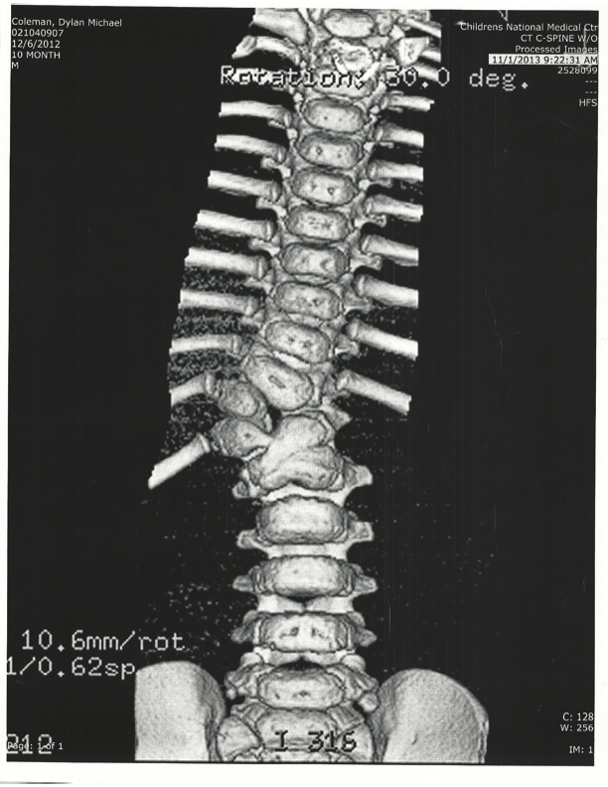
CT of Dylan’s Hemivertebrae @ 10 months old

Slide 4
Echocardiogram example

Slide 5
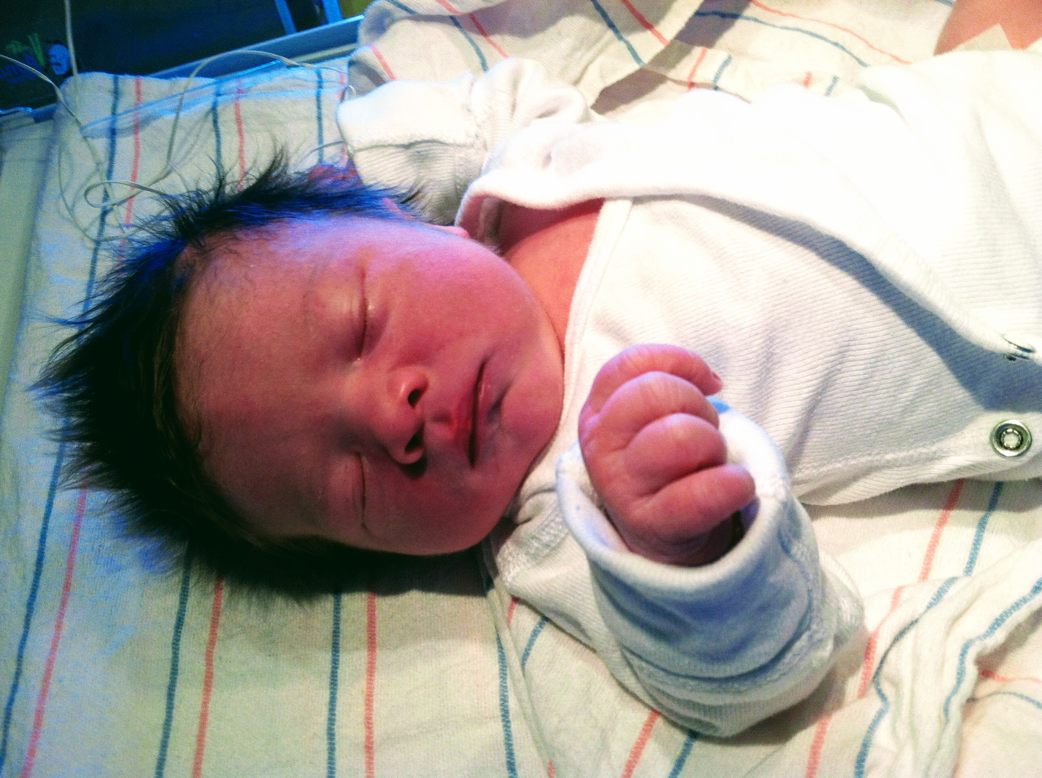
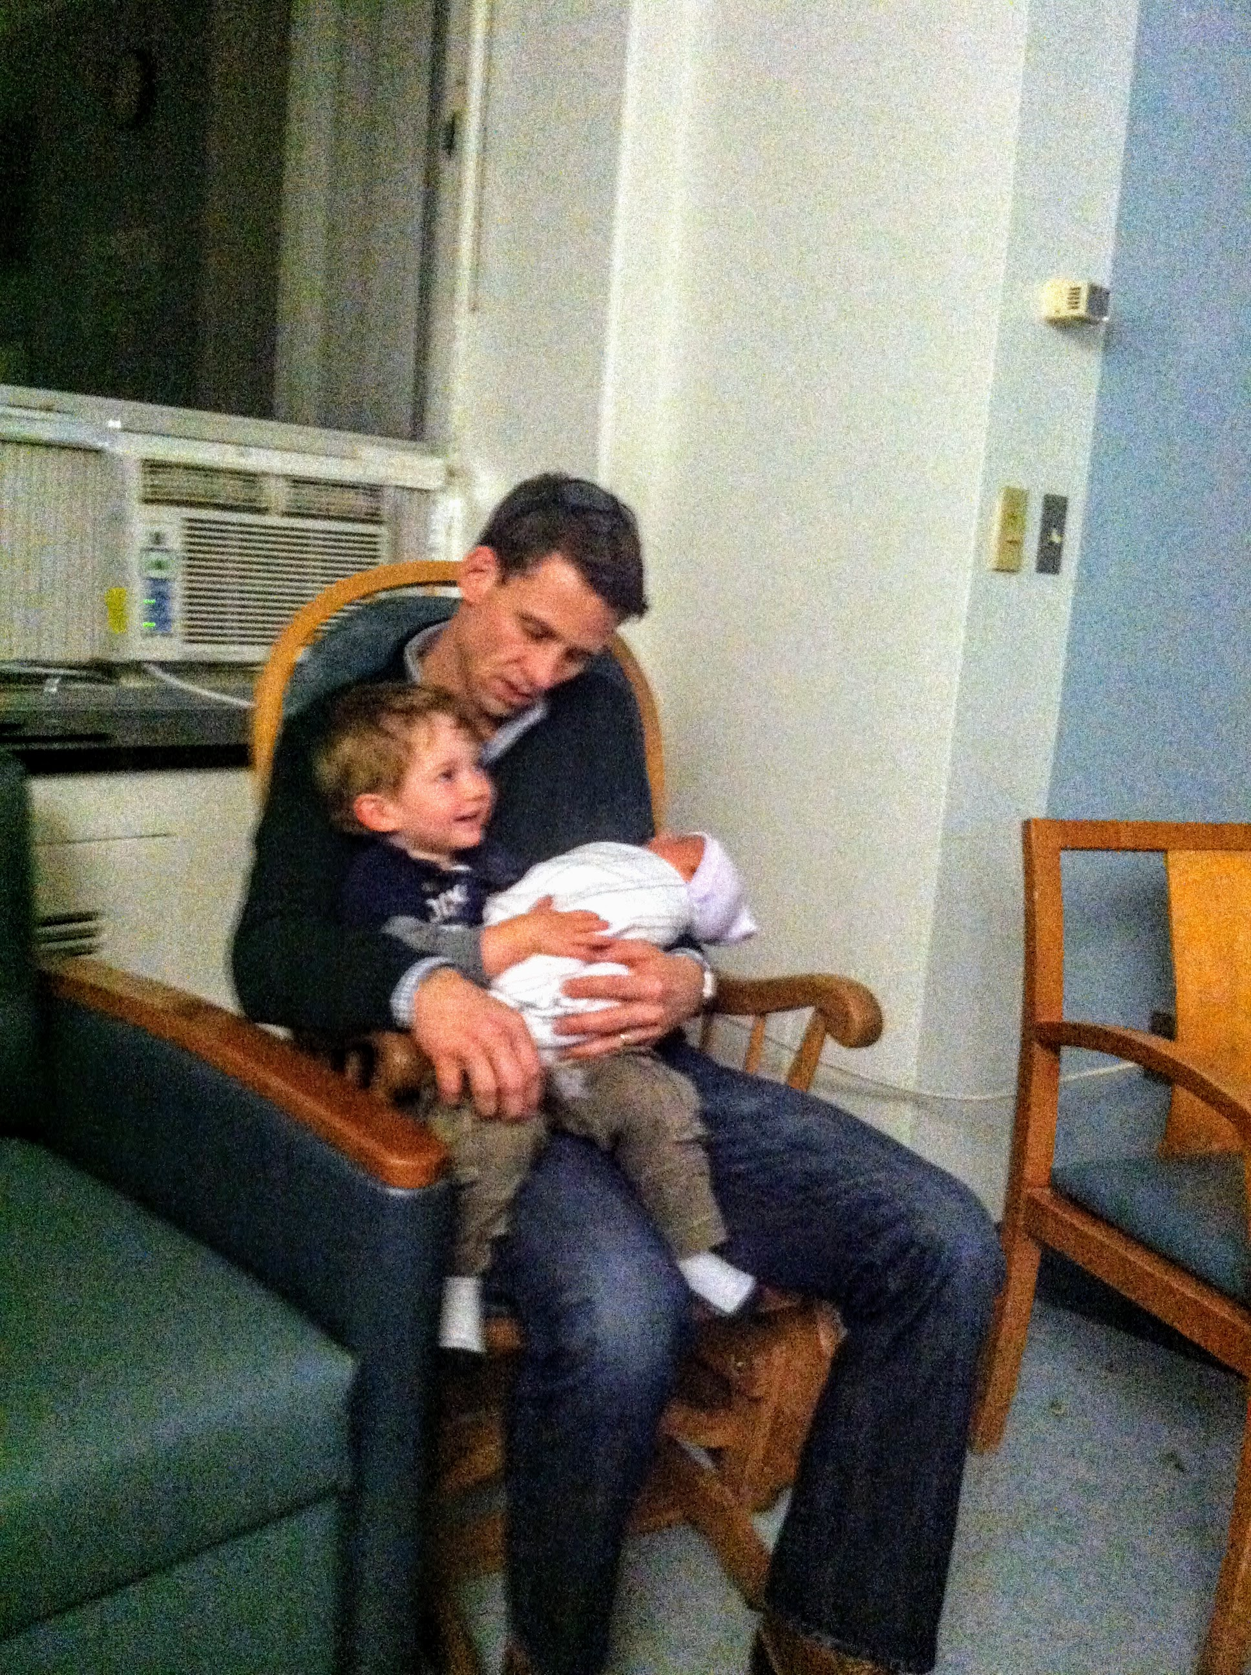
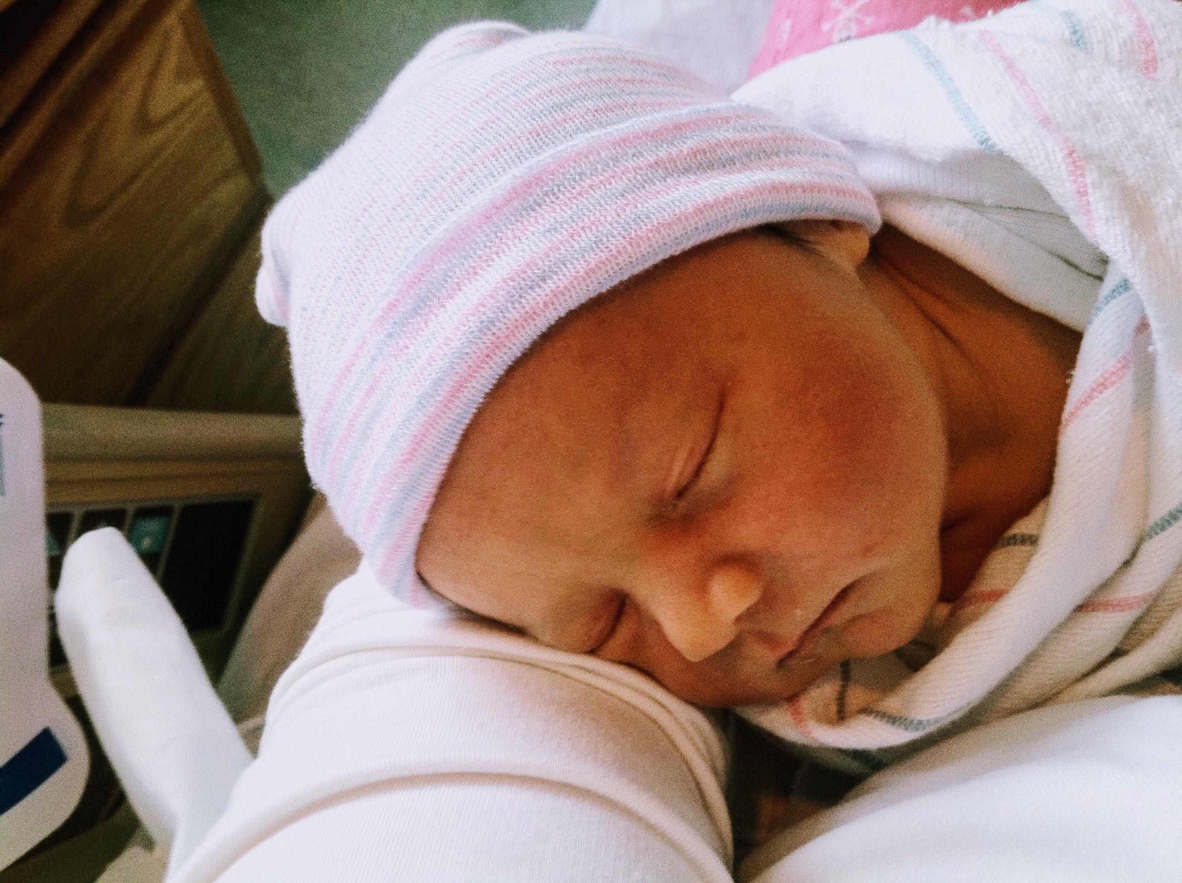
December 2012: Elvis is in the building!

Slide 6
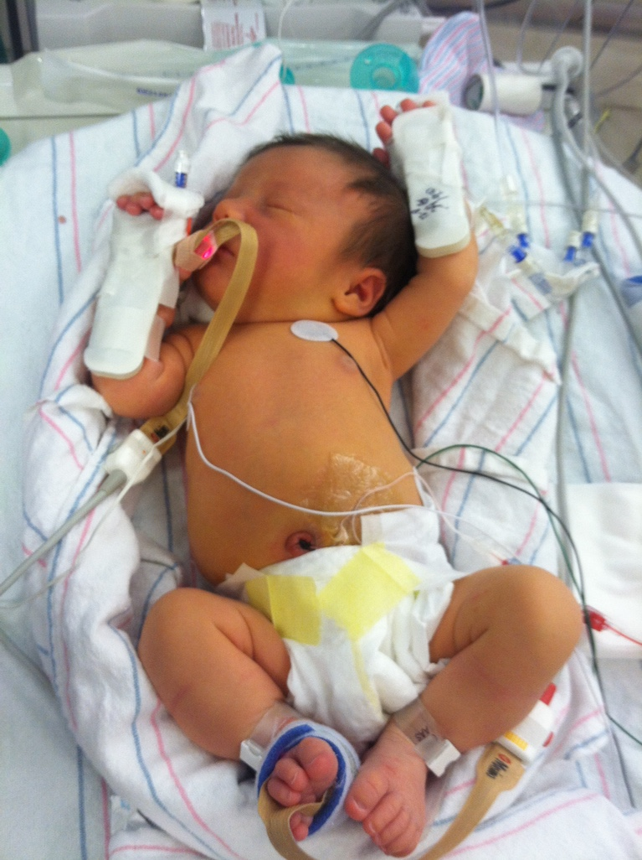
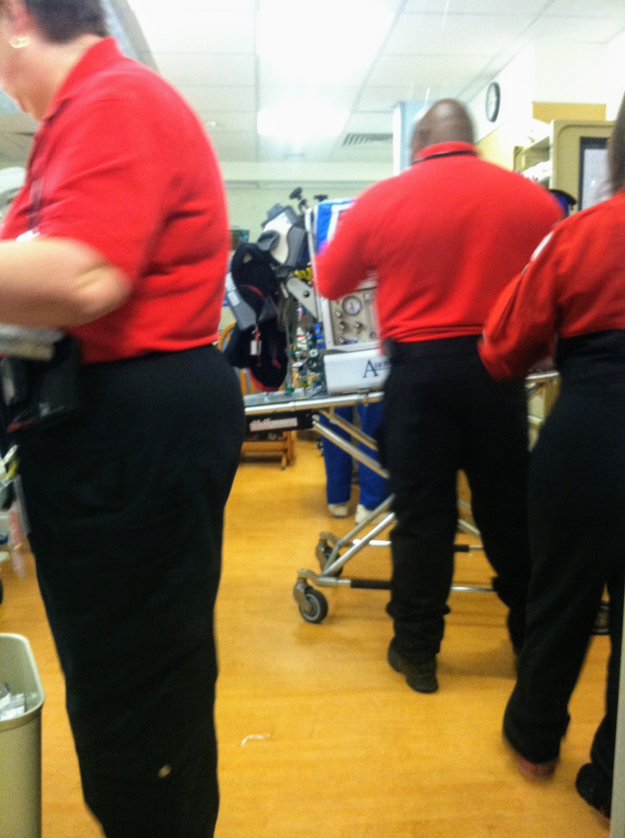
The Children’s National transport team, or Stormtroopers per Dylan!
In the NICU at Holy Cross Hospital

Slide 7
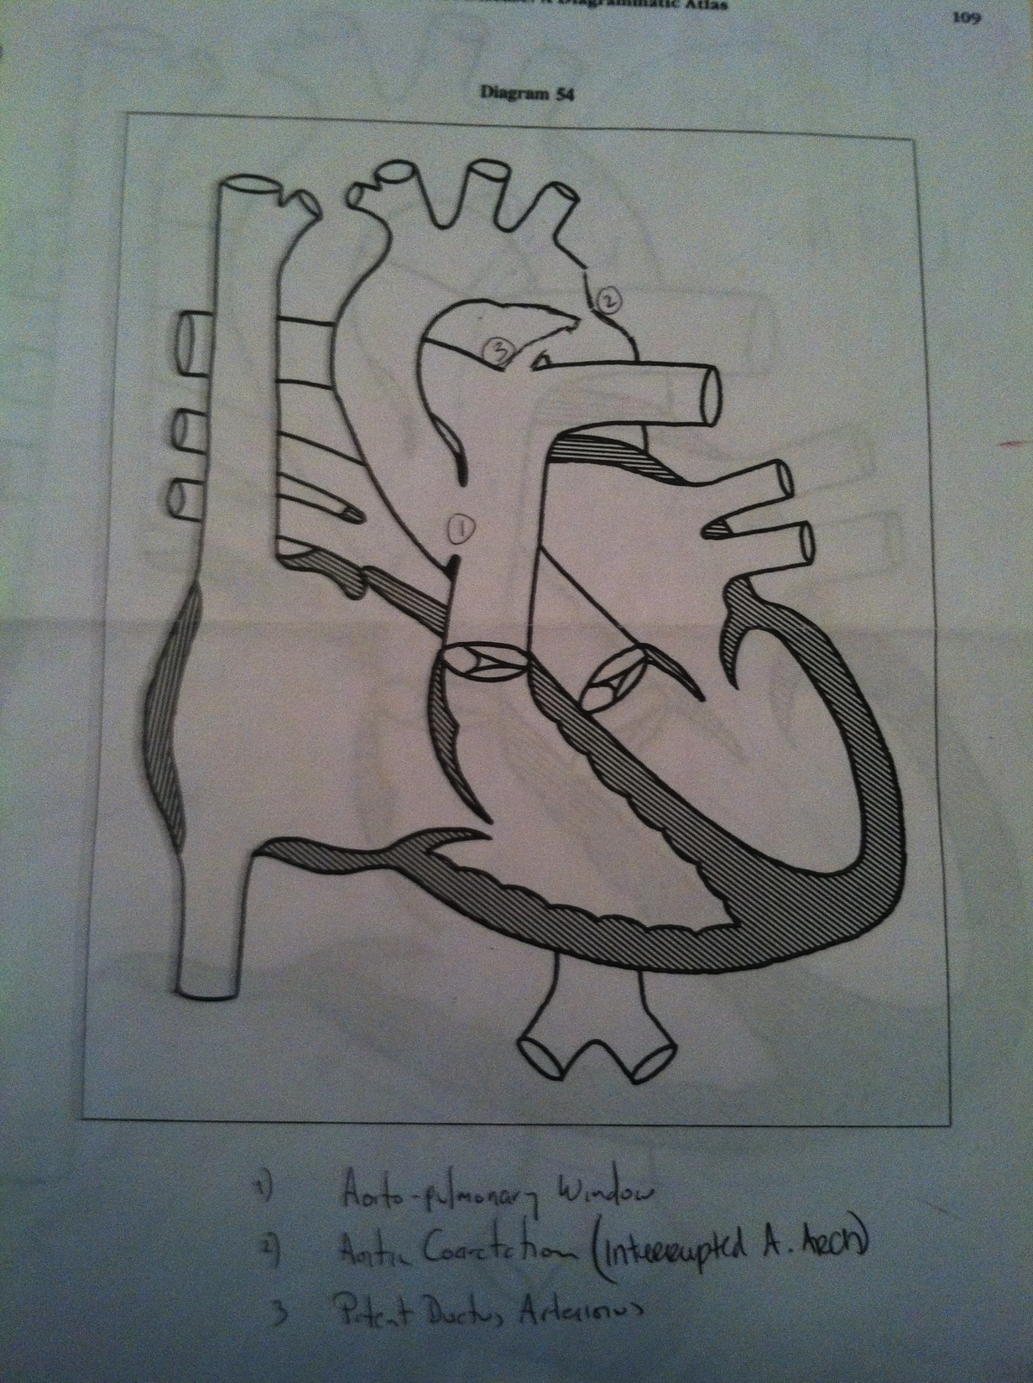
Dylan’s CCHD diagnosis as outlined by the on-call Cardiologist

Slide 8
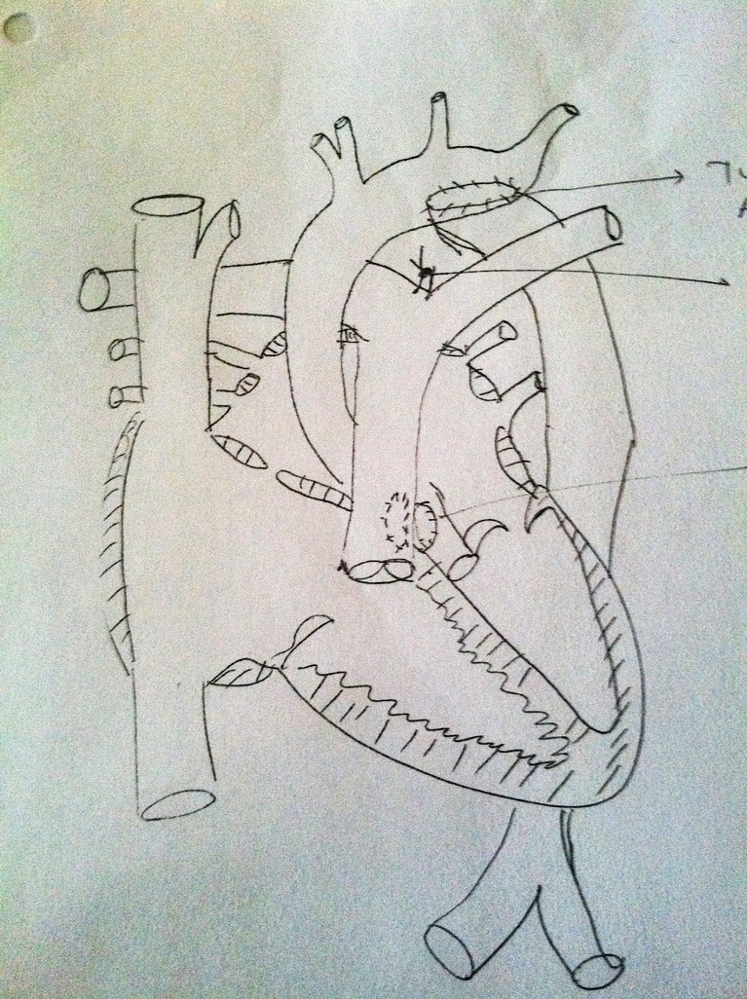
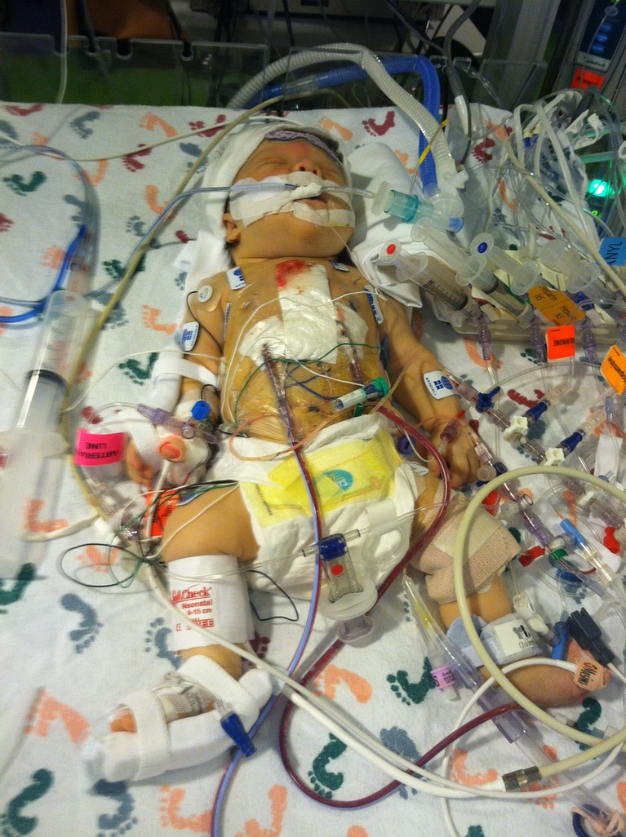
Seven days old … immediately post-op
Dylan's repair (hand-drawn by his surgeon Dr. Pranav Sinha)

Slide 9

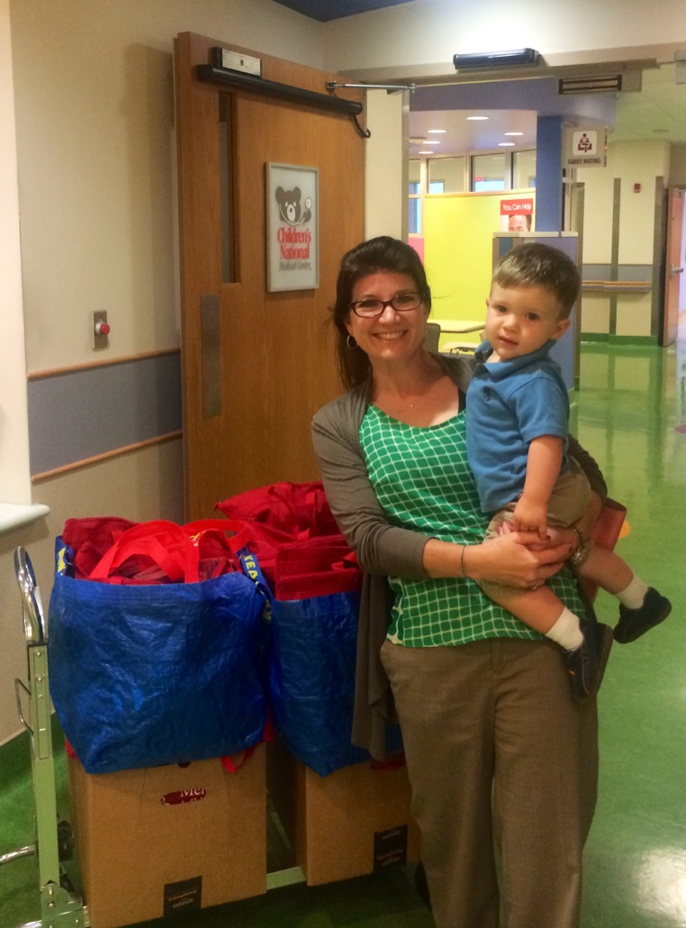
Mended Little Hearts Bravery Bags for the CICU at Children’s National Medical Center

Slide 10
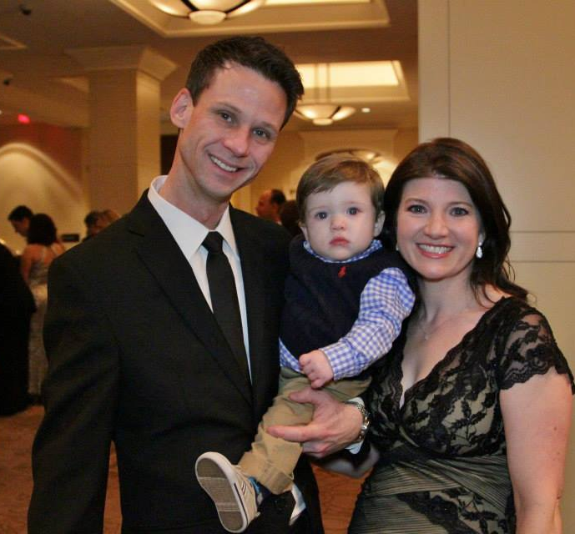
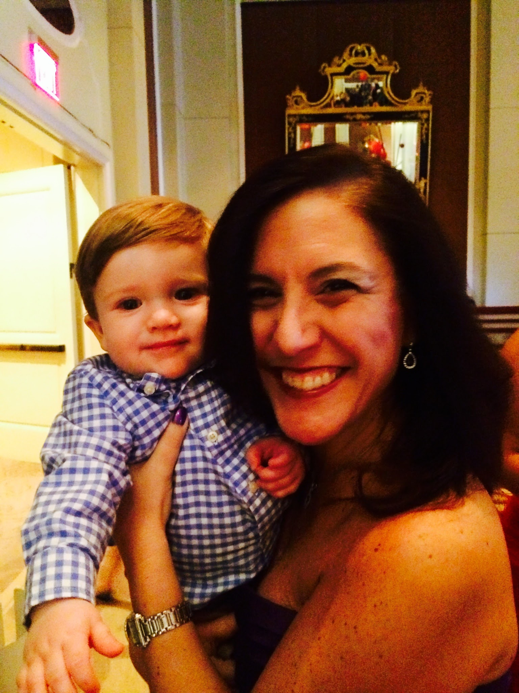
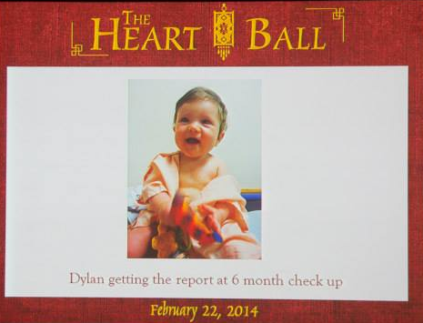
Dylan is the Face of Heart at the 2014 American Heart Association’s Heart Ball

Slide 11
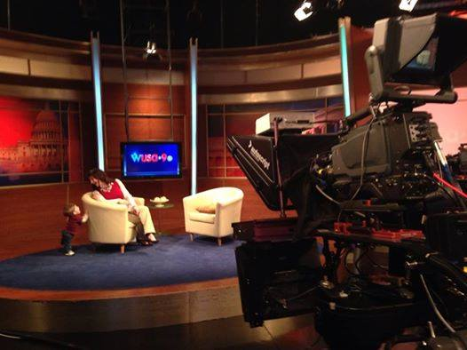
PulseOx Advocacy: Media

Slide 12
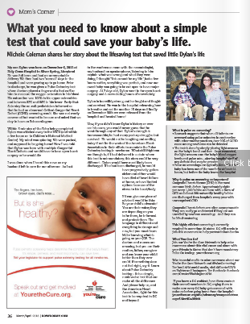
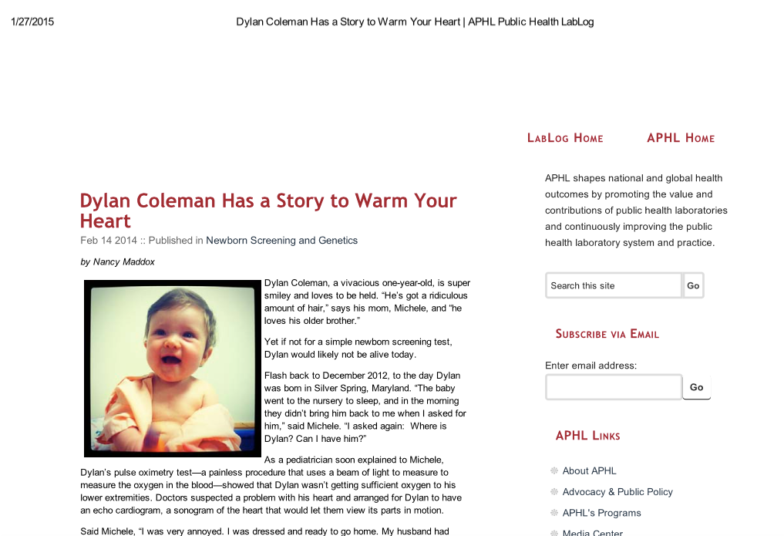
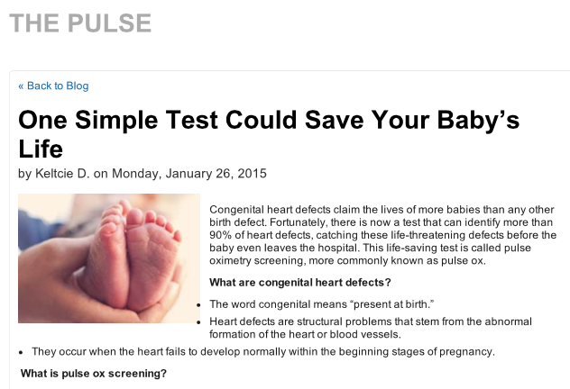
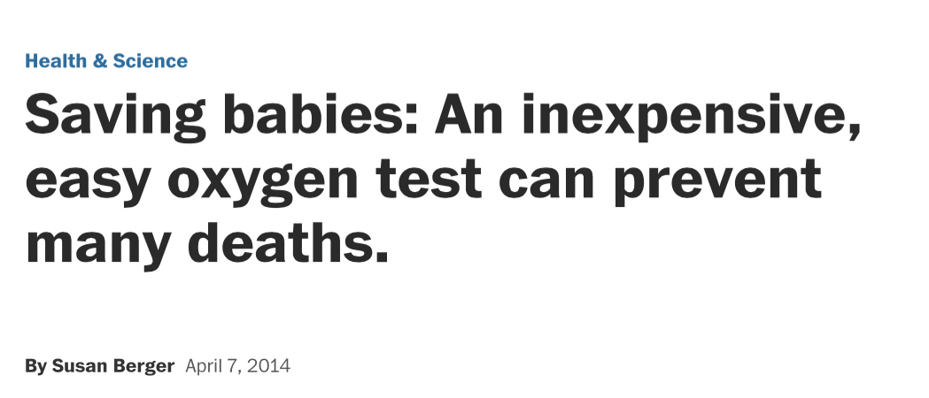
PulseOx Advocacy: Print
The Washington Post

Slide 13
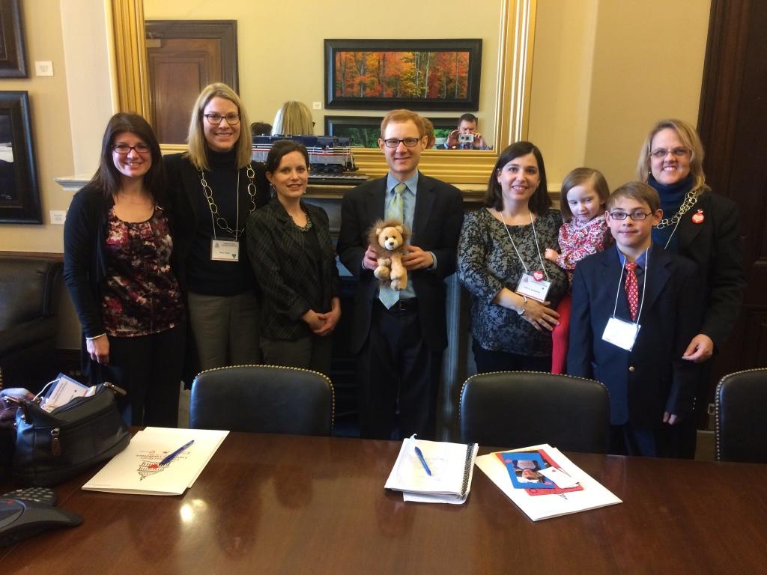
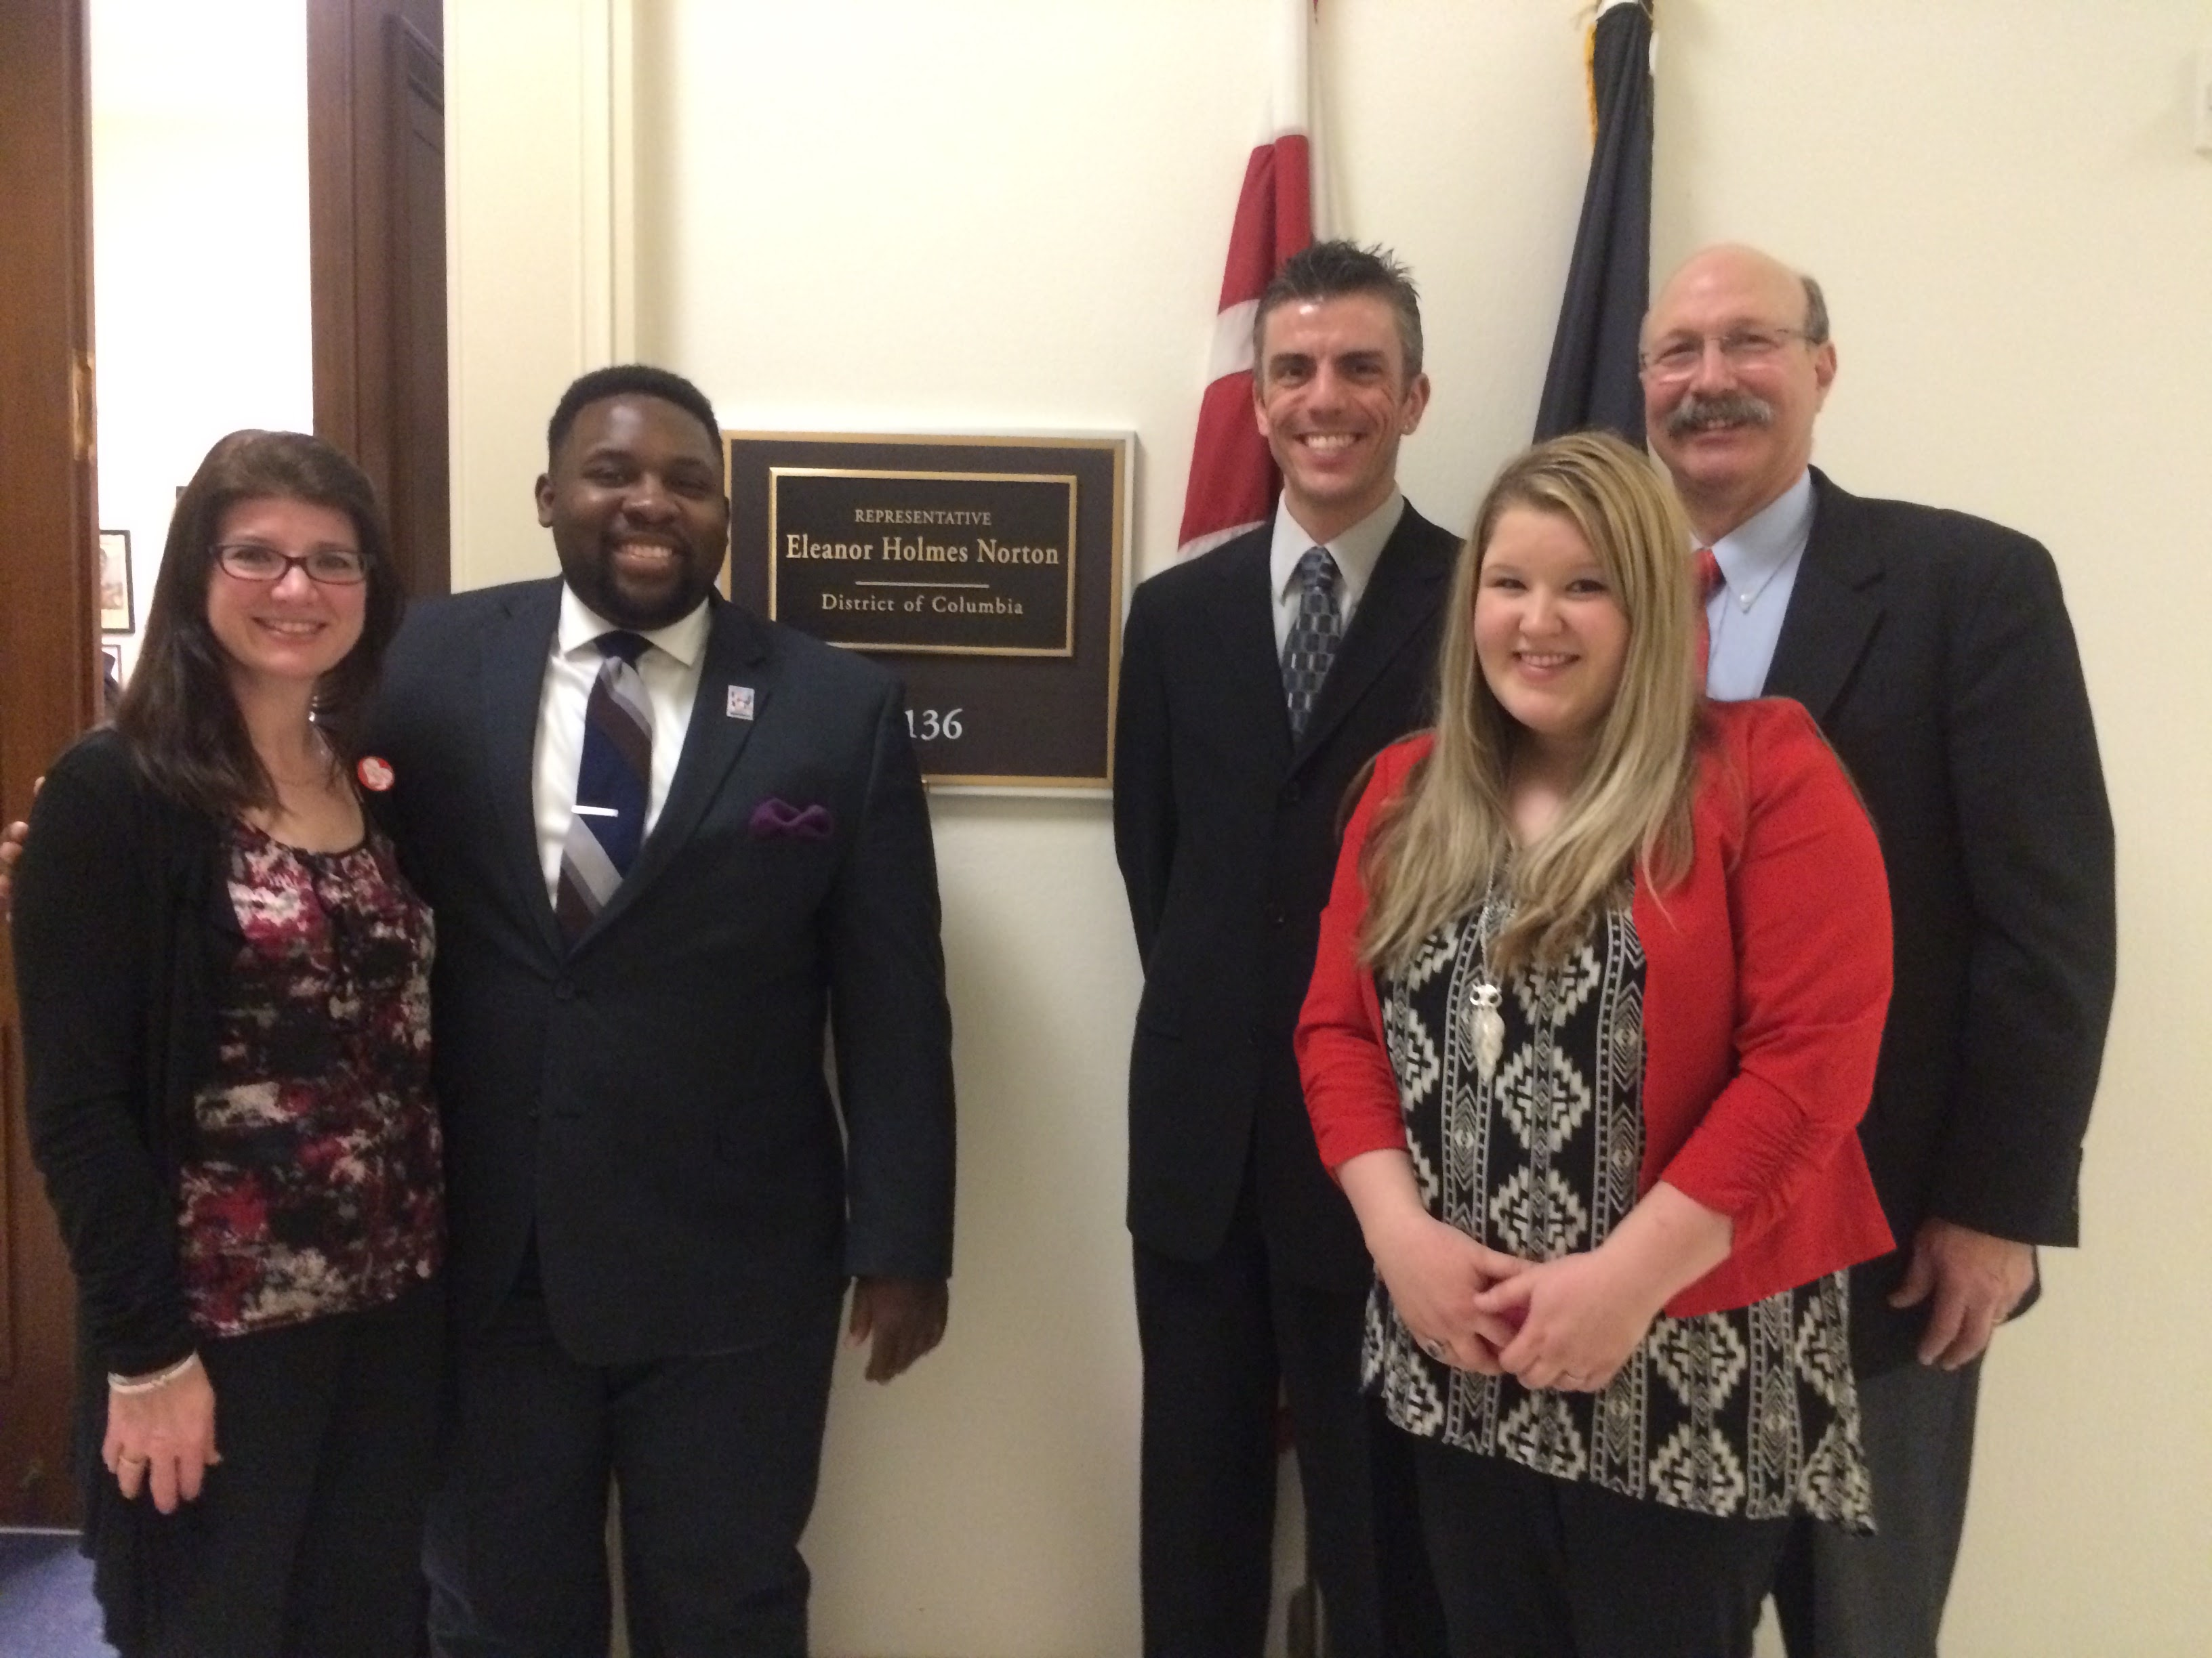
Congenital Heart Advocacy Day
on Capitol Hill
February 27, 2015

Slide 14
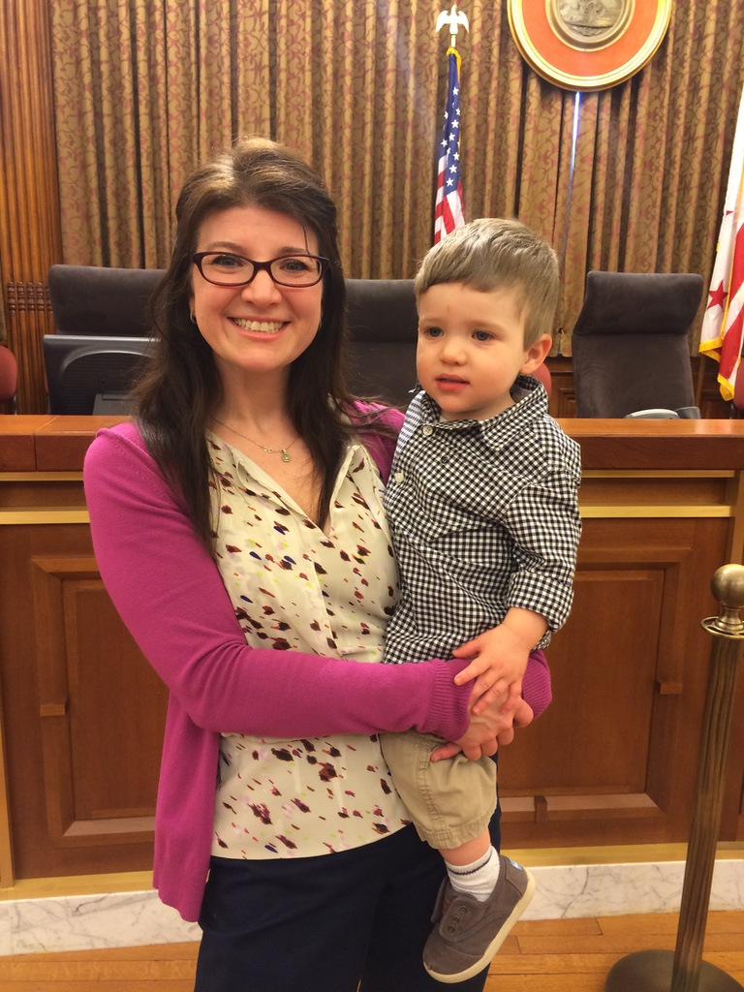
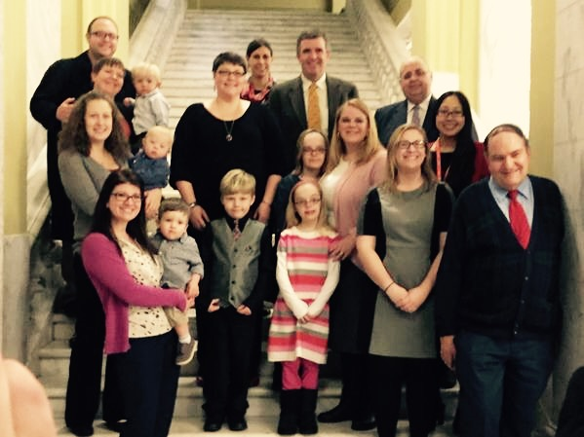
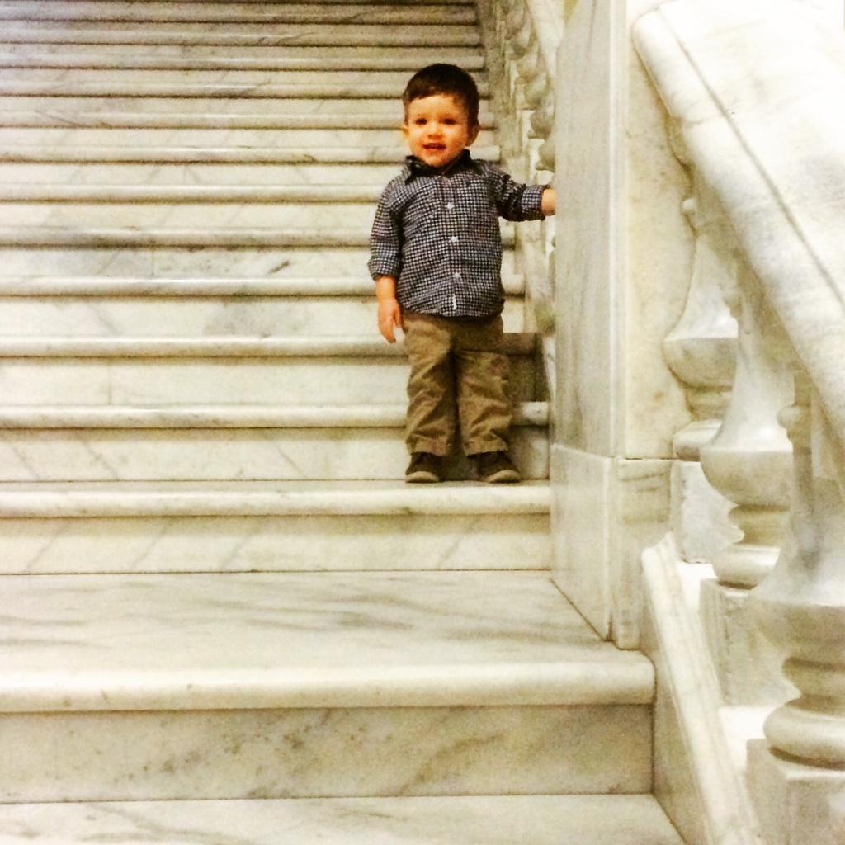
PulseOx Testimony for DC Council HHS Subcommittee
February 2, 2015

Slide 15



Tiny body … Big personality

Slide 16
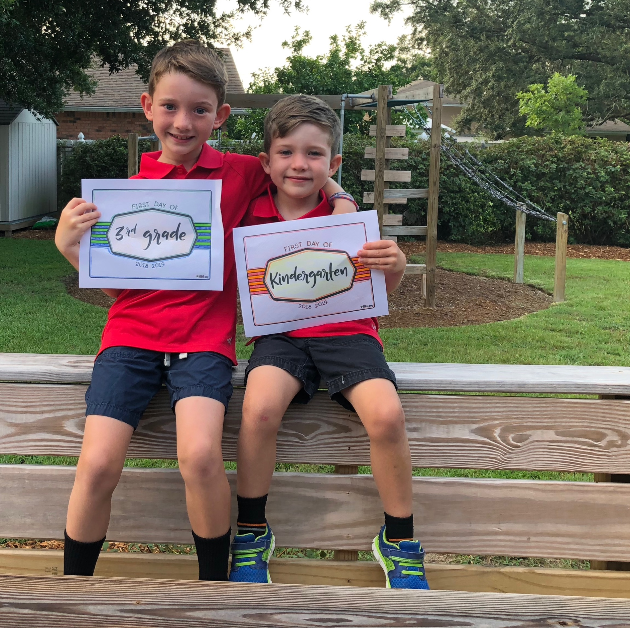
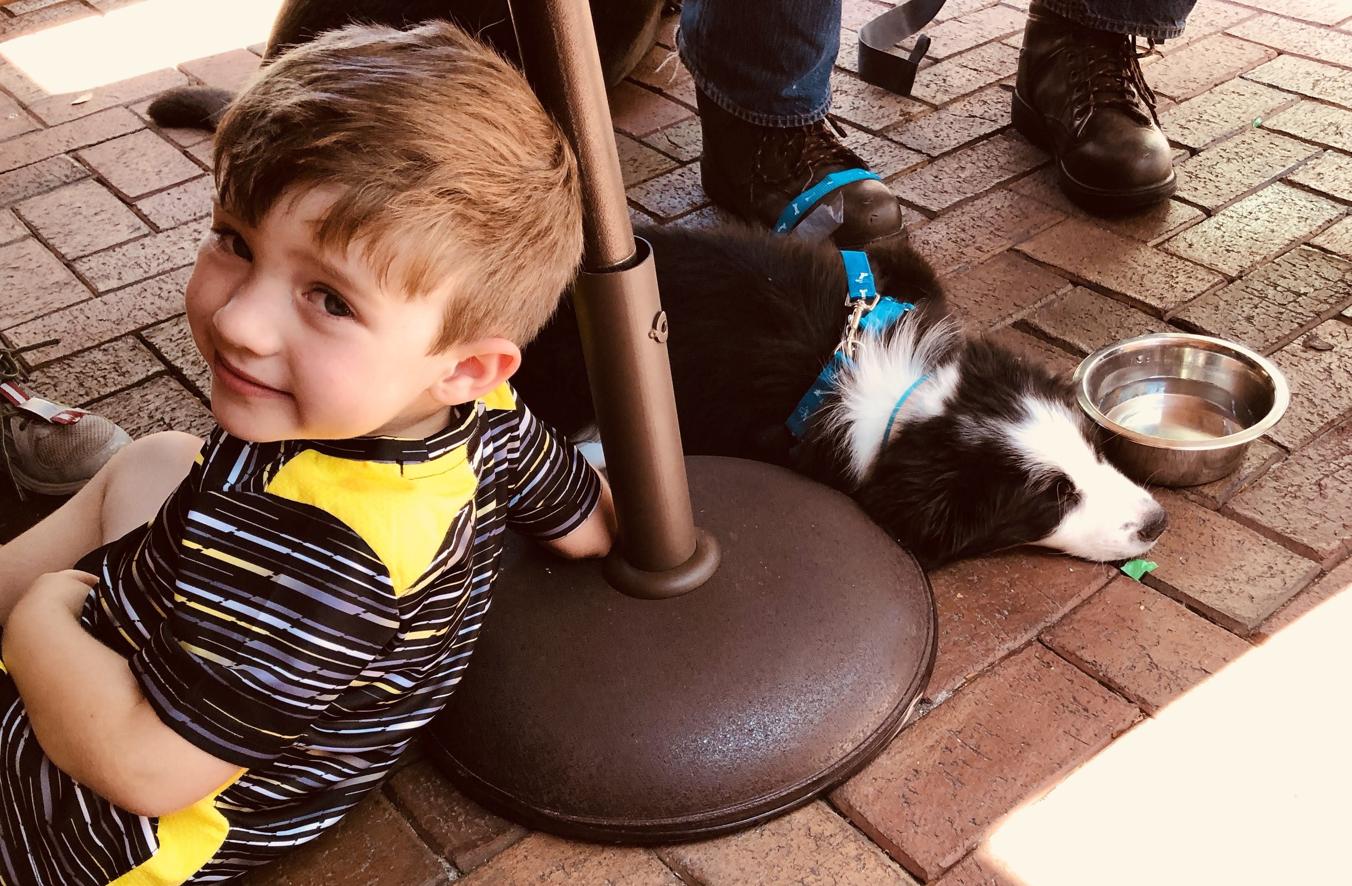

Slide 17

7 days after breaking his arm in two places…Dylan should not be running!!

Slide 18
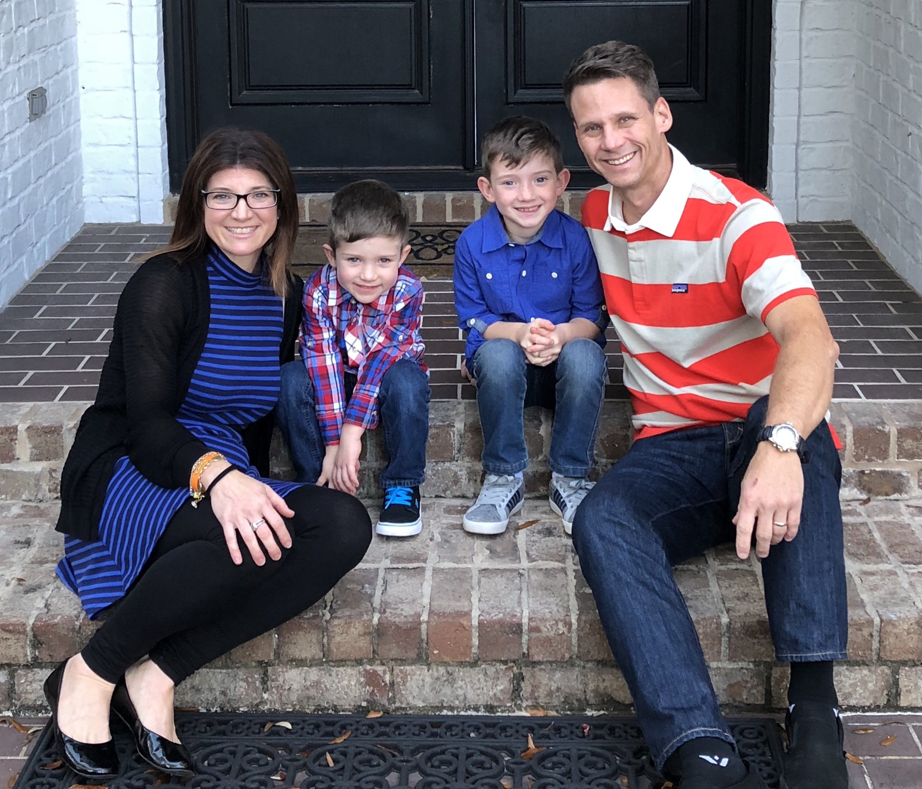
THANK YOU!!!

