Slide 1





Critical Congenital Heart Disease Newborn Screening: Recognizing U.S. Successes and Identifying Next Steps Welcome

Slide 2

Critical Congenital Heart Disease Newborn Screening: Recognizing U.S. Successes and Identifying Next Steps
Scientific Committee
Andrew Ewer
Lisa Hom
Gerard Martin
Matt Oster
Amy Gaviglio
Annamarie Saarinen
Sikha Singh
Marci Sontag
Staff Support
Vivian Thorne Olivia Kranz
Lucas Sanders
Calaia Jackson
John Ponzio
Lindsey Nadeau
John Ponzio
Beverly Hayes
Erin Darby

Slide 3
Critical Congenital Heart Disease Newborn Screening: Recognizing U.S. Successes and Identifying Next Steps
Participants
Associations
AAP
ACC AHA
ACMG JCCHD
APHL
ABP
Gov’t Org
NIH
FDA
CDC
HRSA
AHRQ
ACHDNC
DOH’s
Industry
Masimo
Covidien
Oz Systems
Advocacy Groups
PCHA
CHIN
March of Dimes
Newborn Foundation
ACHA
Baby’s First Test
Mended Little Hearts
Bless Her Heart
Hospitals
Birmingham
UCLA
Boston
Loma Linda
Nemours
Montfiore
Mayo Clinic
Nationwide
Minnesota
Hofstra
HCA
Sibley
Pediatrix Medical
Utah
Seattle

Slide 4
GAPS Discussion
Data &Quality Improvement
Minimum Data Set
QI Efforts
Equity

Slide 5
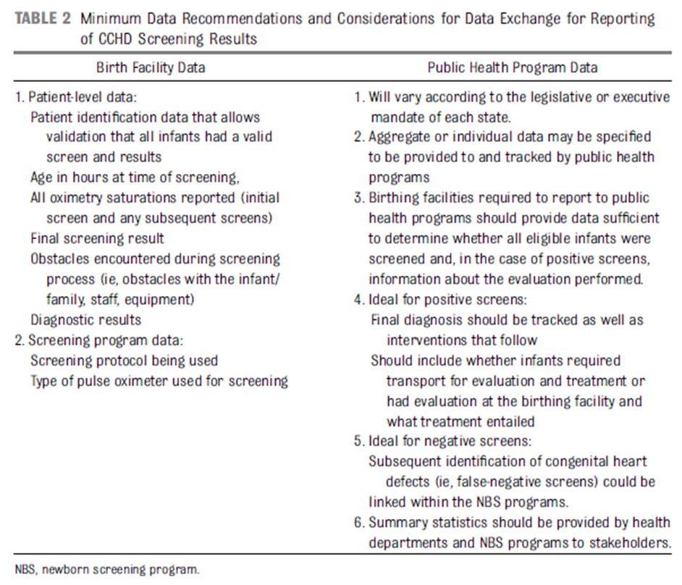

Slide 6
GAPS Discussion
Data & Quality Improvement
Minimum Data Set
QI Efforts
Equity

Slide 7
GAPS Discussion
Protocol
Rescreens
Timing
LVOTO
Special Populations

Slide 8
GAPS Discussion
Global implications/efforts
Role and Goals of CCHD Screening relevant in less developed countries
What is the US role in Global effort

Slide 9
Wrap-up/Discuss Meeting Outcomes

